Slide 1

Capacity Building of the Firm
From Firm to Smart Firm

Slide 2






From Firm to Smart Firm
What You Need to DO
Find a new team member before you need them
Cross Train Your Team Members
Enhance Your Skills – One should be well versed with new emerging technologies such as AI, Data Analytics, Cloud Computing, Automations
Familarise yourself with technologies – it is essential to be comfortable with using software and tools
Tap Emerging Practice areas.
Stay Organised and automate as much as possible

Slide 3

Agenda
Practice Management Software
Power BI
Chat GPT
Co-pilot
Audit Analytics Software
Data on Cloud
Effective Use of Tally
CMP Benefits

Slide 4
Agenda
Practice Management Software
Power BI
Co-Pilot
Chat GPT
Audit Analytics Software
Data on Cloud
Effective Use of Tally
``

Slide 5


Practice Management Software
Register at cacloud.ca.in

Slide 6

Practice Management Software
Features
  Task Management
  Document Management
  Account Management
  Client Management
  Employee Management
  Communication Management

Slide 7

Practice Management Software
What you can do with PMS
  Prioratisation of your tasks
  Management of everything with a paperless office system
  Enhance Operational Efficiency
  Faster Processing of Data
  Generation of Internal Reports
  Management and Tracking of Client Information from Mobile also
  Effortless management of employees
  Manage every account with great communication

Slide 8
Agenda
Practice Management Software
Power BI
Co-Pilot
Chat GPT
Audit Analytics Software
Data on Cloud
Effective Use of Tally
``

Slide 9
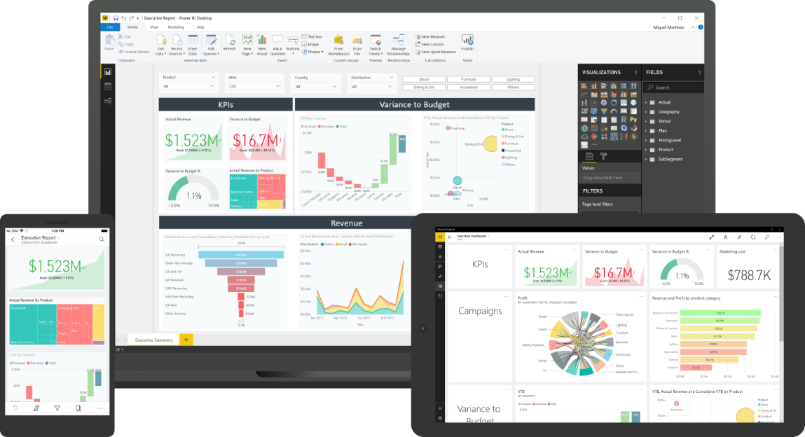
What is Power BI
Power BI is a business analytics tool developed by Microsoft.
It provides interactive visualizations and business intelligence capabilities with an interface simple enough for end-users to create their own reports and dashboards.
Power BI consists of multiple components, including Power BI Desktop, Power BI Service, Power BI Mobile, and Power BI Report Server.

Slide 10
Benefits of Power BI
Connects to a variety of data sources
Interactive dashboards and reports
Collaboration and sharing
Real-time data analysis
Cost-effective

Slide 11
Agenda
Practice Management Software
Power BI
Chat GPT
Microsoft Co-pilot
Audit Analytics Software
Data on Cloud
Effective Use of Tally
``

Slide 12
Agenda
Practice Management Software
Power BI
Co-Pilot
Co-pilot
Audit Analytics Software
Data on Cloud
Effective Use of Tally
``

Slide 13

Introduction to Co-pilot
Microsoft 365 Copilot is an AI assistant feature for Microsoft 365 apps
It utilizes OpenAI's GPT-4 Large Language Models (LLMs) and Microsoft Graph to convert user text input into content in Microsoft 365 apps
Copilot is being marketed for productivity with 20 initial testers in March 2023
Expanded access to 600 customers willing to pay for early access in May 2023

Slide 14
Features of Microsoft Co-pilot
Copilot can generate and edit text, and provide rewrite suggestions in Word
It can assist with data analysis, formatting data, creating graphs, and identifying trends in Excel
Copilot can create PowerPoint presentations and adjust presentation style and formatting
In Outlook, it can draft emails, summarize email threads, and pull relevant information
Copilot can present information for meetings, transcribe meetings, and summarize discussion points in Teams

Slide 15


Slide 16
Agenda
Practice Management Software
Power BI
Co-Pilot
Chat GPT
Audit Analytics Software
Data on Cloud
Effective Use of Tally
``

Slide 17
Agenda
Practice Management Software
Data on Cloud
Effective Use of Tally
``
Audit Analytics Software
Power BI
Co-Pilot
Chat GPT

Slide 18

Data on Cloud
Cost savings
Accessibility
Security
Disaster recovery
Improved Efficiency

Slide 19
Agenda
Practice Management Software
Power BI
Co-Pilot
Chat GPT
Audit Analytics Software
Data on Cloud
Effective Use of Tally
``

Slide 20
Agenda
Practice Management Software
Power BI
Co-Pilot
Chat GPT
Audit Analytics Software
Data on Cloud
Effective Use of Tally
CMP Benefits

Slide 21

http://cmpbenefits.icai.org/

Slide 22

Thank You

