Slide 1






#JAINSAABKEGEMS
Gem Stock Entry & Exit Strategies

Slide 2


About Tradeswift
First breed of Commodity Brokers in the country.
An established name in the Equity, Commodity & Currency Broking Industry.
The Company has achieved many remarkable highs since its inception in 2003.
Strong focus on Research & Client Servicing.
Impressive growth in the number of Ultra HNIs and HNI Clients, Franchisees & Business Associates nationwide.
Strong team of Professionals, Experienced and Qualified pool of Human Resources forms
the back bone of our sizeable infrastructure.
Providers of one of the best Trading Platforms to trade in NSE, BSE, NCDEX, MCX.
First Broker in Rajasthan to launch it’s own Mobile Trading Application
Gem Stock Entry & Exit Strategies

Slide 3













Accolades & Achievements
Won the CNBC Awaaz Champion of the Year (2013) IPL Positional Maha-Muqabla, a competition amongst leading analysts on CNBC Awaaz.
BSE’s Top Performer in Retail Segment 2011-12
Acclaimed as one of the Top Stock Pickers in the country by the channels and media.
A lead speaker in various awareness programmes organized by the equity & commodity exchanges, seminars and conferences on equities, commodities and investments organized by various trade bodies and academia across the country.
MR. SANDEEP KUMAR JAIN
Other Achievements
Financial Freedom Fighter
#JainSaabKeGems
Amongst few of the prominent spokespersons playing influential role for the broking industry and has served on several committees.
Vice President of Commodity Participants Association of India (CPAI), One of the Strongest Voices for Commodity and Capital Markets.
Longest Serving and Founding National Executive Member of Commodity Participants Association of India (CPAI).
Member Secretary of Rajasthan Exchange Members Association (REMA)
Executive Committee Member - JITO Jaipur Chapter
Ex-member of Education and Training Committee of Association of National Exchanges Members of India (ANMI)
Brief Profile
Co-founder of Tradeswift, a leading Full-Fledged Broking House in India.
Serial Entrepreneur with Interests and Investments in NBFC, Publications, Online Business, Real Estate and Startups.
A very well-known face featuring on various business channels like Zee Business, CNBC Awaaz, TV-18, Bloomberg Quint, Print Media and Social Media as well for his Analysis on Equities & Commodities since last 18 years.
Now a member of Exclusive Panel of Analysts on Zee Business.
Perhaps one of the most followed business Twitter handles in Jaipur with 2.30 Lac followers
Personal Likings and Hobbies
Reading, Travelling, Playing Tabla, Singing, Music Lover, Networking, Mentoring
Education and Extra Curriculars
Contact Info
A commerce graduate from Mumbai’s Mithibai College and MBA (Finance) from Mumbai’s K.J. Somaiya - Sandeep, with his passion for general knowledge, equities, investments and economic affairs, brings to the table a rare combination of being an equally articulate and knowledgeable speaker on equities, commodities and economic issues.
Won many awards in Quizzes, Debates, Extempore Speeches, Personality Contest during Student life
sandeepjainboltu@gmail.com / sandeep@tradeswift.net
@SandeepKrJainTS
@SandeepJain
@SandeepJainboltu
+91 9828072000

Slide 4

In stock markets, these 4 conditions are permanent
Everyday fluctuations
Short-term corrections
Medium-term crashes
Long-term recovery and compounding
The investor who stays the course through conditions one t(w)o three reaps the best rewards
Saare conditions ki dawaa hai – RRR
R – Research
R – Risk Management
R – Right Position Sizing
Gem Stock Entry & Exit Strategies

Slide 5
Post Crises Opportunities ??
How Market has bounced back during prominent corrections
Global Recession (1986-88) : Market Fall - 40.8%⬇ | Post Return 3Yrs - 199.5%⬆
Gulf War/India Fiscal Crises (1990-91) : Market Fall - 39.3%⬇ | Post Return 3Yrs - 320.5%⬆
Harshad Mehta Scam (1992-93) : Market Fall - 56.4%⬇ | Post Return 3Yrs - 90.2%⬆
Stock Market Stumble (1994-96) : Market Fall - 41.6%⬇ | Post Return 3Yrs - 73.8%⬆
97 Market Meltdown (1997-98) : Market Fall - 40.5%⬇ | Post Return 3Yrs - 11.7%⬆
Dot-Com Bubble (2000-01) : Market Fall - 57.1%⬇ | Post Return 3Yrs - 110.6%⬆
Central Election Results (2004) : Market Fall - 32.4%⬇ | Post Return 3Yrs - 238.3%⬆
High Inflation (2006) : Market Fall - 30.6%⬇ | Post Return 3Yrs - 73.2%⬆
Financial Crisis (2008) : Market Fall - 63.7%⬇ | Post Return 3Yrs - 124.6%⬆
European Sovereign Debt Crises (2010-11) : Market Fall - 11.6%⬇ | Post Return 3Yrs - 80.8%⬆
Corona Lockdown (2020 & 2021) : China + 1
Market Fall - 36.5%⬇ (24 Feb, 20 - 11829 to 24 March, 20 - 7511) | Post Return 3.3 Years – 159.8 %⬆ (04 Aug, 2023 - 19517)
Russia – Ukraine Crisis : Russia + 1, Europe +1, Inflation
Market Fall - 36.5%⬇ (17 Jan, 22 - 18350 to 07 March, 22 - 15711) | Post Return 1.4 Years – 24.22 %⬆ (04 Aug, 2023 - 19517)
Every time the crisis hit the market, it has fallen but it has definitely recovered and surged ahead ..
This is a slide presented in my various webinars dated 18th April, 10th May, 28th May, 25th July, 28th Aug, 2020, 25th Sep, 2020, 12th Dec, 2020, 04th Jan, 2021, 07th March, 2021, 29th May, 2021, 05th June, 2021, 12th June, 2021, 17th June, 2021, 19th June, 2021, 26th June, 2021, 02nd July, 2021 & 13th July, 2021
Gem Stock Entry & Exit Strategies

Slide 6
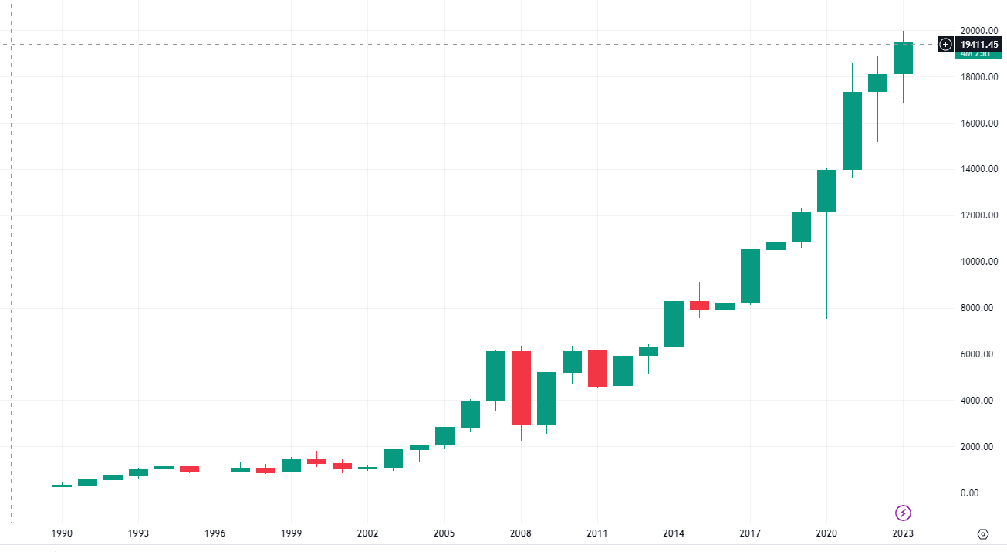
Post Crises Opportunities ??
Guess
The Chart ?

Slide 7
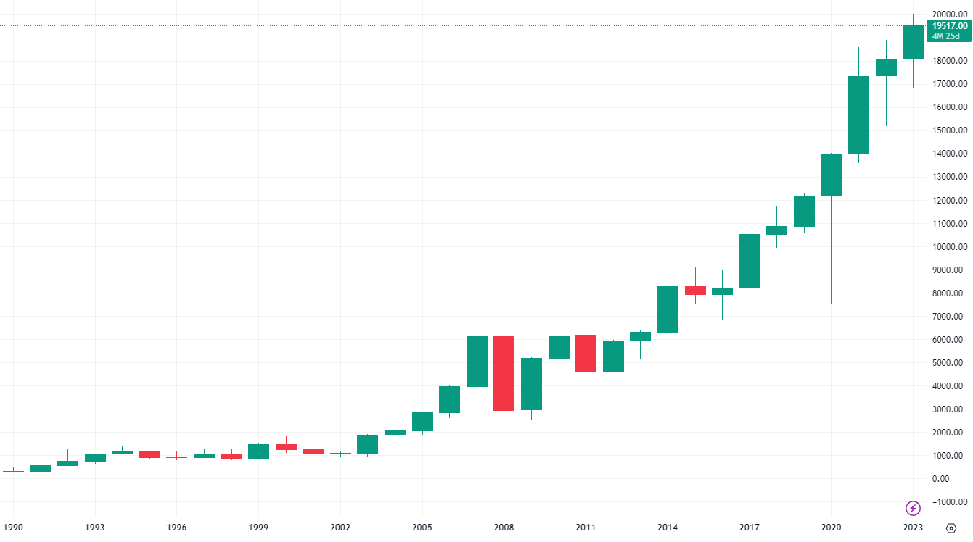
NIFTY
Yearly Chart

Slide 8

















Full-time Investors & Traders need to learn these skills
Fundamental
Analysis
Technical
Analysis
Knowledge about
Futures & Options
Read & Analyse Financial
Statements
Macro
Economics
Micro
Economics
Industry
Specific Knowledge
Company Specific
Knowledge
Tax
Efficiency
Basic
Accounting
Using
Spreadsheet
Filtering
Information
?
Long Term
Thinking & Discipline
Human
Psychology
Self
Reflection
Inquisitive
Thinking
Combating
Biases
Emotional
Control
Gem Stock Entry & Exit Strategies

Slide 9
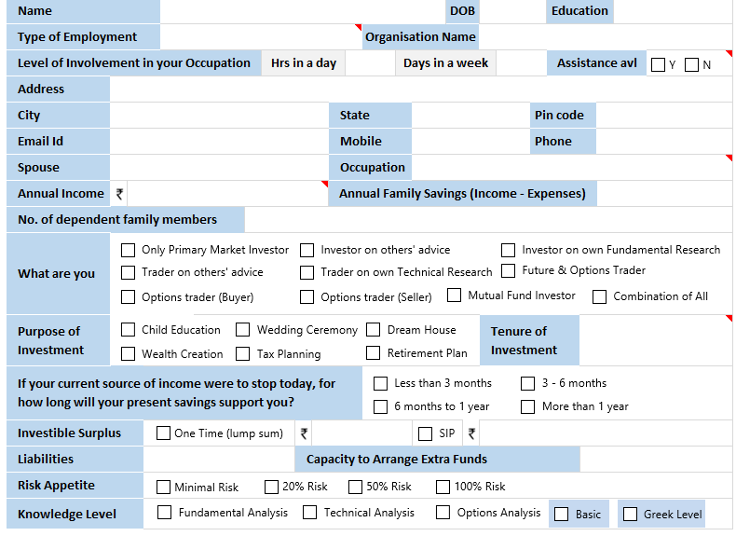
Financial Freedom &
Risk Profiling Questionnaire
(Non-Scoring)
Gem Stock Entry & Exit Strategies

Slide 10
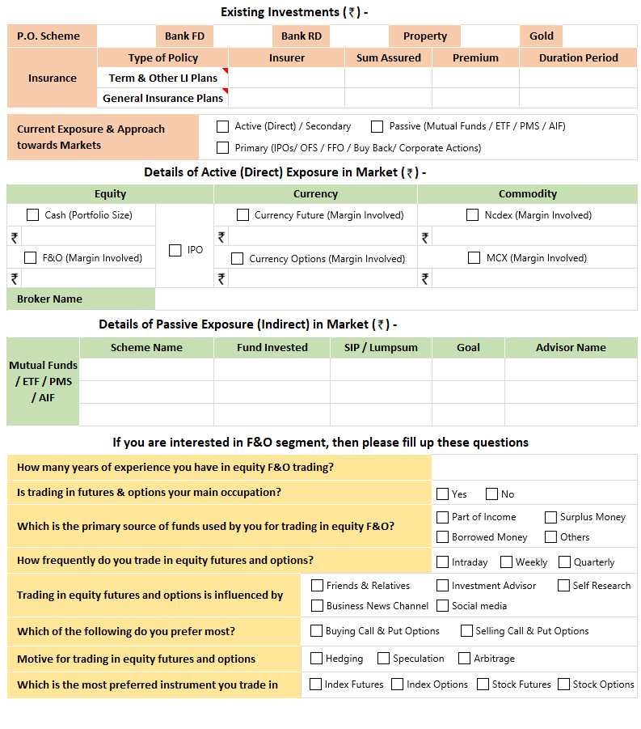
Financial Freedom &
Risk Profiling Questionnaire
(Non-Scoring)
Gem Stock Entry & Exit Strategies

Slide 11
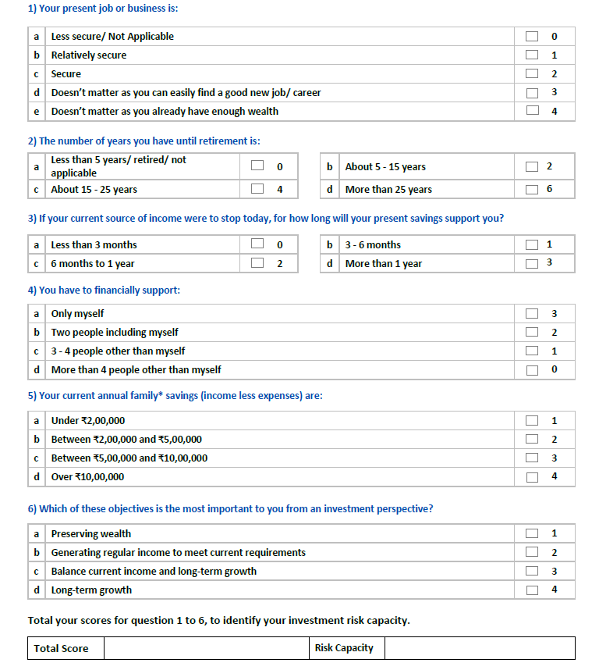
Financial Freedom &
Risk Profiling Questionnaire (Scoring)
For having a smooth investing and trading journey it is important to know one’s Risk Capacity
Risk capacity refers to the amount of financial risk that an individual or investor can afford to take in pursuit of their financial goals. It takes into account various factors such as the investor's age, income, financial goals, and other personal circumstances that determine their ability to bear risk. For example, an investor who needs a retirement corpus of ₹50 lakhs after 10 years and has a current savings of ₹5 lakhs and monthly additions of ₹20,000 will need to earn a return of approximately 10% per year. Achieving this level of return may require taking on a certain level of risk, such as investing in equities or other volatile assets. However, it is important to note that risk capacity is not the same as risk tolerance. While risk capacity reflects an investor's ability to take on risk, risk tolerance reflects their willingness to take on risk. It is important to strike a balance between risk capacity and risk tolerance to ensure that an investment portfolio is aligned with an investor's financial goals and personal circumstances.
Gem Stock Entry & Exit Strategies

Slide 12
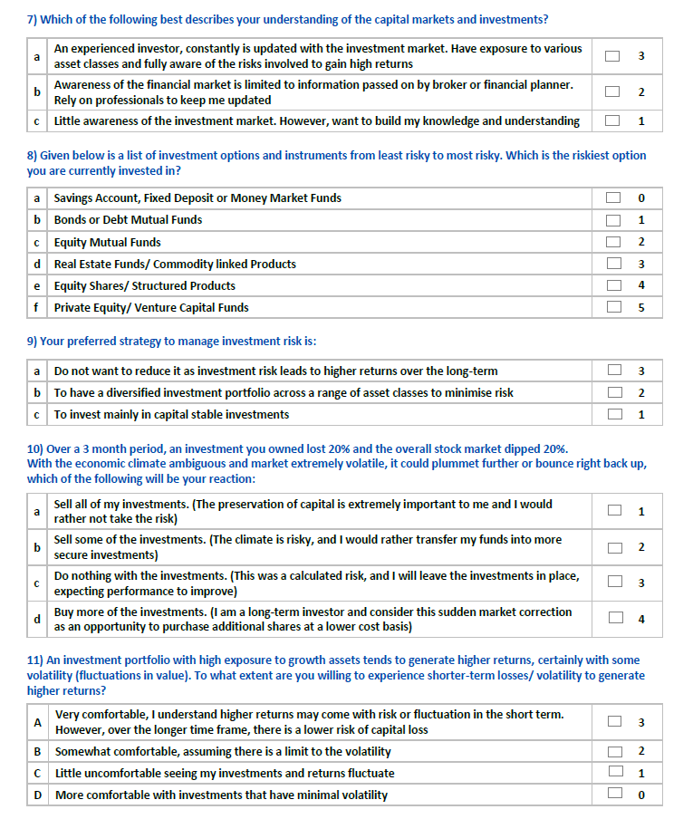
Financial Freedom &
Risk Profiling Questionnaire (Scoring)
In these current volatile markets it is very important to know one’s Risk Tolerance
Risk Tolerance is the amount of risk that an investor is comfortable taking or the degree of uncertainty that an investor may be able to handle or tolerate. It is crucial as it can greatly influence one’s emotional reaction to portfolio. Investing too far out of once comfort zone (appropriate risk tolerance) may result into buying-selling for wrong reasons or react improperly to wild swings in the markets that could hurt the portfolio and returns.
Gem Stock Entry & Exit Strategies

Slide 13
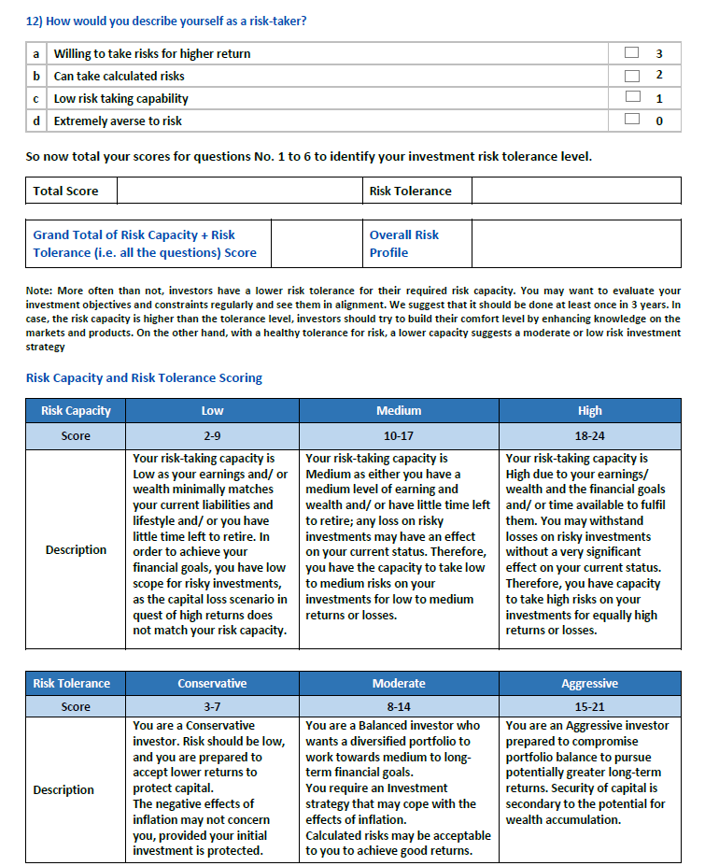
Financial Freedom &
Risk Profiling Questionnaire (Scoring)
In these current volatile markets it is very important to know one’s Risk Tolerance
Risk Tolerance is the amount of risk that an investor is comfortable taking or the degree of uncertainty that an investor may be able to handle or tolerate. It is crucial as it can greatly influence one’s emotional reaction to portfolio. Investing too far out of once comfort zone (appropriate risk tolerance) may result into buying-selling for wrong reasons or react improperly to wild swings in the markets that could hurt the portfolio and returns.
Gem Stock Entry & Exit Strategies

Slide 14
Challenges involved in Investing & Trading directly in Capital Markets
Time
Compromise with Existing Occupation
Expertise & Skills
Lack of Information
Portfolio
Volatility
Indirect Investing through Mutual Funds, PMS and AIFs
Passive Investing through ETFs
Gem Stock Entry & Exit Strategies

Slide 15
How to Start your Journey of Markets and Investments
After filling the questionnaire either you are confused or you are very clear that you were not right and were going wrong somewhere
After finalising what you are, set a long vision/goal you want to achieve
Do a Self Belief exercise
Write down the skills you have & skills you need to acquire
Build a knowledge base by starting or pursuing right courses, regular reading and keeping track of news & price
Learn to keep your emotions in control (Meditation will help)
Finally Practice, Discipline and Perseverance
Jack of all trades is fine but must be a master of one
Gem Stock Entry & Exit Strategies

Slide 16
360° Approach
Should Open all the Family Members’ Trading & Demat accounts
Should do Aggressive Primary participation through all family members’ accounts (easy and lesser risky though small returns in markets should not be overlooked)
Can have different strategy portfolios in different accounts
Must open HUF account (preferable for trading in Cash + F&O market)
If possible should trade in Corporate Account for Taxation Arbitrage
Should have an OD limit for grabbing sudden opportunities like OFS etc.
Special Situations Arbitrage or opportunities should not to be missed
Should have full fledged team comprising a fundamental analyst, technical analyst and a back-office executive cum dealer, accountant
Must do a formal course on Fundamental Analysis, Technical Analysis and Options before entering into the markets
If possible Should try hands on various strategies to understand the markets better
  Fundamental
  Chart patterns
  Price action / BTST / STBT / BTSTT
  News / results arbitrage
  Cash-futures arbitrage
  Settlements arbitrage
  Special situations investing
  Options parity trading
Gem Stock Entry & Exit Strategies

Slide 17
360° Approach
Should subscribe to good research plans, analytics apps, softwares
Should try to have mentor/s and a knowledgeable group for regular discussions
Should have a Quarterly Result Tracker (format in excel)
Should buy Sovereign Gold Bonds as 5 to 10% of your portfolio and it should be used for margin pledging.
Can buy midcap, smallcap mutual funds for margin pledging as there is lower haircut than pledging midcap & smallcap stocks directly
Must watch the management interviews on TV Channels & Social Media. eg News Par Views on Zee Busniess
There are various tools available for Fundamental Analysis. They are generally very basic and most of them are available easily and freely :
 Annual report of the company  Industry related data  Access to news  MS Excel  Various softwares  Mobile Apps  Concalls
Should never miss to attend stock market research related seminars and conferences
Last but not the least, Common sense, street smartness, basic mathematics and a bit of business sense and reading habit is all that is required
Plan the Trade & Trade the Plan (Play it by the Numbers)
  Document your Plan
  Monitor your Position
  Learn from the Numbers
  Keep a Trading Diary
Gem Stock Entry & Exit Strategies

Slide 18
Why a Process based Investing & Trading ?
Investing & Trading is very complex and it's a path of uncertainity
So we need here some guide or navigator or a process
Process of or rules based strategy helps us as guide or navigator to take faster and better decisions very simply in this complex market business.
We need to have a process which helps us in taking decisions on stock selection and screening through fundamentals & technicals and strategising through blending with options in F&O stocks
Position sizing, risk management, fund management
Well defined entry and exit rules.
80/20 Rule or Law of Pareto also applies here. Research is just 20%, rest 80% is fund management, risk management, position sizing and discipline
Gem Stock Entry & Exit Strategies

Slide 19
The Whole Investment & Trading Process
Fundamental Analysis
Corporate Governance Analysis
Technical Analysis
Cash Market Portfolio (Non F&O) +
Distant Options Writing for Alpha
Entry into Cash Market Stocks after these 3 Analyses
Cash Secured Put Trade
Options Backed Strategies in F&O Stocks
Fund Management
Cash Market (Multicap) + Systematic Weekly Options Trading in Indices
Risk Management
Gem Stock Entry & Exit Strategies

Slide 20
Fundamental
Analysis
Gem Stock Entry & Exit Strategies

Slide 21

The following 3 charts are historically very important for tracking overall valuations of the markets and can be very instrumental in making logical & broader entry and exit decisions and last but not the least for right position sizing and efficient risk management
The
Big
Picture
Gem Stock Entry & Exit Strategies

Slide 22
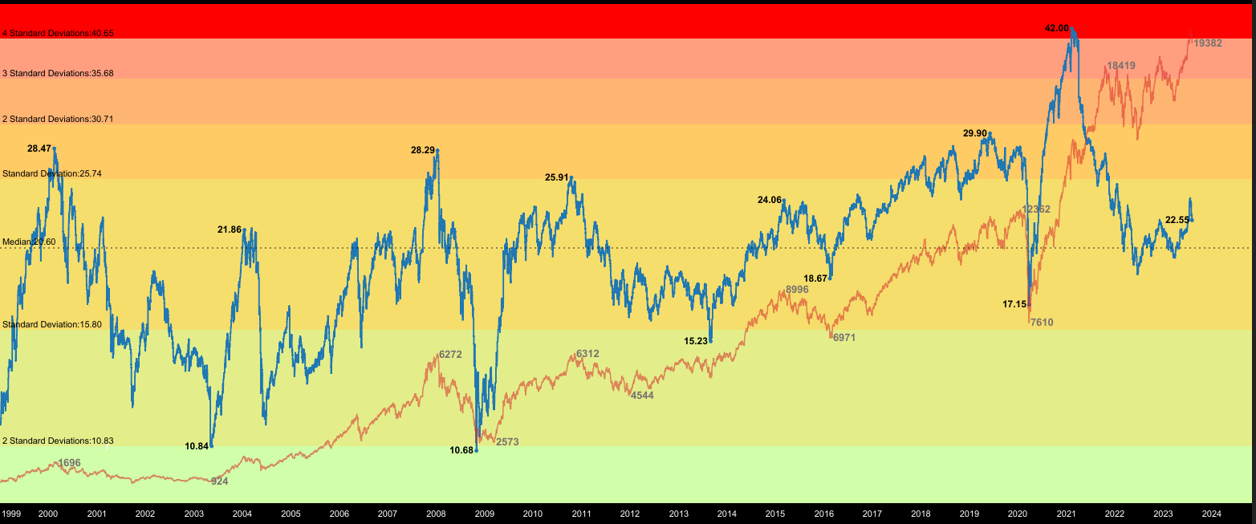
Nifty PE Ratio
Date | Nifty | Nifty PE | Nifty EPS
11-02-2000 | 1756 | 28.47 | 61.67
21-09-2001 | 854.4 | 12.3 | 69.46
07-03-2002 | 1193.05 | 19.11 | 62.43
08-02-2021 | 15115 | 42 | 359
19-10-2021 | 18418 | 27.97 | 658.49
20-06-2022 | 15350 | 18.99 | 808.32
04-08-2023 | 19382 | 22.55 | 859.51

Slide 23
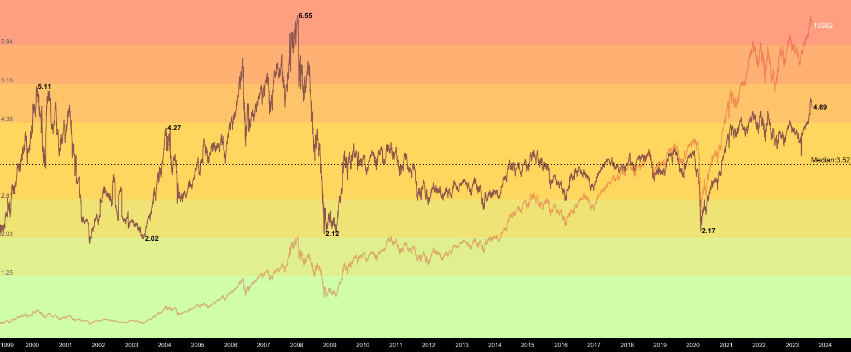
Nifty PB Ratio
Date | Nifty | Nifty PB | Nifty Book Value
02/05/2003 | 938 | 2.02 | 464.35
08/01/2008 | 4771 | 6.54 | 729.51
27/10/2008 | 2524 | 2.12 | 1190.5
25/03/2020 | 7610 | 2.17 | 3506.9
17/02/2021 | 15208 | 4.31 | 3528.5
20/06/2022 | 15350 | 3.92 | 3915.82
04/08/2023 | 19382 | 4.69 | 4132.62

Slide 24
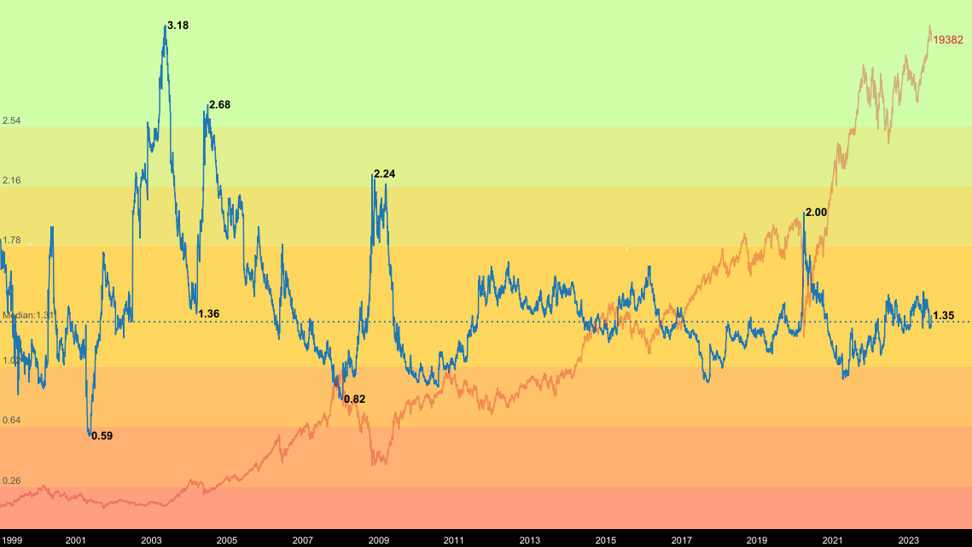
Nifty Dividend Yield Ratio
Date | Nifty | Nifty Dividend Yield (%) | Nifty Book Value
07-05-2001 | 1139 | 0.59 | 6.72
12-05-2003 | 936 | 3.18 | 29.76
08-03-2004 | 1885 | 1.36 | 25.63
27-10-2008 | 2524 | 2.24 | 55.53
28-07-2010 | 5430 | 0.9 | 48.87
23-03-2020 | 7610 | 2.00 | 152.2
20-02-2022 | 15350 | 1.48 | 227.18
04-08-2022 | 19382 | 1.35 | 261.65

Slide 25
I Love
MidCaps, SmallCaps, MicroCaps and NanoCaps
INDEX | 2013 | 2023 | Growth
NIFTY | 5937 | 19513 | 3.2x
Sensex | 19513 | 65676 | 3.3x
NIFTY Midcap 100 Index | 8507 | 37560 | 4.4x
NIFTY Small Cap 100 Index | 3719 | 11734 | 3.1x
NSE Micro Cap 250 Index (Jan, 2022)* | 10581 | 14620 | 1.3x
S&P BSE AllCap (April, 2015)* | 3022 | 7761 | 2.5x
*NSE Micro Cap and BSE All cap were launched recently compared to other indices so we have do not have data for 10 years
We look for opportunities to play with high growth and
Under researched companies and unsung heros
for higher returns and alpha
Gem Stock Entry & Exit Strategies

Slide 26
Fundamental Analysis
Fundamental Analysis helps in making long term investments in companies with strong fundamentals
Fundamental Analysis helps us to separate an investment grade company from a non investment grade company
For Fundamental Analysis one does not require any special skill. Common sense, street smartness, basic mathematics and a bit of business sense is all that is required
There are various tools available for Fundamental Analysis. They are generally very basic and most of them are available easily and freely :
Annual report of the company
Industry related data
Access to news
MS Excel / Spreadsheet / Power BI
Various softwares
Mobile Apps
Gem Stock Entry & Exit Strategies

Slide 27
Top-down and Bottom-up Approaches in Fundamental Analysis
Top-down
Economy
Sector
Industry
Company
Economy
Sector
Industry
Company
Bottom-up
Gem Stock Entry & Exit Strategies

Slide 28
Identifying & Riding the Right Cycle is very Important
1996-2000
Technology
Media
2003-2008
Infrastructure
Commodities
2009-2014
Consumption
Pharma
2015-2019
2020-21 onwards ??
Real Estate
FMCG
Auto
Financials (NBFCs, HFCs )
Import Substitution (Chemicals, APIs, Electronic Manufacturing)
Financial Intermediaries & Financialisation Theme (Insurance, Wealth, AMC, Exchange Ecosystem)
Healthcare (Herbal, Organic, Wellness)
Staffing
Agri Theme
Edutech
Online Businesses
New Gen IT Companies (AI, Cloud)
Retail
Dotcom Boom & Bust
PSU Privatisation
PLI
Gem Stock Entry & Exit Strategies

Slide 29
Company Analysis
Qualitative Factors
Business Model
Management
Corporate Governance
Corporate Culture
Quantitative Factors
Earnings of the company
Financial Leverage
Operating Leverage
Competitive Edge
Financial Ratio Analysis
Valuation Ratios
Liquidity Ratios(ability to meet financial obligations)
Leverage Ratios (use of debt)
Turn over Ratios (asset management or efficiency ratios)
Profitability Ratios (Reflect profitability)
Financial Analysis
Balance Sheet
Profit and Loss Account
Fund Flow and Cash Flow Statement
Gem Stock Entry & Exit Strategies

Slide 30
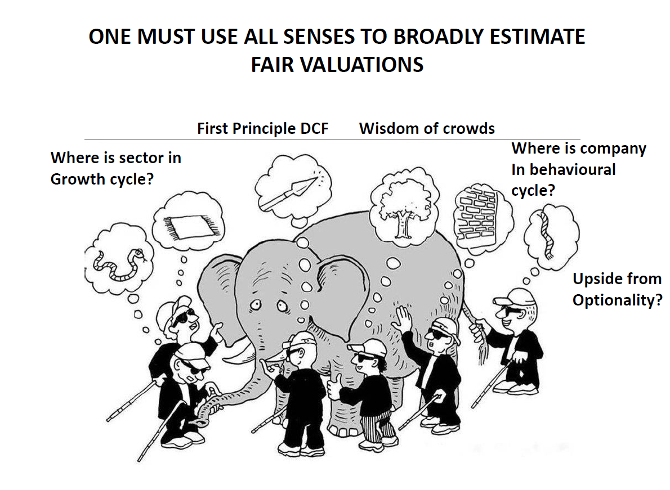
Gem Stock Entry & Exit Strategies

Slide 31
Fundamental Indicators
Valuation
Ratios & Parameters
Dividend Yield
Debt to equity
Interest Coverage Ratio
Shareholding pattern
(Promoters, FIIs, DIIs & Celebrity Investors)
P/E
EV/EBITDA
P/BV
PEG Ratio
Price Range
Pledged percentage
Market Cap / EBITDA
Market Cap / Net Profit
Market Returns
Current Price
52 weeks High / Low
5 year High / Low
Life time High / Low
Gem Stock Entry & Exit Strategies

Slide 32
Fundamental Indicators
Margins
Management Effectiveness
Performance Parameters
EBITDA Margin
Net Profit Margin
ROCE
ROE
Asset Turnover Ratio
Inventory Turnover Ratio
Debtor Turnover Ratio
Current Ratio
Sales growth 3 Years
Sales growth 5 Years
Profit growth 3 Years
Profit growth 5 Years
Average ROE 3 Years
Average ROE 5 Years
Average ROCE 3 Years
Average ROCE 5 Years
Last 5-10 Annual Results
Last 5 Quarterly Results
Size
Market Cap
Book Value
Equity capital
Reserves
Debt
Face Value
Cash Flow Statement
Cash from Operating Activity
Cash from Investing Activity
Cash from Financing Activity
Gem Stock Entry & Exit Strategies

Slide 33
Fundamental Indicators – Valuation Ratios
Price to Earning
The price-to-earnings ratio is a metric that represents a company's profit potential. The value paid by equity investors for each stock unit is used to calculate this potential. As a result, it shows whether a stock is cheaper or more expensive than its competitors in the same industry. In order to track the company's growth, the current price-to-earnings ratio can be compared to previous ratios.
P/E Ratio = Share Price/Earnings Per Share
Price to Sales Ratio
The Price-to-Sales Ratio (P/S) compares the value of a company to the total amount of annual sales it generated previously. The P/S ratio, often known as the "sales multiple," is a valuation multiple based on the market value that investors place on a company's revenue.
PS Ratio= Market Capitalization/ Annual Revenue
Price to Book Value
The Price-to-Book Ratio (P/B Ratio) compares a company's market capitalization to its book value of equity. The P/B ratio, popular among value investors, can be used to find cheap companies in the market.
P/B Raito = Market Capitalization / Book Value of Equity
Gem Stock Entry & Exit Strategies

Slide 34
Fundamental Indicators – Valuation Ratios
EV/EBITDA
The enterprise value to earnings before interest, taxes, depreciation, and amortization ratio (EV/EBITDA) compares the value of a company—debt included—to the company’s cash earnings less non-cash expenses.
The EV/EBITDA metric is a popular valuation tool that helps investors compare companies in order to make an investment decision.
EV calculates a company's total value or assessed worth, while EBITDA measures a company's overall financial performance and profitability.
Typically, when evaluating a company, an EV/EBITDA value below 10 is seen as healthy.
It's best to use the EV/EBITDA metric when comparing companies within the same industry or sector.
PEG Ratio
The PEG ratio was popularized by Peter Lynch. It is calculated as follows:
The PEG ratio takes into account growth rate when considering valuation. This is intuitive. A company growing at 10% a year should have a higher price-to-earnings ratio than a company growing at 2% a year. The PEG ratio takes this into account.
A PEG ratio below one is generally said to be a bargain.
Gem Stock Entry & Exit Strategies

Slide 35
Cash Flow Statement – Doodh ka Doodh, Paani ka Paani
Net Cash Flow of a Company = Operating Activities + Investing Activities + Financing Activities
The Cash flow statement provides us a picture of the true cash position of the company
Each activity either generates or drains money for the company
Investors should pre-dominantly and specifically look at the cashflows from the operating activities
When the liabilities increase, cash level increases and vice versa
When the assets increase, cash level decreases and vice versa
The net cash flow number for the year is also reflected in the balance sheet
This Statement is a useful addition to the financial statements of a company because it indicates the company’s performance
Gem Stock Entry & Exit Strategies

Slide 36
Cash Flow Statement – Doodh ka Doodh, Paani ka Paani
Classification of a Company’s Activities
Operational Activities (OA): Activities directly related to the daily core business operations are called operational activities. Typical operating activities include sales, marketing, manufacturing, technology upgrade, resource hiring etc.
Investing Activities (IA): Activities pertaining to investments that the company makes with an intention of reaping benefits at a later stage. Examples include parking money in interest bearing instruments, investing in equity shares, investing in land, property, plant and equipment, intangibles and other non current assets etc
Financing Activities (FA): Activities pertaining to all financial transactions of the company such as distributing dividends, paying interest to service debt, raising fresh debt, issuing corporate bonds etc
Gem Stock Entry & Exit Strategies

Slide 37
Correlating and Connecting the Balance Sheet and P&L
The P&L Statement
Sales Revenue
Operating Expenses
Depreciation & Amortization
Finance Cost
Other Income
PAT
The Balance Sheet Statement
Receivable and Cash Balance
Inventory and Trade Payables
Accumulted Depreciation
Debt
Investments
Shareholders Equity
Gem Stock Entry & Exit Strategies

Slide 38
Categorisation of Businesses helpful in making
Investment Decisions
Extractors
A business that grows products or takes raw materials from nature
Marketers
A type of business involved in moving the goods from producers to consumers
Types of Business (Stage)
Manufacturers
Takes the extractors products or raw materials and changes them into a for that consumers can use
Service Business
Takes the extractors products or raw materials and changes them into a for that consumers can use
Gem Stock Entry & Exit Strategies

Slide 39
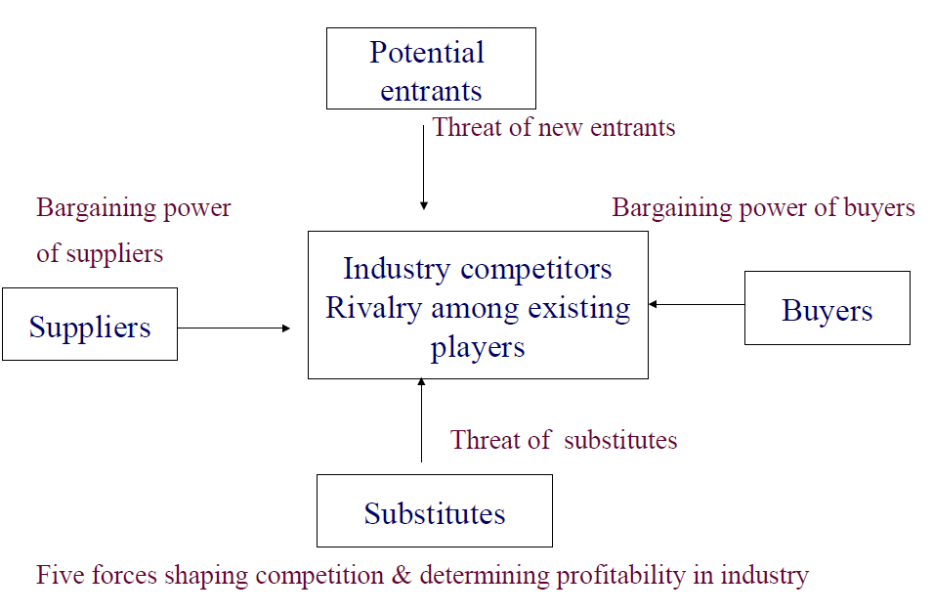
Porter’s 5 Forces Model
Gem Stock Entry & Exit Strategies

Slide 40
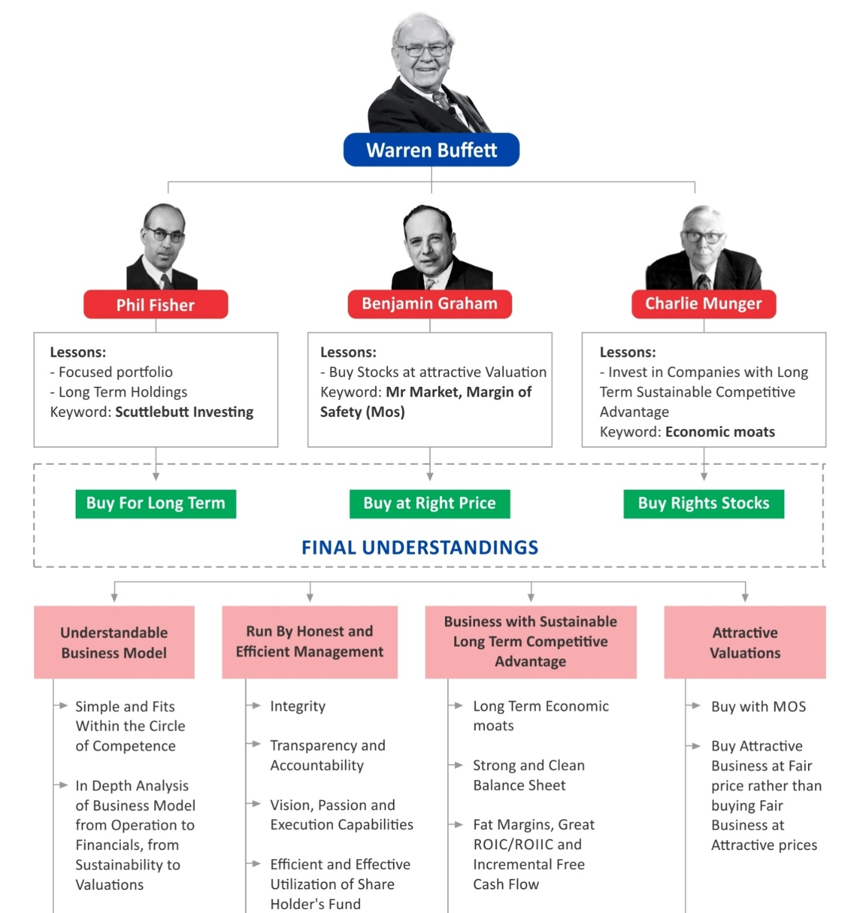
Warren Buffett
in a Nutshell
Gem Stock Entry & Exit Strategies

Slide 41
Parameters we look for beyond Fundamentals & Technicals
High growth non-cyclical lesser regulated companies
Companies having promoters with skin in the game
Companies with no political connections & Government dependence
Pledging - a big NO
Debt - Net cash companies (zero net debt) - growth should be funded by internal accruals and not debts
C3 Corporate Governance, Credit Reports and Channel Checks (Continuous Interaction with company suppliers, distributors, direct consumers, employees & other stakeholders and last but not the least Domain Experts)
Buy-Backs \ Creeping Acquisition : Companies which have done buy-backs / creeping acquisition in the last 2-3 years.
Other than the financials - social, economic, cultural, environmental, general look & feel and other dynamics of a company to be looked for
A BIG NO to
PDC
Gem Stock Entry & Exit Strategies

Slide 42
What we AVOID & RED FLAGS
Impulsive decisions
Being influenced by financial news channels and platforms
Acting on market movements
Chasing winners or hot stocks
Low promoter holdings
Poor corporate governance
High institutional ownership
Leverage
Fad / hot sectors
Expensive valuations
We Avoid
Red Flags
Gem Stock Entry & Exit Strategies

Slide 43
Generating a Stock Idea
Trying to identify Multibaggers
Stocks that gives return in multiples of their actual costs are called multi-baggers
Strong Industry Tailwinds
A Strong MOAT
High Market Share
Lowest cost producer / unique resources / Bargaining power
Pricing Power
Scale of Operations
Strong Brand Equity
Extensive Research & Development Resources and Capability
Strong Technical Tie-Ups or Intellectual property
Wide, Strong & Reliable Distribution Network
Favorable Regulations or Lesser Regulated
Capable and Reliable Management
Light Balance Sheet
Reasonable Valuations
Last but not the least Patience & Discipline
Multibaggers
milte nahi hai…
banana parte hai…
General Observation
Stock screener
Macro Trends
Sectoral Trends
Special Situation
Circle of Competence
Gem Stock Entry & Exit Strategies

Slide 44



Multibagger Approach
GROWTH
CONTRARIAN
VALUE
The company has to be a growth company with above-average growth potential for the next 3-5 years. Markets reward a higher PE multiple for growth companies.
Contrarian approach does not mean doing the opposite of others, rather, it means doing things differently. Buying in popular names will not provide multibagger returns.
The valuation has to be reasonable. This is important because there has to be potential for re-rating. A combination of EPS growth
and PE re-rating leads to multibagger returns.
Gem Stock Entry & Exit Strategies

Slide 45
Understanding Risk
Risk is not a number, rather, it is a concept or notion.
Risk equates to what Ben Graham called a “Permanent Loss of Capital".
VALUATION RISK
Earnings Risk
Balance Sheet Risk
Risk of buying stocks dear without adequate margin of safety. Reasonable valuation is the corner stone of all our investment decisions.
Risk that current earnings could decline due to technological changes, economic changes or deterioration in management.
The risk of an overleveraged balance sheet which is
ignored during good times in favour of the cyclic high and unsustainable earnings.
Gem Stock Entry & Exit Strategies

Slide 46
Risk Management
Buying Right
Don't invest in what we don't understand
Avoid complexity and poor governance
Use check lists
Position sizing - Increase size of bet with conviction and liquidity
Constant Vigil
Track progress of Financial and Operating variables
Track capital allocation decisions of surplus cash flow
Track valuations
Selling Right
When facts change that requires us to change our views
When we encounter evidence that our analysis is wrong
Exit/trim during euphoria - Bull case IRR falls below NIFTY returns estimate
Ability to re-allocate capital to a significantly better
Gem Stock Entry & Exit Strategies

Slide 47
The 10-Minute Test
Does the Company Pass the Quality Hurdle?
Is the Company making Operating Profit?
Does the Company Generate Consistent Cash Flow from Operations?
Are ROCE Consistently over 10 Percent, with acceptable Leverage?
Is Earnings Growth Consistent or Erratic?
How Clean Is the Balance Sheet?
Does the Firm Generate Free Cash Flow?
How Much "Other" Is There?
Has the Number of Shares Outstanding Increased Markedly over the Past Several Years?
How is the Credit Rating ?
Beyond the 10 Minutes : If the firm does pass these tests and it looks as through it's worth a detailed examination, then we can proceed with detailed & thorough research which will take much longer than 10 minutes, but it's worth the effort for an idea that passes the initial hurdles
Gem Stock Entry & Exit Strategies

Slide 48
Corporate Governance Analysis
Board Composition and tenure
Removal of / Resignation by Independent Directors
Succession Plan, especially if control is in the hands of the Founder
Management salary and growth of company
Related Party Transactions
Ethics Violation
Transparency, no manipulations
Management achieve targets / defer targets ? If defer, reason ?
Quality of Auditors
Group Companies History and Pedigree
Rating Agencies (Upgrade and Downgrade)
Gem Stock Entry & Exit Strategies

Slide 49
Important Points & Sources for Analysing a Company
Parameter
Relevance
Last 10 Years Financials
AGM Notice
Chairman's Speech
Director's report
Mgt Discussion & Analysis
Shareholding Patterns
Notes on Accounts
Schedules
Cash Flow Statement
Continuity
Coherence
Sales & Debt
Depreciation
Taking Loss to BS
Tax Rate
Contingent Liability
Diluted EPS
How the company has grown in the past 10 years ? Were there any down years and Why?
Gives lots of information about agenda and special resolutions
Vision about the Future
Current Business Structure - Issues faced and mitigation
Where the company is headed for the next 3 to 5 years
Note the Top 10 Non Promoter shareholder, free float and Institutional ownership & shareholders >1%
Understand all minute details regarding the financials
Very important, look into borrowing Banks, details of receivables due - entities and timelines
Check OCF, Capex and FCF trends also OCF to PAT and OCF / Sales trends in last 10y. 5y and 3y rolling
Compare management commentary from last year to this year
Numbers at different parts of the Annual report should match, Capacity addition not showing up in Fixed Assets etc.
Check growth in Sales vs Growth in Receivables, trends of receivables due (30D, 60D 90D and beyond)
Check Depreciation as %age of Sales over 10 years and see aberrations, R&D should be expensed, not capitalized
If large expenses are directly debited from the Reserves bypassing the P&L
If proper tax rate has been paid on the profits, Apply median tax rates to profits and consider final EPS not the reported one
Whether company has provided adequate cover for the Contingent Liabilities. CL as % of Net Worth
Consider net profits to company (excluding any MI) and diluted EPS post considering all potential warrant conversion
Gem Stock Entry & Exit Strategies

Slide 50
Important Points & Sources for Analysing a Company
Parameter
Relevance
Tax Rate
Contingent Liability
Diluted EPS
Goodwill
Related Party Transaction
Management Salary
Frequent Dilution
Warrant Conversion
Composition of Board
Fees for Audit
Auditor Remuneration
Auditor Report
Cash Yield
If proper tax rate has been paid on the profits, Apply median tax rates to profits and consider final EPS not the reported one
Whether company has provided adequate cover for the Contingent Liabilities. CL as % of Net Worth
Consider net profits to company (excluding any MI) and diluted EPS post considering all potential warrant conversion
Investors should remove Revaluation Reserve and Goodwill from Networth for calculations
Watch out for sales to group entities at low margins. Also consider RPT/Sales trends over years
As percentage of Profits, 10% of PAY is celling under Companies Act. Approaching >5% should raise a red flag
Diluting Equity cheaply is a big detractor. See whether equity dilution is absolutely necessary (already high debt etc.)
Check for outstanding warrants to be converted and resulting dilution from this
Qualification of Independent Directors on the Board. How many premature early resignations
Bulk of Auditor expenses should be audit fees and not legal and other charges
Auditor's salary as part of Sales - 10 year trends and should not see sudden jumps
Comments and Observations ( debt payments, taxes overdue, PF contribution pending)
Compare the interest earned on the Cash and Cash equivalents. Too low rate means cash is non existent
And Above All Channel Check…
Gem Stock Entry & Exit Strategies

Slide 51
Important Financial Ratios & Metrics to Improve Stock Picking Skills
Basics (Income Statement) Revenue Expenses Depreciation Earnings & Adjusted Earnings EPS Gross Margin Operating Margin Net Margin
Basics (Balance Sheet) Assets Current Assets Liabilities Current Liabilities Debt Equity
Basics (Cash Flow) Capital Expenditures Cash flow from operating activities Free Cash Flow
Basics (Miscellaneous) Market Capitalization Enterprise Value Sector Volume
Profitability Ratio ROA ROE ROCE Net Profit Ratio Gross profit ratio
Stock Price Risk Metrics Standard Deviation Beta Maximum Drawdown Value at risk
Fundamental Metrics Margin of Safety Sloan Ratio Piotroski F-Score Altman-Z Score Beneish-M Score
Risk/Return Ratio Sharpe Ratio Treynor Ratio Sortino Ratio Calmer Ratio & MAR Ratio Sterling Ratio Omega Ratio Information Ratio Upside & Downside Ratio
Gem Stock Entry & Exit Strategies

Slide 52
Important Financial Ratios & Metrics to Improve Stock Picking Skills
Dividend Ratio & Metrics Dividend Yield Dividend Payout Ratio Dividend Payback Ratio Yield on cost Dividend Discount Model Dividend History
Growth, Return, Performance Ratio & Metrics Arithmetic Growth Ratio Geometric Growth Ratio Total Return Survivorship bias
Equity to Assets Ratio
Cash Flow to Debt Coverage Ratio
Quick Ratio
Debt to Equity Ratio
Interest Coverage Ratio
Technical & Momentum Ratios and Indicators
52 Week Range
Momentum
Simple Moving Average
Relative Strength Index
Average True Range
Capital Asset Pricing Model & Portfolio Ratios & Metrics
Alpha
Risk Free Rate and Returns
WACC
R-Squared
Active Share
Tracking Error
Correlation
Alternative Earnings Metrics
Owner's Earnings
FFO
AFFO
Miscellaneous Descriptive Ratios & Metrics
Short Ratio
Insider Ownership
Institutional Ownership
Other Business Performance Ratios & Metrics
Cash Conversion Cycle
Days Sales of Inventory
Days Sales Outstanding
Days Payable Outstanding
Inventory Turnover Ratio
Gem Stock Entry & Exit Strategies

Slide 53
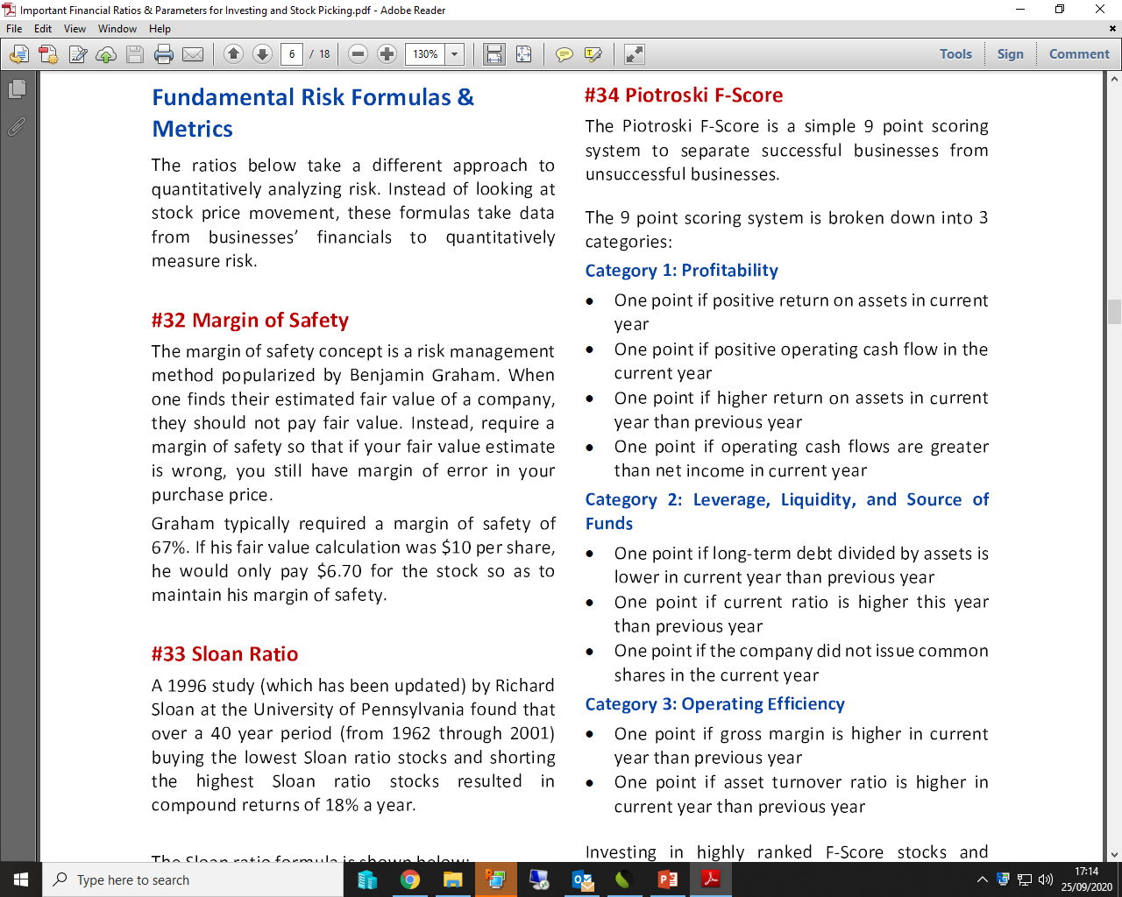
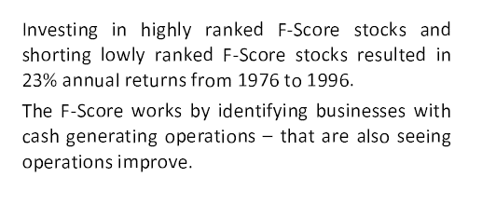
Fundamental Metrics
Piotroski F-Score
Gem Stock Entry & Exit Strategies

Slide 54
Primary Participation in Equity Markets
Your First Step to the World of Wealth Creation & Generating Aplha in very Safe and Predictive Manner
Invest in IPOs, ETFs, OFSs and Buybacks.
Make the chances higher by opening family members A/c (including Minors).
Invest your hard earned money in Mutual Funds through SIP, STP & Lumpsum.
A great way to be with the markets
A great TIME PASS.
But our objective is to learn stock picking … so let’s jump into exploring the Equity markets directly
Gem Stock Entry & Exit Strategies

Slide 55
Technical
Analysis
Gem Stock Entry & Exit Strategies

Slide 56
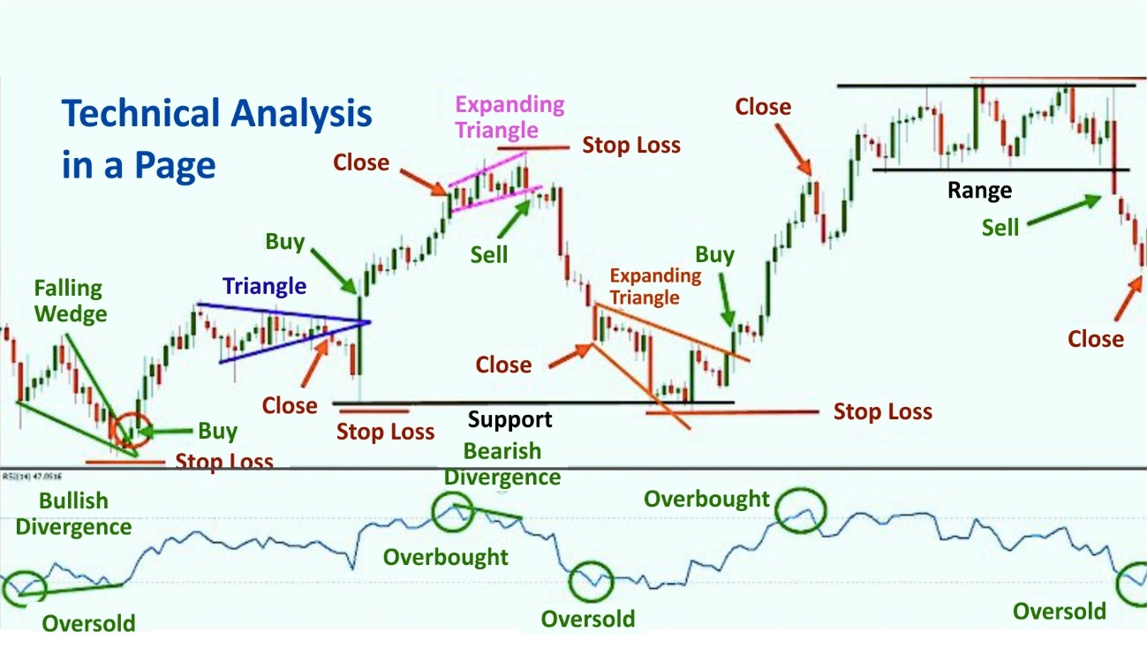

Slide 57
Technical Indicators
Moving Averages (DEMA , WEMA & MEMA)
Trend
20 Days
50 Days
100 Days
200 Days
1000 Days
Short Term
Medium Term
Long Term
Supertrend
Momentum
RSI
MACD
ADX
Gem Stock Entry & Exit Strategies

Slide 58
Timeframes
For Weekly Options... 15 Minutes Charts
For Futures and Short Term Investment...Hourly Chart Better
For Delivery Based Medium Term Investment...Daily Chart
For Long Term Investment... Weekly Chart
Gem Stock Entry & Exit Strategies

Slide 59
Technical Analysis
Exponential Moving Average: -
An exponential moving average (EMA) is a type of moving average (MA) that places a greater weight and significance on the most recent data points. The exponential moving average is also referred to as the exponentially weighted moving average. An exponentially weighted moving average reacts more significantly to recent price changes than a simple moving average (SMA), which applies an equal weight to all observations in the period.
MACD Histogram
MACD is often displayed with a histogram (see the chart below) which graphs the distance between the MACD and its signal line. If the MACD is above the signal line, the histogram will be above the MACD’s baseline. If the MACD is below its signal line, the histogram will be below the MACD’s baseline. Traders use the MACD’s histogram to identify when bullish or bearish momentum is high.
Relative Strength Index
The relative strength index (RSI) is a momentum indicator used in technical analysis that measures the magnitude of recent price changes to evaluate overbought or oversold conditions in the price of a stock or other asset.
Traditional interpretation and usage of the RSI are that values of 70 or above indicate that a security is becoming overbought or overvalued and may be primed for a trend reversal or corrective pullback in price. An RSI reading of 30 or below indicates an oversold or undervalued condition.
Super Trend Indicator
The super-trend indicator relies on two fundamental dynamic values- period and multiplier. But before we get into that, it is important to understand the concept of ATR or Average True Range. ATR is yet another indicator that gives you market volatility value by decompressing the range of prices of a security for a particular time.
Gem Stock Entry & Exit Strategies

Slide 60
The World’s Greatest Investors
Jesse Livermore - The Trend-Following Boy Plunger
David Ricardo - The Napolenic Speculator
George Soros - The Alchemist Who Broke the Bank of England
Michael Steinhardt - The Contrarian Hedge Funder
Benjamin Graham - The Father of Value Investing
Warren Buffett - The Elder Statesman of Finance
Anthony Bolton - The British Warren Buffett
Neil Woodford - The Top Current Value Manager in Britain
Philip Fisher- The Inventor of Growth Investing
T.Rowe Price - The Pragmatic Growth Investor
Peter Lynch - The Man who Beat the Street
Nick Train - The Inactive Optimist
Georges Doriot - The Venture Capital Pioneer
Eugene Kliener and Tom Perkins - The VCs of Silicon Valley
John Templeton- The Global Investor
Robert W. Wilson - The Short Seller
Edward O. Thorp - The Revange of the Quants
John Maynard Keynes - The Stockpicking Economist
John ‘Jack’ Bogle- The Founder of Index Investing
Paul Samuelson- The Secret Investor
Please read the book – “Super Investors” by Matthew Partridge
Gem Stock Entry & Exit Strategies

Slide 61
Stocks Filtered on our Fundamental and Technical Parameters
Fundamental Parameters
S.No. | Parameter
1 | Price to Earning >8
2 | Price to book value >1
3 | Profit growth >10
4 | Profit growth 3Years >10
5 | Sales growth >10
6 | Sales growth 3Years >10
7 | Debt to equity <0.30
8 | Pledged percentage <1
9 | Return on capital employed >15
10 | Return on equity >10
11 | Market Capitalization >100
12 | Current ratio >1
13 | EV/EBITDA
14 | PEG Ratio
15 | Promoter holding
16 | YOY Quarterly sales growth >15
17 | Piotroski score
18 | Interest Coverage Ratio >4
19 | OPM > 10%
Technical Parameters
S.No. | Parameter
1 | 20 DEMA | Y(Above) & N(Below)
2 | 50 DEMA | Y(Above) & N(Below)
3 | 100 DEMA | Y(Above) & N(Below)
4 | 200 DEMA | Y(Above) & N(Below)
5 | MACD | P(Positive Divergence & N(Negative Divergence)
6 | RSI | P(Positive Divergence & N(Negative Divergence)
7 | Super Trend | P(Positive) & N(Negative)
Gem Stock Entry & Exit Strategies

Slide 62
Seven Steps for Blending Fundamentals, Technicals and Options
Step 1
We have to create a universe of fundamentally strong stocks. The stocks are filtered on the basis of 20 to 25 parameters on regular intervals
Step 2
Then we time the entry & exit with the help of Technical Analysis on the stocks filtered fundamentally
Step 3
Then we try to mostly sell puts and at times buy calls also if we are extremely bullish, in the stocks filtered both technically & fundamentally parameters. We sell puts of strikes closer to the DEMAs & WEMAs preferably 200 or atleast 5-10% lower strike
Step 4
We also try to avoid events like the results months, elections, budgets etc..
Gem Stock Entry & Exit Strategies

Slide 63
Step 5
Before selling puts in any stock even through passed through our fundamental & technical filters, the broader market technicals are very important to consider. If the broader market are giving bearish signals, we try to avoid taking positions in options atleast.
Step 6
The stop loss in selling puts is strike price – the premium, so we compulsorily exit the position, here we also check whether the stock has closed decisively below its DEMA of which we have sold puts (atleast twice on EOD basis)
Step 7
We document our plan, then monitor our position and keep a trading excel with logic explained and the plan B
Gem Stock Entry & Exit Strategies

Slide 64

Exit
Strategy
How to Exit & Why Exit is Important ?
Gem Stock Entry & Exit Strategies

Slide 65
How to Exit & Why Exit is Important ?
If stock down 50%, you need it to double to come back to cost
If stock down 70%, you need it to more than triple to come back to cost
If stock down 75%, you need it to rise 4x to come back to cost
If stock down 90%, you need it to rise 10x to come back to cost
Gem Stock Entry & Exit Strategies

Slide 66
Its very tough to make EXIT decisions
Technicals
Fundamentals
Multibaggers or Multibeggars
Gem Stock Entry & Exit Strategies

Slide 67
Exit Decisions Tracking Fundamentals
Fundamental analysis is a continuous process, and it's essential to stay updated with the company's performance and industry trends. These exit strategies are not rigid rules but rather guidelines to help you make informed decisions based on changing fundamentals. Always conduct thorough research and consider seeking advice from financial experts before making any investment decisions.
Targets
Stop Losses - ?
Trailing Stop losses
Better Opportunity or need of funds
Change in Fundamentals
Change in Management & other Parameters
Corporate Governance Issues
Change in broader market trends & valuations (Market PE, P/BV, Dividend Yield)
Price has gone up too much too fast
If buying the stock was a mistake
The stock price has reached unsustainable levels
Gem Stock Entry & Exit Strategies

Slide 68
Exit Decisions Tracking Fundamentals
Stagnancy in Growth Stocks
Look Out for Media Hype
Reduced Dividends
Continuously under performing or bad 4 to 5 quarters ( see quarterly result tracker)
Competitive Threats: Exit if new competitors or disruptive technologies emerge that could potentially erode the company's market share and profitability. Example: Nokia lost its dominance in the mobile phone market due to the rise of smartphones from competitors like Apple and Samsung.
Industry or Regulatory Changes: Exit if there are major shifts in the industry landscape or unfavorable regulatory changes that could impact the company's operations and growth prospects. Example: The ban on mining activities in Goa had a significant negative impact on mining companies like Sesa Sterlite (now Vedanta Limited).
Erosion of Competitive Advantage: Exit if the company's competitive advantage weakens, leading to a loss of market share or pricing power. Example: Kingfisher Airlines lost its competitive advantage and struggled to maintain profitability in the aviation sector.
Mergers and Acquisitions: Exit if the company undergoes a merger or acquisition that might negatively impact its business or financials. Example: Tata Steel's acquisition of Corus led to increased debt and financial strain on the company.
Gem Stock Entry & Exit Strategies

Slide 69
Exit Decisions using Technicals
Technical analysis provides insights into short-term price movements, and exit decisions should be aligned with your trading or investment goals. Combine technical analysis with fundamental analysis for a well-rounded approach to decision-making. Regularly reassess your positions and adapt your exit strategies based on changing technical conditions. As always, seek guidance from financial experts or professionals before making critical decisions.
Stop Losses
Trailing Stop losses
Targets
Timeframe
Resistance Levels: Exit when the stock price approaches a significant resistance level, which may act as a barrier preventing further price increases. Example: Tata Motors faced strong resistance around the ₹450 level in 2018, leading to a reversal and subsequent decline.
Overbought Conditions: Exit when technical indicators like Relative Strength Index (RSI) show the stock is overbought, indicating a potential reversal or correction. Example: In 2020, HDFC Bank reached overbought levels on the RSI, followed by a pullback.
Bearish Reversal Patterns: Exit when bearish chart patterns like Head and Shoulders or Double Tops emerge, signaling a potential trend reversal. Example: Hindustan Unilever displayed a Head and Shoulders pattern in 2019 before a significant decline.
Gem Stock Entry & Exit Strategies

Slide 70
Exit Decisions using Technicals
Moving Average Crossovers: Exit when a shorter-term moving average crosses below a longer-term moving average, indicating a potential shift from a bullish to a bearish trend.
Example: Tech Mahindra experienced a death cross (50-day moving average crossing below the 200-day moving average) in 2019.
Breakdown from Support: Exit when the stock price breaks below a key support level, signaling a potential continuation of the downtrend. Example: Reliance Communications broke down from a long-term support level in 2017, leading to a sustained decline.
Divergence in Indicators: Exit when there's a divergence between the stock price and technical indicators like MACD or Stochastic, suggesting a weakening trend. Example: ONGC exhibited a bearish divergence between price and RSI in 2020, followed by a decline.
Volatility and ATR: Exit if the Average True Range (ATR) indicates heightened volatility, which could lead to unpredictable price swings.
Example: Vodafone Idea displayed increased volatility during its significant price fluctuations.
News and Event-driven Moves: Exit if the stock experiences a sudden price spike due to news or events, as such moves may be short-lived. Example: Yes Bank witnessed sharp intraday movements in response to news and events related to its financial health.
Gem Stock Entry & Exit Strategies

Slide 71
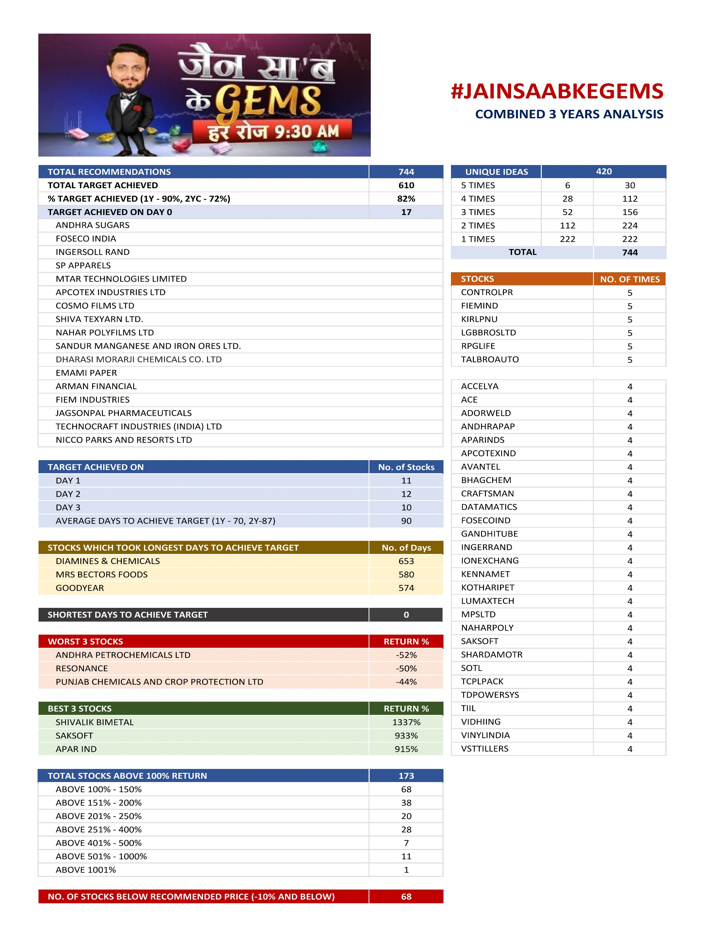


Slide 72
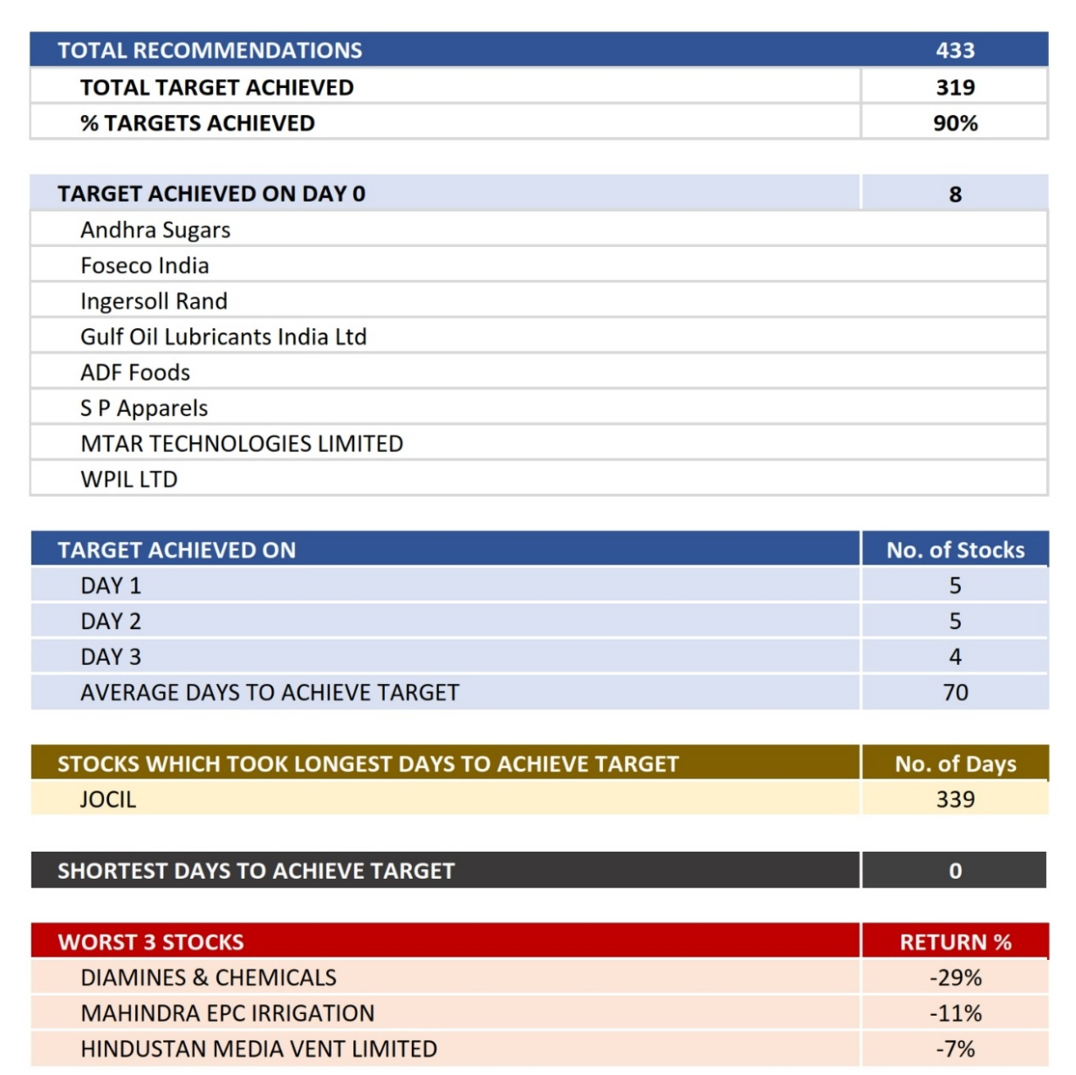

#JAINSAABKEGEMS
1st YEAR ANALYSIS

Slide 73
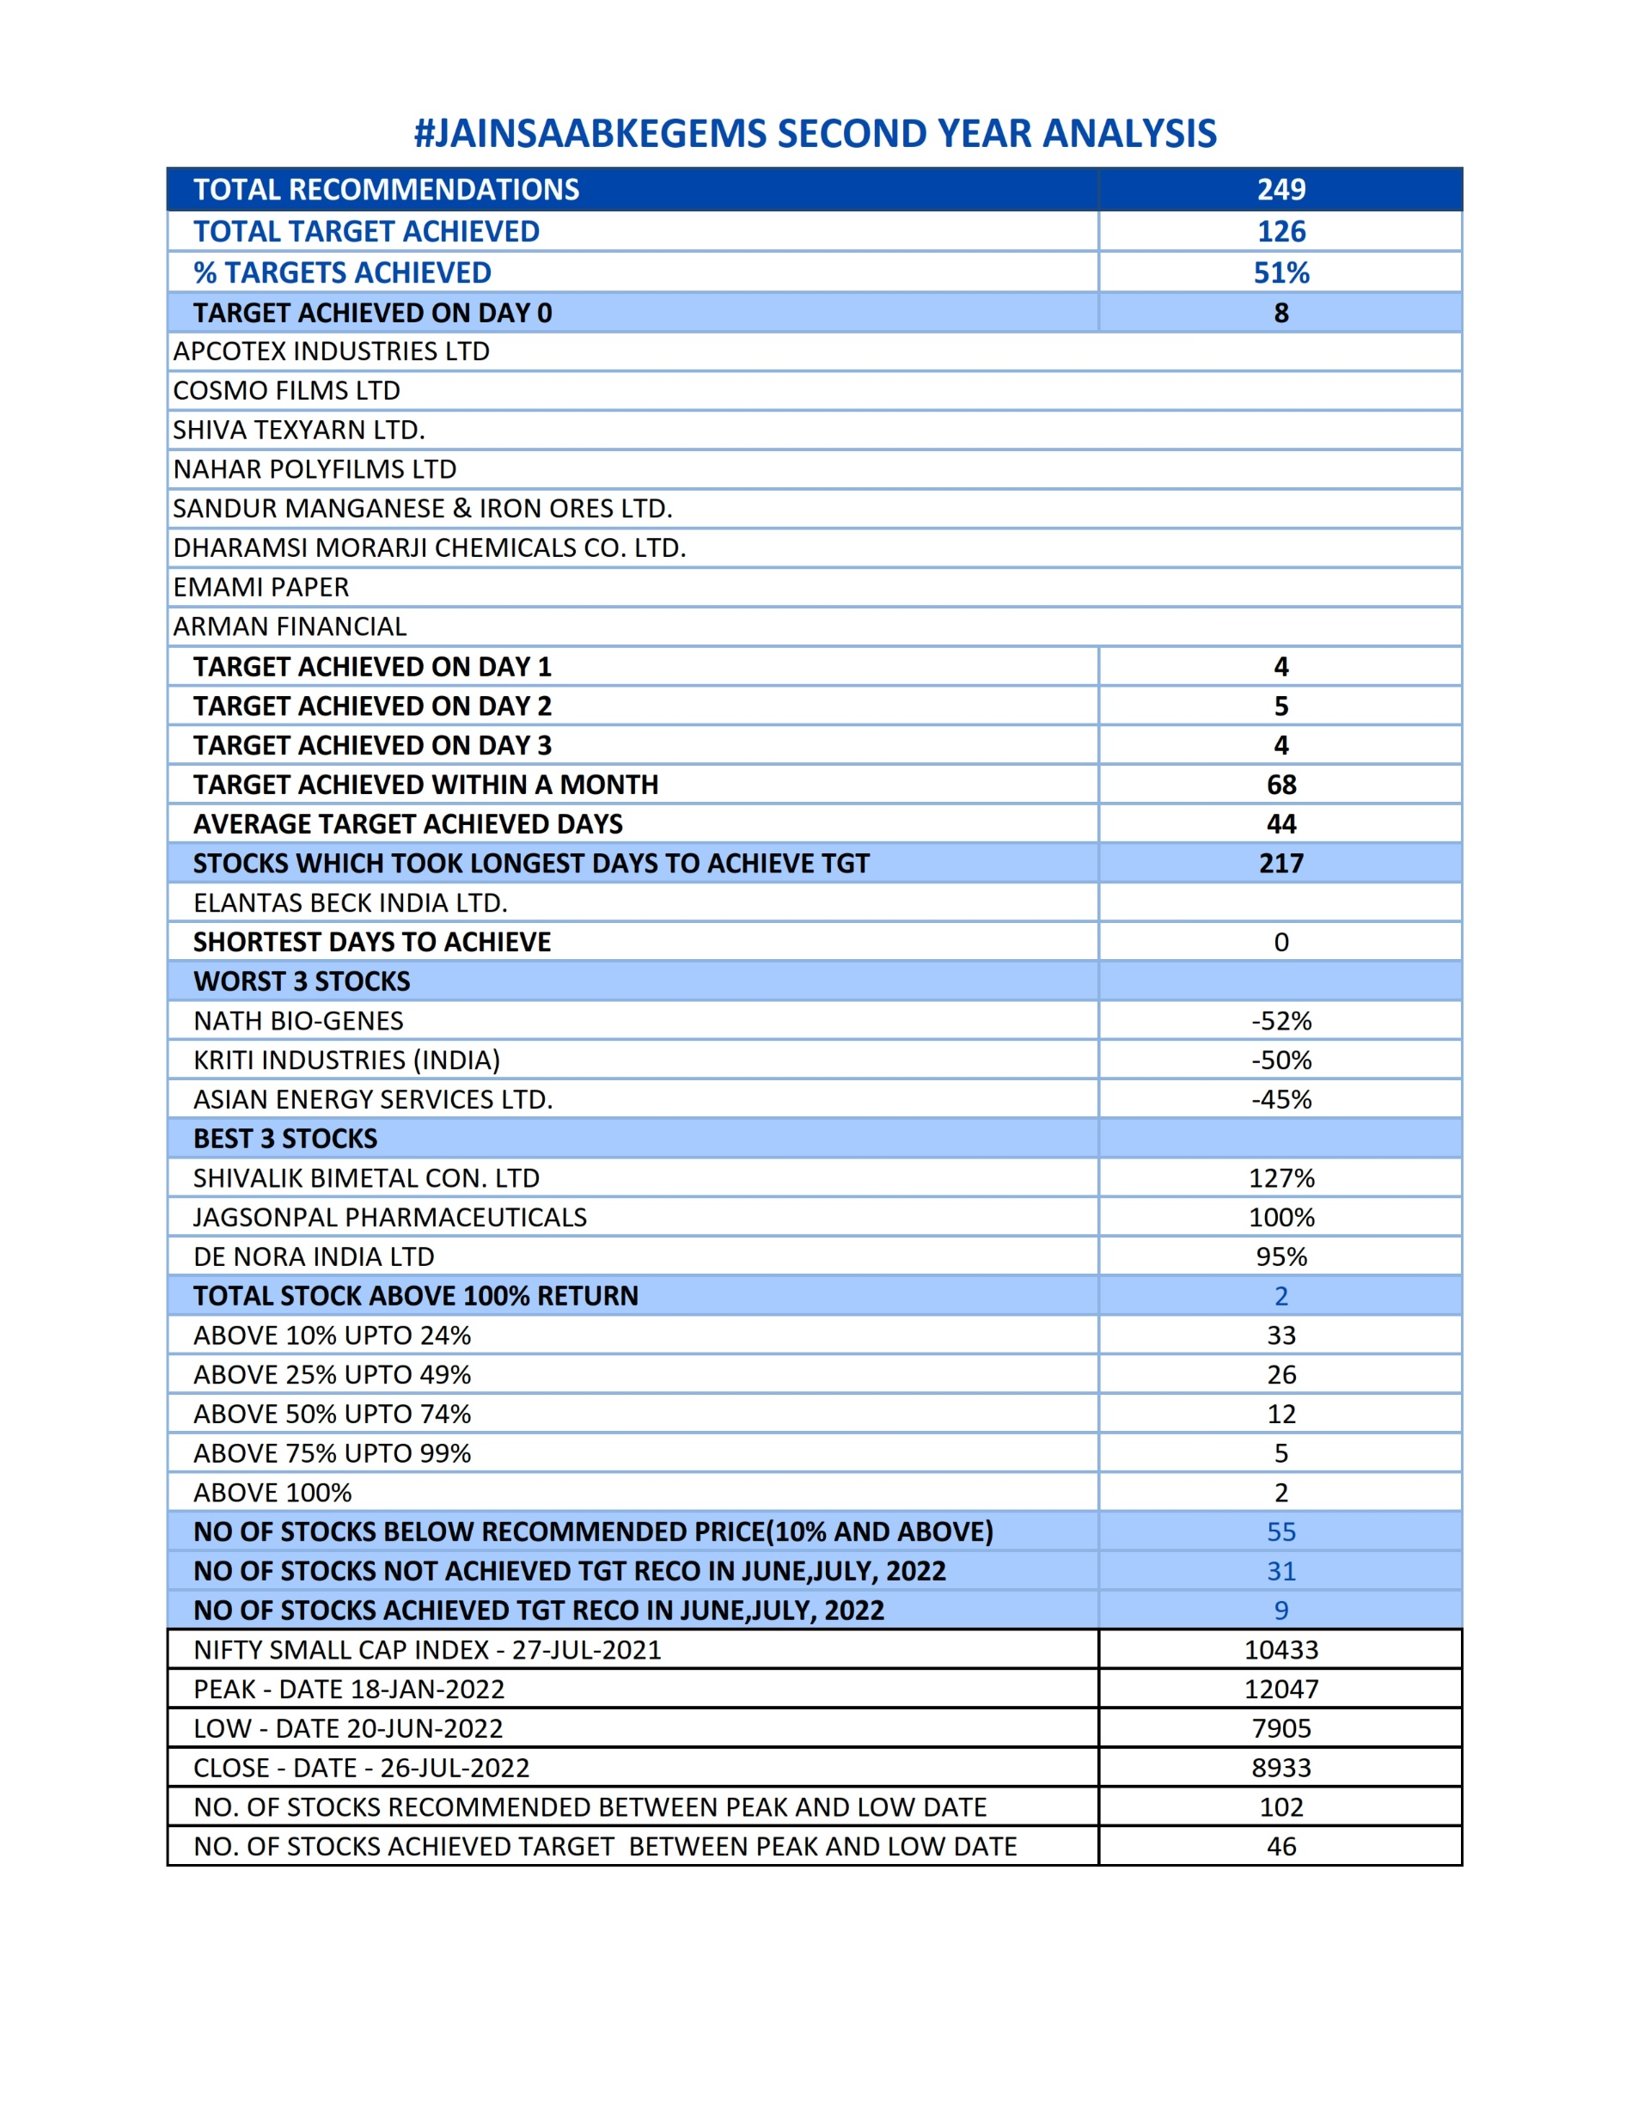
#JAINSAABKEGEMS
2nd YEAR ANALYSIS

Slide 74
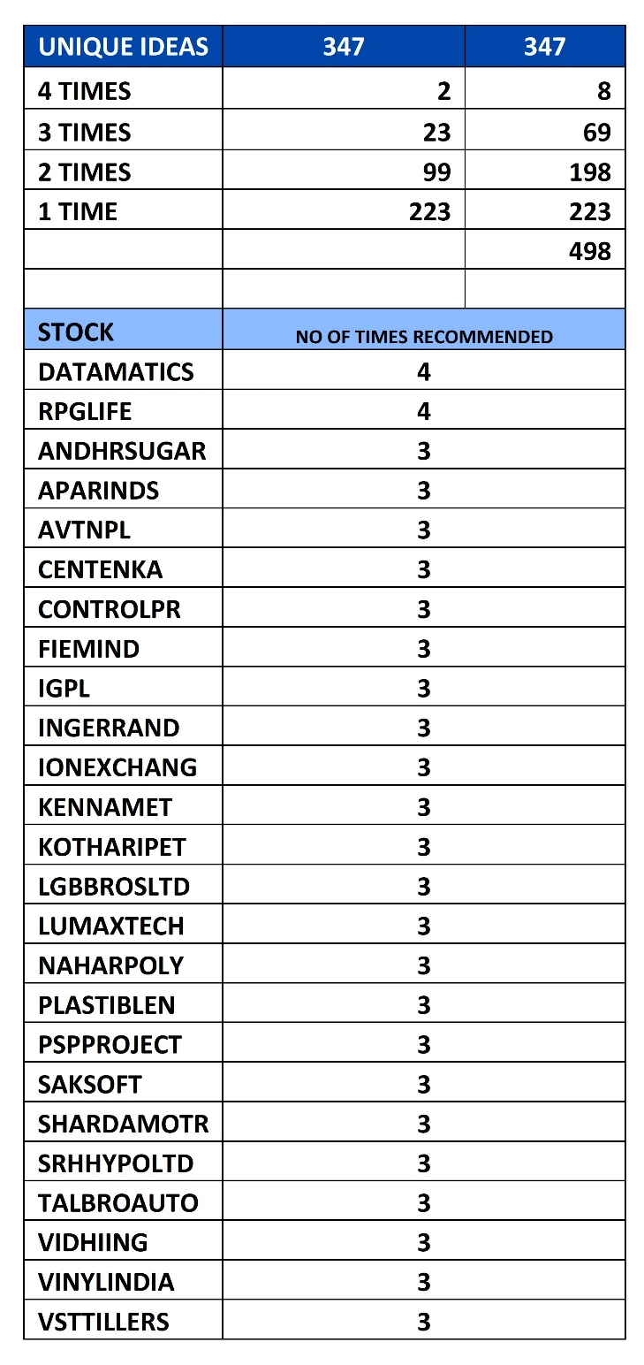

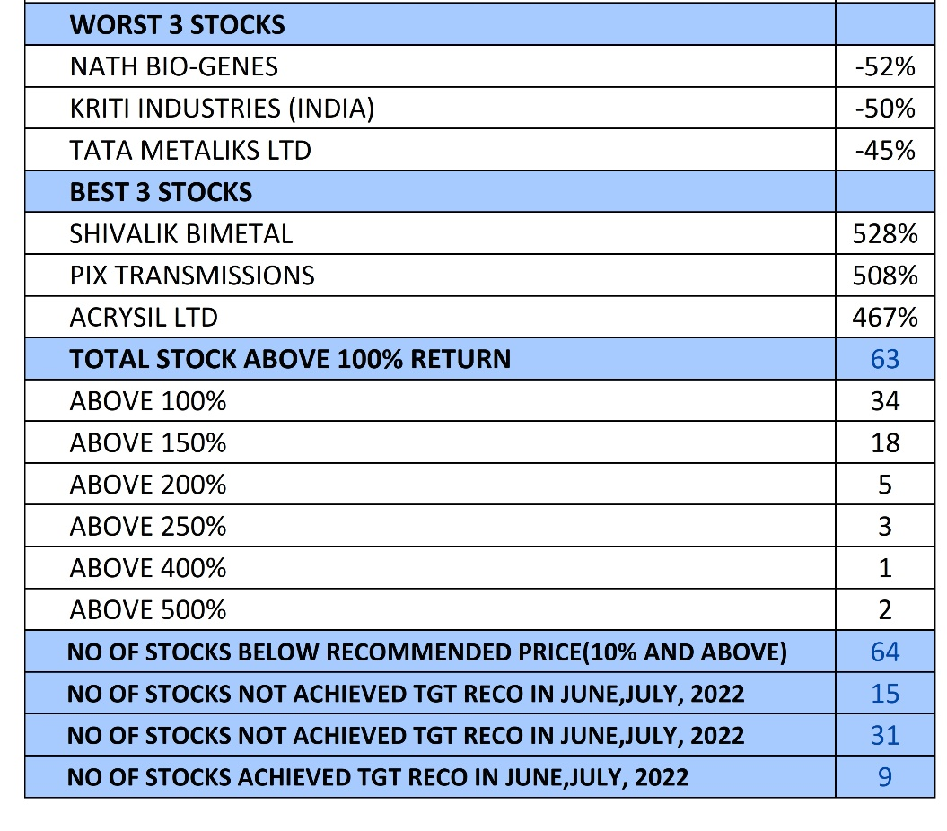
#JAINSAABKEGEMS
COMBINED 2 YEARS ANALYSIS

Slide 75
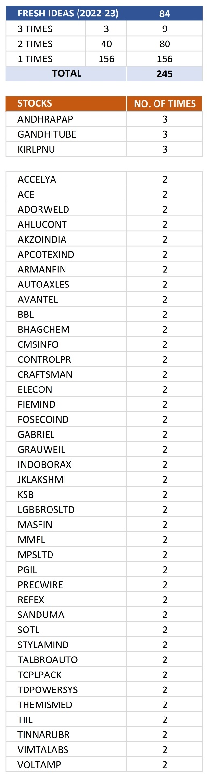


#JAINSAABKEGEMS
3rd YEAR ANALYSIS (1 Year)

Slide 76



#JAINSAABKEGEMS
COMBINED 3 YEARS ANALYSIS

Slide 77

#JAINSAABKEGEMS
If 10000 Invested in every Recommendation and Exit on Target
Particulars
Total Recommendations | 744
Total Target Achieved | 610
Net Investment as on 26-07-23 | 268,732
Valuation of Stock which are open for Target as on 26-07-23 | 1,177,757
Profit (Closing Stock Valuation Basis) | 909,024
XIRR* | 50.36 %
Maximum Fund Involvement | 895,362
Entry & Exit on Target
*This is just a indicative figure, not an guaranteed return
Gem Stock Entry & Exit Strategies

Slide 78

#JAINSAABKEGEMS
If 10000 Invested in every Recommendation
Particulars
Total Recommendations | 744
Total Target Achieved | 610
Net Investment as on 26-07-23 | 7440000
Valuation of Stock which are open for Target as on 26-07-23 | 12681007
XIRR* | 39 %
Buy
&
Forget
*This is just a indicative figure, not an guaranteed return
Gem Stock Entry & Exit Strategies

Slide 79
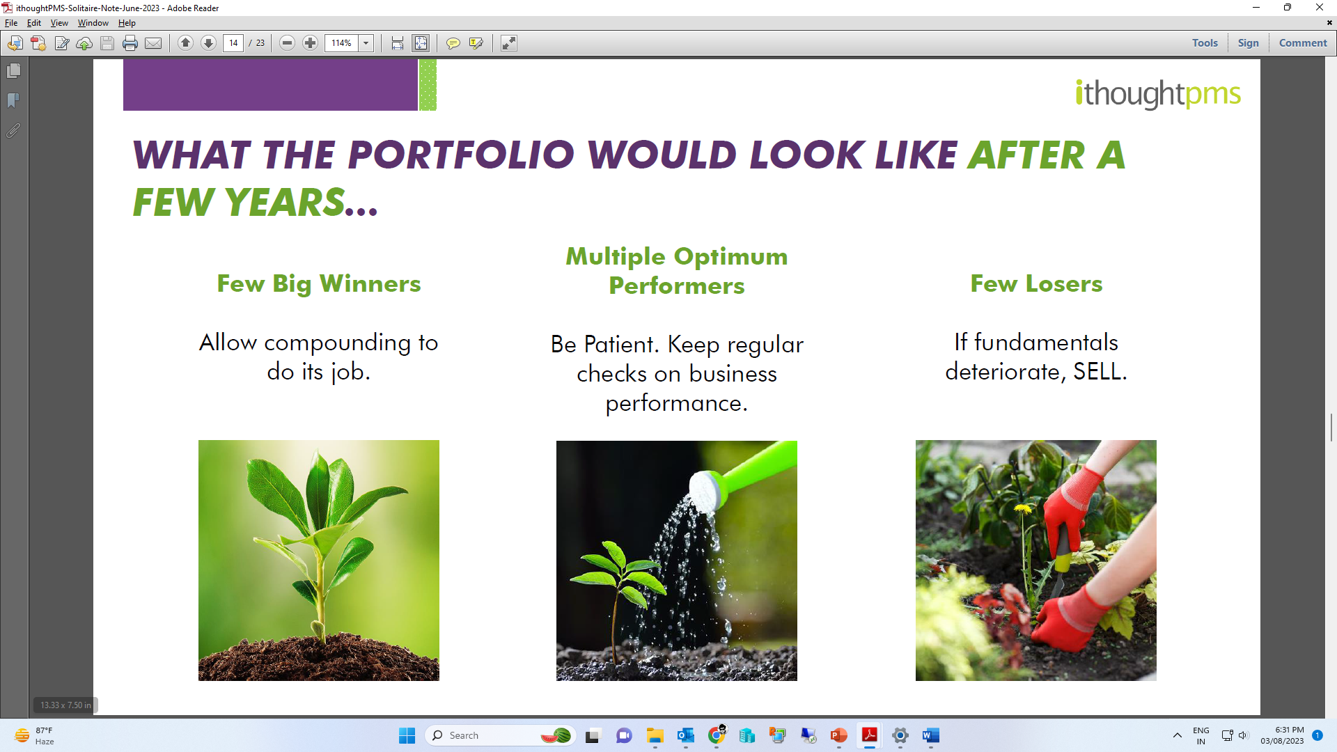
WHAT THE PORTFOLIO WOULD LOOK LIKE
AFTER A FEW YEARS..
Few Big Winners
Let compounding
do its job
Multiple Decent Performers
Have Patience. Keep regular checks on business performance
Few Losers
If fundamentals
deteriorate, SELL
Gem Stock Entry & Exit Strategies

Slide 80
Case Study on Stock Picking and Choosing Son in Law (Jawaai)
All parents are more concerned about their daughters and their future life as compared to their sons. They want to find the most perfect and most compatible partner for her. All parents want 100% assurance that their daughter will spend a good and happy life after marriage. They have some basic expectations from him like:
Good looks and physically fit
Well educated and well-mannered
Good & Comparable Family background ( is family nice and will they love and respect her)
Social status & reputation ( are they clear from any sort of police / court cases or anything that affected their name in society)
Wealth (How wealthy a person and his family)
Character & habits of the groom ( If groom smokes etc it become negative point for him)
Sensitive, caring, loving and responsible
Financially and professionally stable
Able to take care of his family in future
Understanding and liberal
Give her respect and should be compassionate
Mentally strong and able to make his own decisions if situation comes
Able to support and remain with her in all situations and conditions
Should remain loyal to her
Compatible to her
Insaan sabse jyada research Jawaai chun ne main karta hai..
Stocks bhi waise hi dhoondne chaahiye…
Gem Stock Entry & Exit Strategies

Slide 81
Options Backed Strategies
in F&O Stocks using Cash Market
The Atta - Namak Combo
adding Spice to the Portfolio Generating Alpha
Gem Stock Entry & Exit Strategies

Slide 82
Cash Market (Non F&O) + Distant Options - Strategy 1
This is a strategy wherein we create a well researched midcap & smallcap (specifically Non F&O) stocks portfolio & pledge it to create margin for Selling distant OTM Options . Generally we use 50% of the margin which can be created after pledging the portfolio. In the process we create a diversified portfolio of options of safer megacaps.
It helps in generating the Alpha by using the idle assets.
Professional Option Traders regularly track IVP (Implied Volatility Percentile)
Gem Stock Entry & Exit Strategies

Slide 83
Cash Secured Put Strategy - Strategy 2
The cash-secured put involves writing an at-the-money or out-of-the-money put option and simultaneously setting aside enough cash to buy the stock. The goal is to be assigned and acquire the stock below today's market price.
Advantages
Writers gets paid to acquire the stock
Lowers the entry cost
Generates a regular income and alpha
Gem Stock Entry & Exit Strategies

Slide 84
Cash Secured Put Strategy involves the following steps
Finalize the stock you would like to acquire after fundamental & technical analyses
Determine the price applying the fundamental & technical parameters at which you would be willing to purchase the stock
Sell a put option with a strike price near your desired purchase price
Have enough balance in your bank account or liquid funds to cover the purchase of the stock if the put is assigned
Keep collecting the premium from the sale and rolling over the puts, while you wait for the stock to fall in price to the point that you are ready to acquire the stock
Important points to note -
There are few ways to adjust a losing Cash Secured Put trade
An adjustment would usually require an additional amount of capital
CSP is a good setup for those who wish to lower the cost basis on the stock
Enter when the stock you chose is at a lower point from its highs and you see an upside potential
Do not enter the stock you finalise is in an overbought region
Gem Stock Entry & Exit Strategies

Slide 85
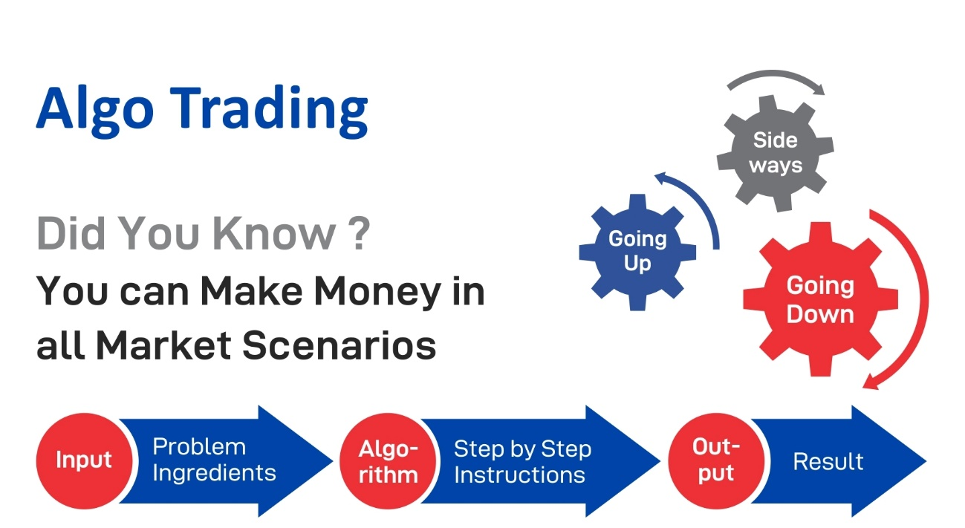
Cash Market (Multicap) + Systematic Weekly Options Trading in Indices - Strategy 3
This is a strategy wherein we create a well researched multicap portfolio & pledge it to create margin for Systematic Trading. Generally we create a portfolio with higher weightage on largecaps with 10 to 20 % haircuts
Systematic Options Trading
Gem Stock Entry & Exit Strategies

Slide 86
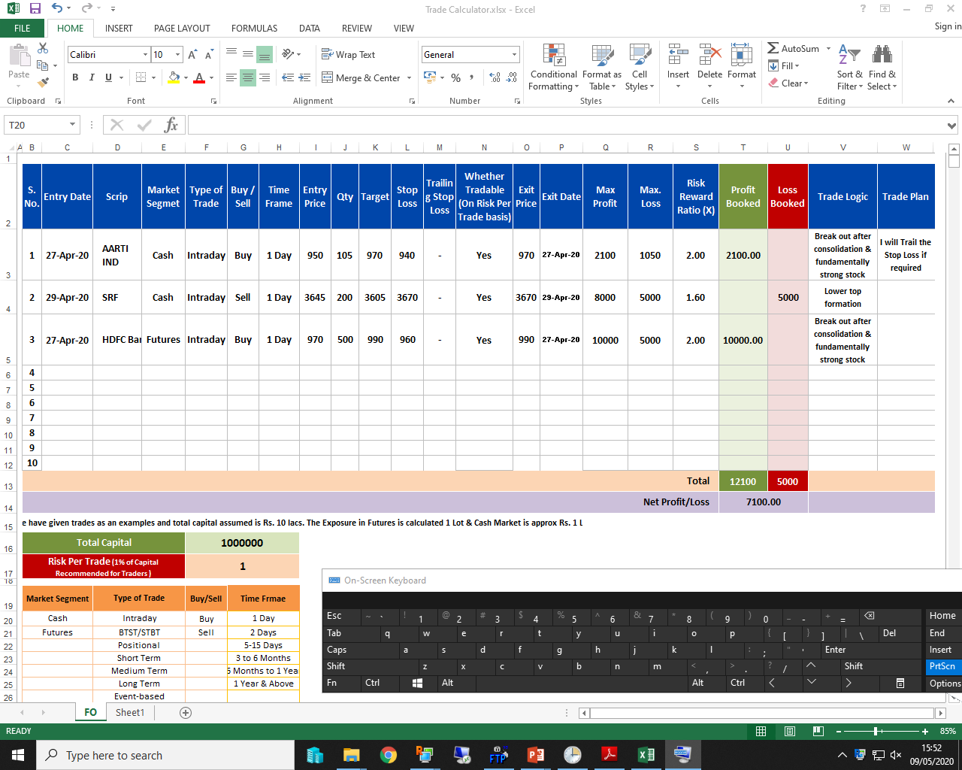
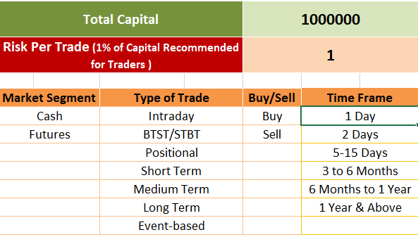
Investment & Trading Planner
Gem Stock Entry & Exit Strategies

Slide 87
Picks of the Seminar
Stocks | Recommended Price | Target | Time Frame
Accelya Solutions India Ltd | 1375 | 1650/1690 | 6 to 9 Months
Swaraj Engines Ltd | 2021 | 2390/2450 | 6 to 9 Months
Shree Digvijay Cement Co. Ltd | 91 | 109/115 | 3 to 6 Months
Disclaimer : It is safe to assume that the similar advice has been given to our clients also, please take into consideration all the risk factors including your financial condition, suitability to risk return profile and the like and take professional advice before investing.
Gem Stock Entry & Exit Strategies

Slide 88
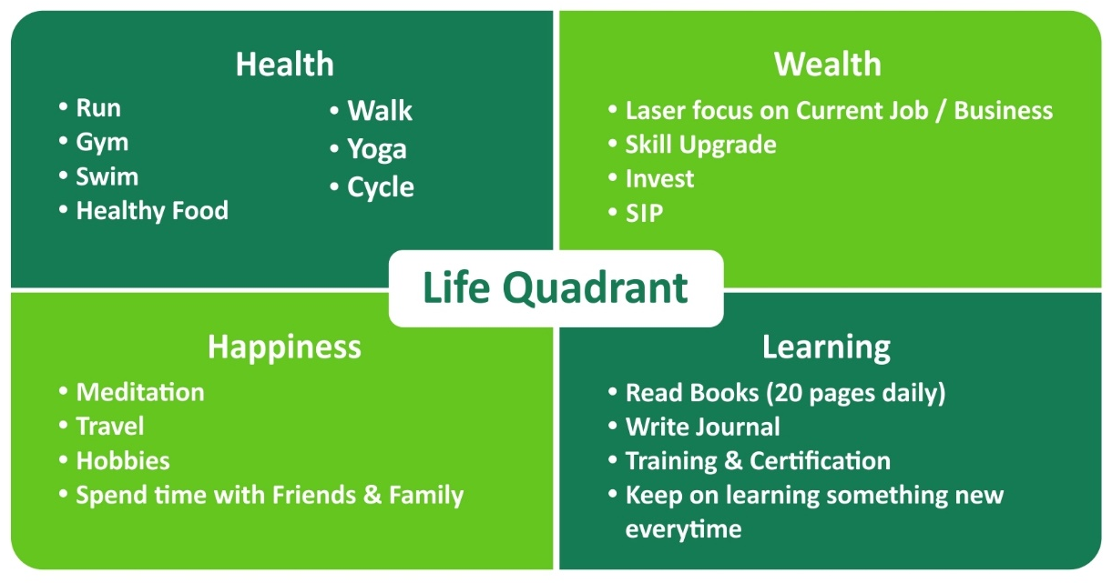

Slide 89
Success Mantra in Markets
“Spend lesser money than you make.
Save the difference.
Buy a diverse portfolio of different asset classes.
- Be patient.”
Sandeep Jain

Slide 90

Thank you so much for being a
Great Audience
#StaySafeStayHealthy

