Slide 1
eInvoice
and Litigative issues
E-Way Bill
2 Days National Conference on GST at National Library, Kolkata 7th Oct 2023
CA Venugopal Gella
Venu and Vinay
Chartered Accountants

Slide 2
Webinar Outline
Basics of eInvoice
Legal Provisions
eWayBill
Important Aspects of envoice
MOV Forms + Legal Provisions
Important Judgements

Slide 3
Legal Provisions

Slide 4
Relevant Dates
Notification | Aggregate turnover Between | Effective Date
CT NN 61/2020 | > INR 500 crore | 1st Oct 2020
CT NN 88/2020 | INR 100 crore and 500 crore | 1st Jan 2021
CT NN 05/2021 | INR 50 crore and 100 crore | 1st April 2021
CT NN 01/2022 | INR 20 crore and 50 crore | 1st April 2022
CT NN 17/2022 | INR 10 crore and 20 crore | 1st Oct 2022
CT NN 10/2023 | above INR 5 crore | 1st Aug 2023

Slide 5
Relevant Notifications / Rules
CGST Notification 68/2019
  Rule 48- Manner of issuing invoice
    48(4) - FORM GST INV-1
    48(5) - Invoice other than the above is not valid
    48(6) - Multiple copies of invoice not required
CGST Notification 69/2019 - Notifies Common Portal
  www.einvoice1.gst.gov.in............einvoice10
CGST Notification 60/2020
  Specifies Schema / fields of INV-01

Slide 6
Persons Exempted
Special Economic Zone (SEZ) Unit
Insurer or a banking company or a financial institution, including NBFC Goods
Transport Agency
Passenger transportation service
Admission to exhibition of cinematograph films in multiplex screens
Government department
Persons covered by CGST Rule 54 (Sub-rules (2), (3), (4), (4A)
Local Authority
  * Updated as per Notification 61/2020 -CT

Slide 7
Transactions covered by E-Invoicing
Document | Type of Transaction | Applicability
Tax Invoices Credit Notes Debit Notes | Business-to-Business (B2B) Business-to-Government (B2G) Export of Goods or Services | YES
Bill of Supply Delivery Challan ISD Invoice | Business-to-Consumer (B2C) Purchase from URD Import of Goods or Services | NO
Applicable only for B2B Notification 70/2019

Slide 8
Penalties for Non compliance of eInvoice
Rule 48(5) – Not a Valid Invoice;
  Non compliance with Sec 16(2)(a) for Recipient
  122(1)(i) & (ii) Incorrect / False Invoice ; violation of provisions of the Act
  Rule 138A (2) – Documents to carry during Transit
Issues
  Credit for Recipient
  General Penalty u/s 122 for violation
  Sec 129 for eWay Bill

Slide 9
Terms and Definitions

Slide 10
Invoice Reference Number (IRN)
Combines Taxpayer GSTIN, Financial Year, Document Type, Invoice Number
64-digit alpha numeric number to uniquely identify an Invoice
For computers only, humans can ignore this
  GSTIN : 33AADCG4992P1Z0
  Financial Year : 2019-20
  Document Type: Invoice
  Document Number: 2
  453c0d4d154f295a808299dc84ab31dffef87a47b70d23602caea41133287ee4

Slide 11
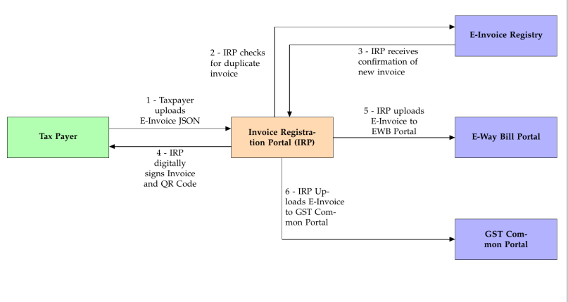
Invoice Registration Portal (IRP)

Slide 12
Invoice Registration Portal (IRP)
Authorized by Government
  First IRP run by National Informatics Centre (NIC)
  Second IRP proposed to be run by Goods and Services Tax Network (GSTN)
Verifies and acknowledges E-Invoices
Replies within blink of an eye
Retains invoices for 24-hours
Does not contain listing of Invoices

Slide 13
Response from IRP
{
  "AckDt": "2020-01-08 12:45:00",
  "AckNo": 55100000009,
  "Irn": "453c0d4d154f295a808299dc84ab31dffef87...", # 64 chars
  “SignedInvoice": "eyJhbGciOiJodHRwOi8vd3d3L...", # ~4000 chars "SignedQRCode": "eyJhbGciOiJodHRwOi8vd3d3Lc...", # ~1000 chars
  "Status": "ACT"
  "EwbDt": "10/03/2020 10:45:00 AM",
  "EwbNo": 151000256262,
  "EwbValidTill": "12/03/2020 11:59:59 PM",
}

Slide 14
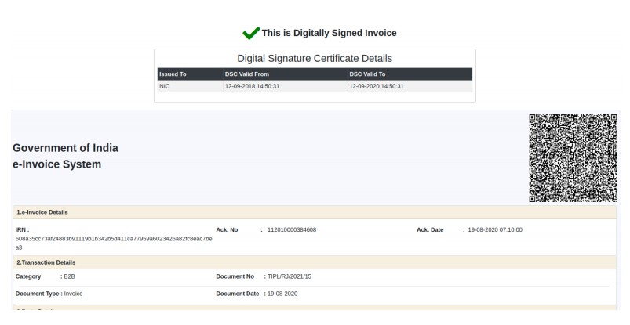

Slide 15
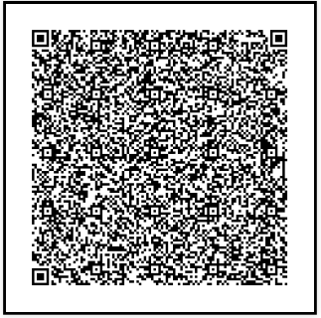
Signed QR Code
Digitally signed by NIC
Contains high level parameters of an Invoice
Can be used to know authenticity of an Invoice

Slide 16
Signed QR Code (Example)
{
  "BuyerGstin“ : "29AAFCC9980M1ZR",
  "SellerGstin“ : "33AADCG4992P1Z0",
  "DocDt“ : "2019-01-08",
  "DocNo“ : "2",
  "DocTyp“ : "INV",
  "Irn": "453c0d4d154f295a808299dc84ab31dffef87a47b70d23602...",
  "ItemCnt“ : 1,
  "MainHsnCode“ : "1001",
  "TotInvVal“ : 11800
}

Slide 17
Frequently Asked Questions

Slide 18
Amendments / Cancellation to Einvoice
Change in books vs Change in IRP Portal
Change in IRP Portal to Change in GSTR 1 vs eWay Bill
eWay bill Active eInvoice cancelled

Slide 19
Key Reconciliations in Einvoice
Change made in books post einvoice but not in IRP Portal
Cancelled in portal but not in books
Wrong data entry while einvoice generation
eINvoice not Auto populated to GSTR1
In Books but eInvoice not generated
eWay bill Active eInvoice cancelled - NA

Slide 20
e-Invoice Generation Time
Invoice for movement of Goods
Before commencing movement
Invoice for across the counter sale
Before completing the sale
Invoice for services
Before issuing of Invoice to the customer

Slide 21
Does E-Way Bills parallel to eInvoice?
E-Way Bills are governed by Rule 138 of CGST Rules.
E-Way Bill
  can be generated simultaneously along with IRN
  It can also be generated later as well
IRP supports E-Way Bills only for Invoice and not DC
Cancellation If needed,
  Cancel EWB first and then cancel Invoice
Physical copy of eWay bill not required if embedded in eInvoice QR
  Rule 138A(2)

Slide 22
Save and Print E-Invoice
Print
  46 (r) Quick Response code, having embedded Invoice Reference Number (IRN)
What details of the E-Invoice should we save in our ERP?
  The acknowledgement number
  Acknowledgement date
  Invoice and QR code digitally signed by the IRP.

Slide 23
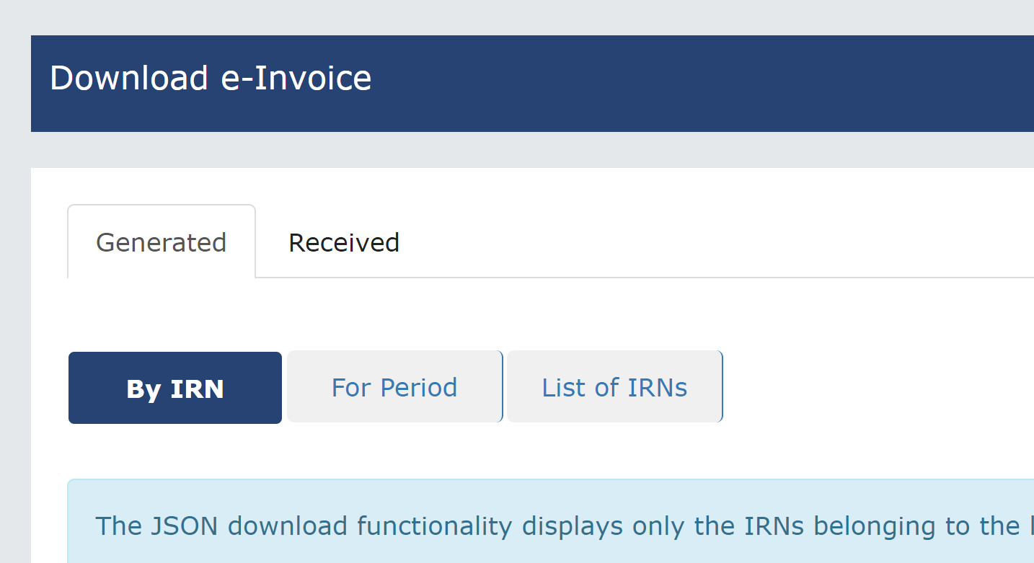
Communication of eInovice
How to send E-Invoice to recipient?
  IRP will not send it for you
  Email Acknowledgement JSON along with PDF – Rule 46(r)
  Government is building a system to send E-Invoice directly to Recipient
From einvoice.gst.gov.in can download
  eINvoice Generated and Received
  For a period of 6 months
    By IRN / by Period
    / By GSTIN recipient / supplier

Slide 24
Generation of Back Dated eInvoice
Time Limit for Back dated reporting of Invoices
  Turnover > 100 crores – 30 days
    time limit of 30 days for reporting of invoices from date of invoice, on e-invoice portals
    For example, if an invoice has a date of Nov. 1, 2023, it cannot be reported after Nov. 30, 2023.
    This validation will come into effect from 1st Nov, 2023
  For Other assesse
    No restrictions set as of now
    Recommended to follow above time lines

Slide 25
Cancellation and Modification
Can E-Invoice can be cancelled
  Yes. within 24-hours of creation.
Can e-Invoice be modified?
  No, once generated document cannot be modified
What if I have generated an Invoice by mistake and it is not cancelled within 24 hours?
  Cancel in your Books of Accounts.
  Do not report the Invoice in your GST Returns.

Slide 26
Inspection of Goods in Movement
Section 68

Slide 27
Inspection of Goods Sec 68
The Government may require
  the person in charge of a conveyance
  carrying any consignment of goods of value exceeding such amount as may be specified
  to carry with him such documents and
  such devices as may be prescribed.
The details of documents required to be carried under sub-section (1) shall be validated in such manner as may be prescribed.
Where any conveyance referred to in sub-section (1)
  is intercepted by the proper officer at any place,
  he may require the person in charge of the said conveyance
  to produce the documents prescribed under the said sub-section and
  devices for verification, and
  the said person shall be liable to produce the documents and devices and
  also allow the inspection of goods.

Slide 28
Applicability of e-way bill - Rule 138 (1)
Registered person under GST
Causes movement of goods
Consignment value > Rs.50,000
Supply, other than supply and inward supply from URD
Furnish information in Part A of EWB-01
Unique number
(EWBN)
138(3) First Proviso E-way bill generation is optional in case of consignment value < Rs.50,000/-

Slide 29
Attributes – Erroneous reporting
Supply Type
I – Inward
O - Outward
Sub Supply Type
1 Supply
2 Import
3 Export
4 Job Work
5 For Own Use
6 Job work Returns
7 Sales Return
8 Others
9 SKD/CKD/Lots
10 Line Sales
11 Recipient Not Known
12 Exhibition or Fairs
Transaction Type
1 Regular
2 Bill To - Ship To
3 Bill From - Dispatch From
4 Combination of 2 and 3
Document Type
INV Tax Invoice
BIL Bill of Supply
BOE Bill of Entry
CHL Delivery Challan
OTH Others
Rule 55A. Tax Invoice or bill of supply to accompany transport of goods , where eWay Bill is not applicable
The person-in-charge of the conveyance shall carry a copy of the tax invoice or the bill of supply issued in accordance with the provisions of rules 46, 46A or 49

Slide 30
General violations
Not Generated
  Not for supply
  Purchase from URP
  Office Furniture shifting
  CSR Disposal
  Job Work
Expired
  Movement Not Terminated
  eWay not renewed
Errors
  Veh No not updated
  Wrong Invoice attached
  Wrong Address
  Un registered ship to
  Multiple Shipments wrong update

Slide 31
Verification of documents and conveyances: Rule 138B, 138C & 138D
Verification of Documents and Conveyances
  The physical verification may be carried out
  by the proper officer
  as authorised by the Commissioner or an officer empowered by him in this behalf
Inspection and verification of Goods
  Summary report of every inspection of goods in transit shall be recorded online in Part A of Form GST EWB-03 within twenty fours of inspection and
  The final report in Part B of Form GST EWB-03 shall be recorded within 3 days of such inspection
Facility for uploading information regarding detention of vehicle
  Where a vehicle has been intercepted and detained for a period exceeding 30 minutes,
  the transporter may upload the said information in Form GST EWB-04

Slide 32
Procedure followed by intercepting officer
MOV Forms

Slide 33
Procedure for Interception - Circular No. -41/15/2018 dated 13.04.2018
Steps | Prescribed Forms
Record statements of driver of the vehicle | GST MOV-01
Issue an order for physical verification of the conveyance, goods and documents and to stop and park the vehicle at the place mentioned in the order | GST MOV-02
Preparation of report within 24 hours of issuance of GST MOV-02, and upload on the portal | Part A of GST EWB-03
Physical verification shall be completed within 3 days of issuance of GST MOV-02. However, if same cannot be completed, written permission shall be obtained from Commissioner to extend the time beyond 3 days | GST MOV-03
Report of completion of Physical verification shall be issued to driver | GST-MOV-04
Such final report shall be updated by officer on common portal within 3 days | Part B of GST EWB-03
Release order shall be issued if no discrepancies are found and release the vehicle | GST MOV-05
If officer wants to detain goods and vehicle, order of detention shall be issued | GST MOV-06
Notice shall be issued for detention within 7 days | GST MOV-07
Notes:
Circular No. -41/15/2018 dated 13.04.2018 - Old

Slide 34
Procedure for Interception - Circular No. -41/15/2018 dated 13.04.2018
Steps |  | Prescribed Forms
On receipt of above said notice, owner of the goods may move ahead as per following:
If Owner accept the penalty as per notice (Section-129) | He can deposit amount of tax and penalty by debiting Electronic Cash Ledger or Credit Ledger (relevant forms) | GST DRC-03
 | Order for releasing of Goods and conveyance shall be passed | GST MOV-05
If Owner does not accept the tax and penalty (Section-129) | Reply should be filed along with the objections
 | Speaking order shall be passed by officer and upload on common portal within 7 days after service of Notice. | GST MOV-09
 | Order for releasing of Goods and conveyance shall be passed after tax and penalty are paid | GST MOV-05
Appeal against the order issued as above (u/s 129) shall be filed on payment of pre-deposit of 25% of the Penalty demanded.

Slide 35
Procedure for Confiscation - Circular No. -41/15/2018 dated 13.04.2018
Steps | Prescribed Forms
Proper officer shall issue Notice under Sec 130 | GST MOV-10
Order of Confiscation | GST MOV-11

Slide 36
Circular No. 49/23/2018-GST
Inspection ONCE done in One State cannot be done again
  Unless a specific information relating to evasion of tax is made available subsequently
Only such goods and/or conveyances should be detained / confiscated in respect of which there is a violation of the provisions of the GST Acts or the rules made thereunder.
  Illustration: Where a conveyance carrying twenty-five consignments is intercepted and the person-in-charge of such conveyance produces valid e-way bills and/or other relevant documents in respect of twenty consignments, but is unable to produce the same with respect to the remaining five consignments, detention/confiscation can be made only with respect to the five consignments and the conveyance in respect of which the violation of the Act or the rules made thereunder has been established by the proper officer

Slide 37
Penalty of Rs.1000 - Circular No. 64/38/2018-GST
Spelling mistakes in the name of the consignor or the consignee but the GSTIN, wherever applicable, is correct;
Error in the pin-code but the address of the consignor and the consignee mentioned is correct, subject to the condition that the error in the PIN code should not have the effect of increasing the validity period of thee-way bill;
Error in the address of the consignee to the extent that the locality and other details of the consignee are correct;
Error in one or two digits of the document number mentioned in the e-way bill;
Error in 4 or 6 digit level of HSN where the first 2 digits of HSN are correct and the rate of tax mentioned is correct;
Error in one or two digits/characters of the vehicle number.

Slide 38
Case Law

Slide 39
Detention of Goods
Wrong classification of goods
  Hon KER High Court quashed detention order on the ground that this was a bona-fide case of dispute in the classification of goods and directed release of goods. [Daily Fresh Fruits India Private Limited v. Commissioner, SGST, 2020-VIL-115- KER; and Hindustan Coca Cola Private Limited v. Assistant State Tax Officer, SGST, 2020-VIL-144-KER]
Under-valuation of goods
  The under valuation of goods in the invoice could not be a ground for the detention of the goods and vehicle u/s129 of the CGST Act. r/w Rule 138 of CGST Rules. Accordingly, the order is quashed, and Authorities were directed to release the goods. [K.P. Sugandh Limited v. Commissioner, SGST, 2020-VIL-142- CHG]

Slide 40
Detention of Goods
Vehicle took a different route or reached wrong destination
  The High Court observed that allegation of ‘wrong destination’ or that the driver has taken a different route is not a ground to detain the vehicle carrying the goods or levy tax or penalty. It was held that the fact that the vehicle was found at another place does not automatically lead to any presumption that there was an intention of evasion of tax. The amount collected was directed to be refunded with interest @ 6%. [Commercial Steel Company v. Assistant Commissioner of State Tax, 2020-VIL- 116-TEL]
Interception of vehicle within a few hours of expiry of E-way bill and Adjudicating authority passed an order of detention of vehicle
  Rule 138(10) of the CGST Rules allow extension of E-way bill within 8 hours of expiry. The Authority noted that the petitioner was not given reasonable time for renewal of the e-way bill and held that penalty under Section 129 of the CGST Act should not be imposed. Since the petitioner has made minor procedural as per Rule 138(10) of CGST Rules, thus the Authority imposed a general penalty of Rs. 1,000/- u/s 125 of the CGST Act. [Bhushan Power & Steel Limited v ACSTE, 2020(2) TMI 858-GSTAA (HP)]

Slide 41
Seizure of Goods
Goods were seized for goods being transported without invoice and e-way bill. Further, the confiscation order was passed without giving an opportunity of being heard to the petitioner.
  The High court quashed the confiscation order considering that principles of natural justice were violated and no opportunity of being heard was provided to the petitioner. It was also observed that the confiscation order was not a speaking order and did not reflect the reasons required to be mentioned as per Section 130 of the CGST Act. [Sitaram Roadways v State of Gujarat,2019-VIL-510-GUJ]
Tax on invoice shown as CGST: SGST as against IGST but e-way bill declared correct tax as IGST
  The High Court observed that a clerical error on the invoice will not prejudice the Revenue. Since there is no question of evasion of tax; goods to be released on executing a simple bond instead of issuing bank guarantee for the demand raised. [Umiya Enterprise Vs Assistant State Tax Officer, 2020-VIL-50-KER]

Slide 42
e-way bill without any intention of evasion
[Mriganka Sarkar v Union of India (2022)(Calcutta)]
Fact of the Case:
  While generating the E-way bill the taxpayer inadvertently mentioned the address of the taxpayer and not the place from where the timber was dispatched. On interception penalty was imposed on account of transporting timber without a valid Way Bill and taxpayer had to pay penalty for the purpose of releasing the said goods upon payment of taxes as well as penalty.
Judgement:
  Hon’ble Court observed that the taxpayer at the very first instance paid the taxes which he was liable to pay on account of the goods in question.
  Due to unintentional error at the time of generating e-Way Bill, the address from where the goods were dispatched was wrongly mentioned and accordingly, the goods were rightly confiscated by the tax authorities.
  Hon’ble Court observed from the conduct of the taxpayer it does not appear that there was an intention to evade tax.
  Therefore, Hon’ble Court set aside the orders passed by Tax Authority and directed Tax Authority to take steps for refund of the amount which was collected from the taxpayer on account of tax for the second time and penalty paid by him at the earliest.

Slide 43
Beyond Jurisdiction
Fact of the Case: In the course of transportation of goods, revenue officers found that tax invoices did not bear continuous invoice numbers. Revenue officers suspected that some invoices could have been used for transportation of other goods that had not been brought to the notice of the department and the detaining authority passed the detention order.
Judgement:
  High Court observed that it is not in dispute that e-way bills did accompany the goods and it is also not in dispute that the transportation was covered by tax invoices.
  High Court held in view of the above observation that the entertainment of such a doubt by the authority cannot be a justification for detaining the goods in question, when they were accompanied by tax invoices as also e-way bills.
  Therefore Court allowed the writ petition and directed the respondents to release the goods detained.
[Devices Distributors v Assistant State Tax Officer (2020)(High Court of Kerala)]

Slide 44
Delay in Delivery Beyond Control Satyam Shivam
Fact of the Case:
  The petitioner made an intra state supply of papers through a tax invoice. It has also generated an e-way bill and goods were delivered to a transporter for making delivery to the consignee.
  On way of delivery the vehicle got delayed due to political rally and by the time the roads get cleared the shop of the buyer could be closed, and so the auto trolley driver took the trolley to his residence with the goods so as to deliver them on the next working day.
  On the next working day when the auto trolley was on its way for delivery of the paper to the buyer/consignee but it was detained and a Detention Notice in Form GST MOV-07 was served alleging that the validity of the e-way bill had expired proposing to impose tax and penalty.

Slide 45
Satyam Shivam
Judgement:
  The court is of the opinion that there was no material before the 2nd respondent to come to the conclusion that there was evasion of tax by the petitioner merely on account of lapsing of time mentioned in the e-way bill.
  On account of non-extension of the validity of the e-way bill by petitioner or the auto trolley driver, no presumption can be drawn that there was an intention to evade tax.
  In this view of the matter, the Writ Petition is allowed and The respondents are directed to refund the said amount collected from petitioner within four (04) weeks with interest@ 6% p.a from 20.1.2020 when the amount was collected from petitioner till date of repayment.
Notes:
A division bench of justices Dinesh Maheshwari and Hrishekesh Roy not only set aside the penalty levied by the GST officer, but also increased the fine imposed on him, by the High Court for the State of Telangana at Hyderabad from Rs 10,000 to Rs 69,000.

Slide 46
Classification cannot be Questioned
Misdescription of Goods (a particular item is called by different names in different States) do not serves as ground for detention as there is no malafide intention to evade tax
  It is seen that one particular item is called by different name and are also understood differently at different places.
  It may be that Cereal Based Blended Food, is called as sattu at Rajasthan but in the State of U.P. may be understood differently.
  Since in the invoice the name "Cereal Based Blended Food" is mentioned and the same was also found with reference to its constituent namely wheat, soyabean, sugar, vitamin and mineral etc.
M/s Ramdev Trading Company And Another Versus State of U.P. And 3 Others 2017 (12) TMI 341 - Allahabad High Court 30-11-17

Slide 47
Other issues-Job work related
Failure of driver to carry tax invoices and E-way Bill along with the goods by mistake
  As driver merely left behind documents by mistake and there being no allegation against transporter whose business would be affected adversely on account of seizure, vehicle directed to be released to him unconditionally if the owner of goods does not come forward to comply with conditions of release [MKC Traders Vs State of U.P.- 2019 (22) G.S.T.L. 348 (All.)
  Detention of goods during the return journey from job-workers premises to the petitioner's premises due to mis-match in the value of goods as in the e-way bill and job work invoice
    High court held that the consignment was covered by the job-work invoice, as e-way bill as also the delivery challan that originally accompanied the goods on its transportation to the job workers premises. There could be no doubt with regard to the identity of the goods that were being transported and the difference in the value shown in the e-way bill was only on account of the requirement of maintaining uniformity in the value shown in the tax invoice raised by the job worker and the e-way bill generated by him-
    The detention in this case is wholly unjustified and set aside. The writ is allowed
    P.H. Muhammad Kunju and Brothers v. Asstt. State Tax Officer, Palakkad [2021]

Slide 48
Other issues
Whether it is mandatory that when a truck is carrying goods of TWO e-Way Bills then it has to unload the goods of shorter distance first and then the goods of longer distance or goods of higher weight first and then goods of lesser weight? – Telangana HC
The petitioner in the course of business purchased stainless steel pipes and tubes from M/s. Santosh Steel and Pipes India Private Limited, Dadra, and Nagar Haveli. The petitioner hired M/s. Anmol Parcel Services for transporting the material from Dadra and Nagar Haveli to Secunderabad.
The said transporter also booked the material of M/s. Simi Steels, Adoni, Kurnool District from the same vendor M/s. Santosh Steels, Dadra, and Nagar Haveli to its business premises at Adoni, Kurnool District. For carrying the material to these two destinations, one at Secunderabad and the other at Adoni, two waybills were generated, one from Dadra and Nagar Haveli to Secunderabad for a travel of 867 kms. and the other from Dadra and Nagar Haveli to Adoni which is at a distance of 940 kms.
The answer is certainly NO. There is no law/rule which says that the goods to be unloaded at a shorter distance must be offloaded first or the goods of higher weight to be unloaded first. Unless there is something on record to prove that there was Bad Intention or intent to evade tax, such action of detention is bad in law and therefore cannot sustain.
Vijay Metal Vs. The Deputy Commercial Tax Officer-Telangana HC

Slide 49
Other issues
Failure of driver to carry tax invoices and E-way Bill along with the goods by mistake
  As driver merely left behind documents by mistake and there being no allegation against transporter whose business would be affected adversely on account of seizure, vehicle directed to be released to him unconditionally if the owner of goods does not come forward to comply with conditions of release [MKC Traders Vs State of U.P.- 2019 (22) G.S.T.L. 348 (All.)

Slide 50
Judgements against the Assessee

Slide 51
Question on Movement
No Movement in Toll Booths
  Officer called information from toll booths from Assam to point of destination i.e., Coimbatore to test claim of petitioner that goods originated from Guwahati – Toll booths enroute between Guwahati and Telangana did not indicate any movement of vehicle in question in that sector and records of movement were available only from Telangana onwards – This led to suspicion that point of origination of goods is Telangana and not Guwahati as claimed and, hence, notice was issued proposing penalty
  Held: Petitioner could very well have produced toll receipts or any other information/material in its possession to disprove suspicion – Consideration of such information, if at all, would involve an examination of disputed facts – Hence, writ petition was to be dismissed as petitioner had an efficacious, alternate remedy provided to approach Appellate Authority
  Sonali Metal Industries LLP v. State Tax Officer (Intelligence), [2022]

Slide 52
Other issues
Can GST be levied on the movement of goods for reasons other than supply?
  In the case, KIA Motors assumed that demo vehicles didn't require an E-Way Bill as they were not considered a supply but merely demo cars. However, during transportation, their vehicle was intercepted, and it was discovered that no E-Way Bill was generated as required by Section 129, read with Rule 138 of the GST Rules, 2017.
  The court clarified that any movement of goods exceeding a value of Rs. 50,000, even if not for the purpose of sale, mandates the generation of an E-Way Bill.
  The supplier must inform about the goods' movement electronically on the common portal using Form-A GST, EWB-01.
  KIA MOTORS INDIA PVT. LTD. Versus STATE OF MADHYA PRADESH

Slide 53
Missing Part B Revenue Favour
HC sustains penalty of Rs. 1.32 Cr (approx.) for violation of Section
  by failing to give details of conveyance in Part-B of E-way Bill during inter-state transportation of taxable goods;
  Notes that although assessee sought to justify such non-submission owing to technical error with no intention to evade tax, no grievance had been raised either on the GST portal or in writing in this regard;
  Rejects assessee’s reliance on Allahabad HC decision in VSL Alloys (India) Pvt. Ltd. inasmuch as distance therein was within 50 km and assessee was not under obligation to fill Part B of E-way Bill;
  Observes that as per the Rules, it is a mandatory requirement that Part B must be updated, else the E-way Bill is not genuine / legal;
  Since in present case, distance was more than 1200-1300 km, assessee was required to file Part B giving all details including the vehicle number before loading of goods and having failed to do so, violated provisions of Rules and Act and accordingly, both Adjudicating & Appellate Authorities rightly imposed penalty
Gati Kintetsu Express Pvt. Ltd. vs. Commissioner, Commercial Tax of MP & Ors - TS-307-HC-2018(MP)-NT

Slide 54
Q&A

Slide 55


Thank | You
For GST UPDATES https://chat.whatsapp.com/EaPmAwzTgzFEnzDOUOM7RR
Clarifications mail to venu@vnv.ca

