Slide 1

Ethical Standards Board

Slide 2

Ethical Standards Board
CA CONNECT
PORTAL

Slide 3
ESB Initiative
“CA Connect” is a portal regulated by the Ethical Standards Board (ESB) for Practicing Chartered Accountants.
Launched at the Annual Day function on 9th February 2021 and operationalized on 31st July 2021

Slide 4
CA CONNECT Objectives
The objective of this Portal is to provide an effective platform for listing to Individual Practitioners/ Firm of Chartered Accountants.
CA Connect Portal will enable Chartered Accountants to be connected and get engaged Professionally across the Globe.
Provide the essential bridge between clients/service receiver and Chartered Accountants.

Slide 5

CA CONNECT a BRIDGE to Global Clients
Prospective Clients / Service Seekers will search the services offered by CA Firms based on (a) requisite professional discipline / area and
(b) geographical locations.
Prospective Clients connect with CAs listed on “CA Connect” according to requirement
Showcase firm to Prospective Clients:
(i) In India (ii) Outside India

Slide 6
Stakeholder Advantage
Prospective Clients / Service Seekers can conveniently search Chartered Accountant for desired assignments
Confidentiality & Privacy of client information - Ensured
Level Playing Ground for Practicing Chartered Accountants
Ineligible persons cannot register on the “CA Connect” portal

Slide 7
“CA Connect”
FEATURES
CRITERIA OF SEARCH
User-friendly Interface:
Navigate effortlessly through
an intuitive interface designed to enhance
productivity and ease
of Use

Slide 8
“CA Connect”
Who can Enroll
Members holding Certificate of practice
Firm of Chartered Accountants

Slide 9
“CA Connect”
Enrollment
Not Permitted
Members not holding Certificate of practice
Networks
Companies registered with ICAI for Corporate Form of Practice

Slide 10
“CA Connect” Easy to Enroll
Members holding Certificate of Practice
State Membership No & Date of Birth
After successful verification of Membership No
A Pre-filled e-Form shall appear for further filling up
2. Firm of Chartered Accountants
State FRN & Constitution Date
After successful verification of FRN No
A Pre-filled e-Form shall appear for further filling up

Slide 11
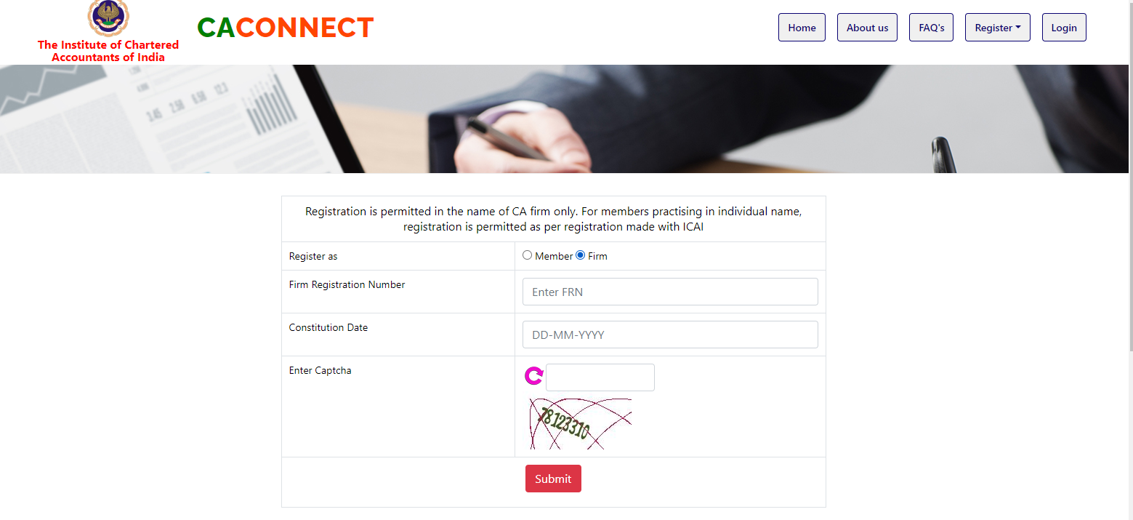

Slide 12
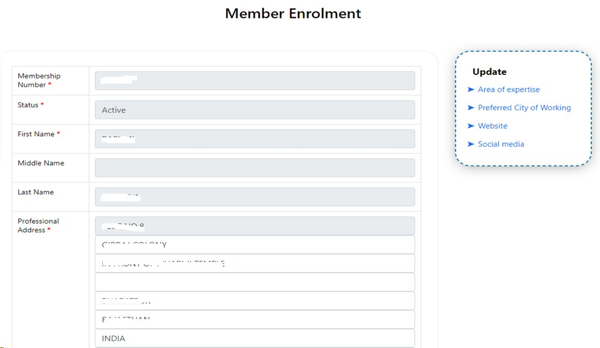

Slide 13
“CA Connect” Registration-After login
There will be additional optional fields for members to update:
Area of Specialization
Professional City of Working,
Website Address,
Social Media Address,
Declaration – to be furnished Online

Slide 14
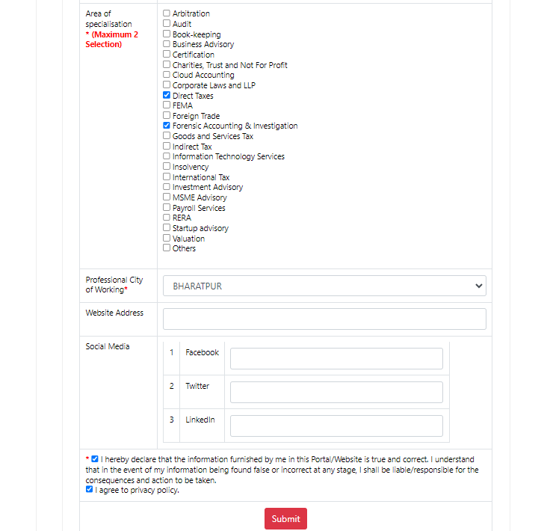

Slide 15
“CA Connect” Registration
Additional field for Firms only
Additional field to be updated by Firms
Network of CA Firms
Firms may specify if willingness to join Network of CA firm
State preferred city and Preferred area of practice for networking

Slide 16
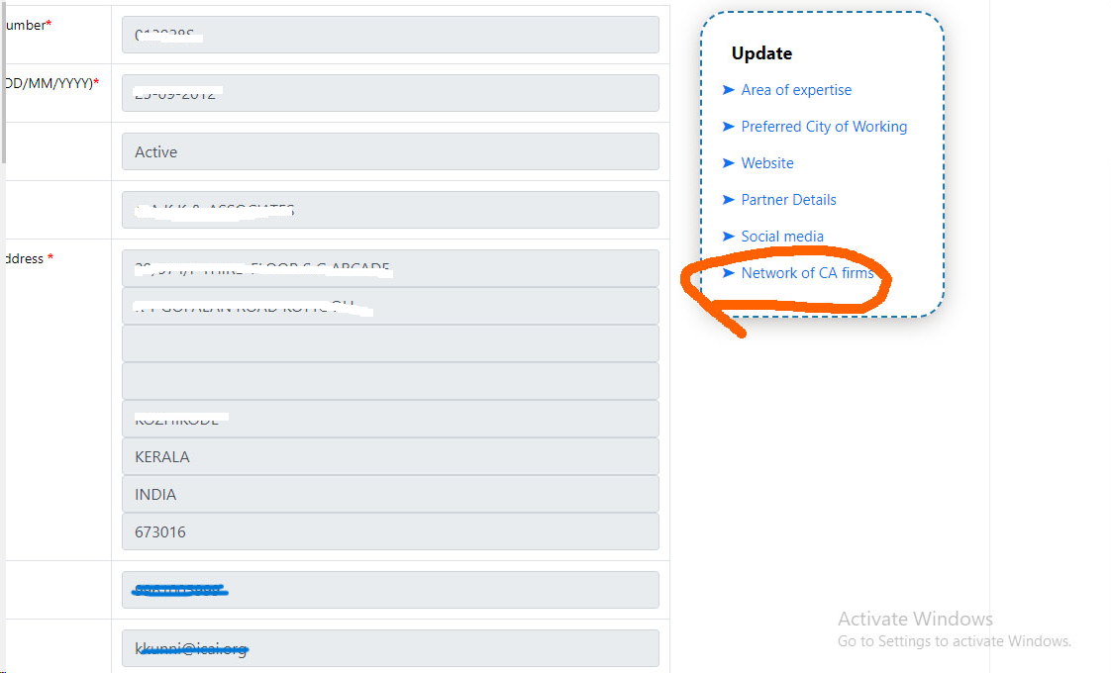

Slide 17
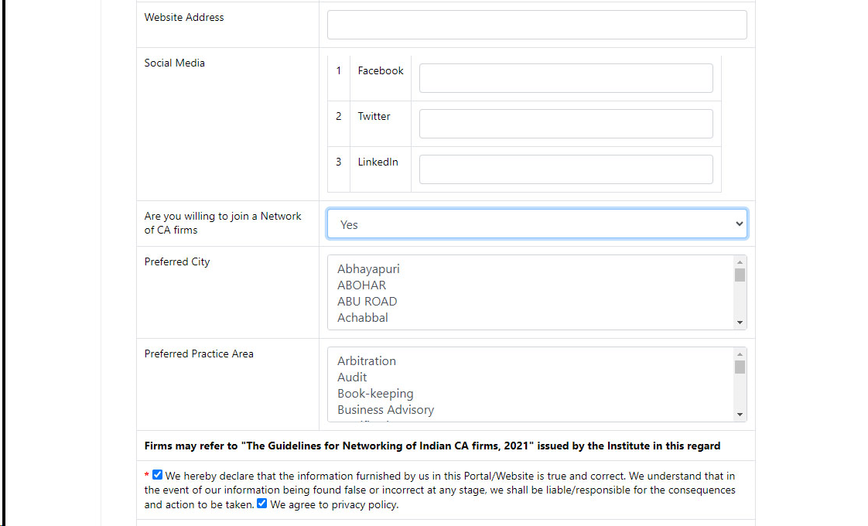

Slide 18
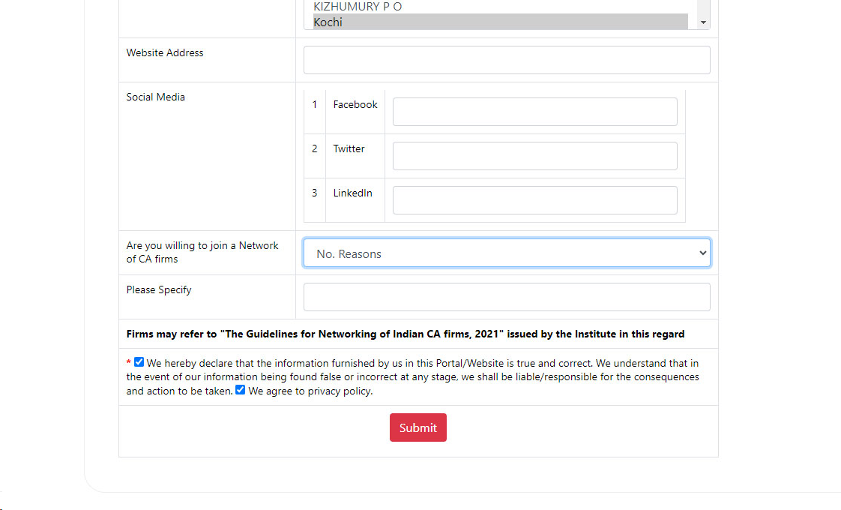

Slide 19
“CA Connect”
Functionality: area of specialization
Sole Proprietor / Member: Select maximum
Two Areas of Specialization
For Partnership Firm / LLP: Select maximum Two Areas of Specialization per partner.

Slide 20
“CA Connect” Functionality: Preferred City of Working
Preferred
One City or
Maximum Two Cities
of Working
Should be Selected

Slide 21
“CA Connect” Functionality:
If Member in practice registered on the portal as an Individual Member
Then the firm wherein such member is a partner cannot register on Portal

Slide 22
CRITERIA OF SEARCH
City-wise:
Location of CA Office
Service-wise:
Nature of services offered by CA
State wise

Slide 23


Slide 24
“CA Connect”
How to search on Portal by Stakeholders
Service seekers are required to select state
City
Professional Services
To fetch the details such as mobile number and Email id of members/firm- Service seekers should register as Guest User

Slide 25
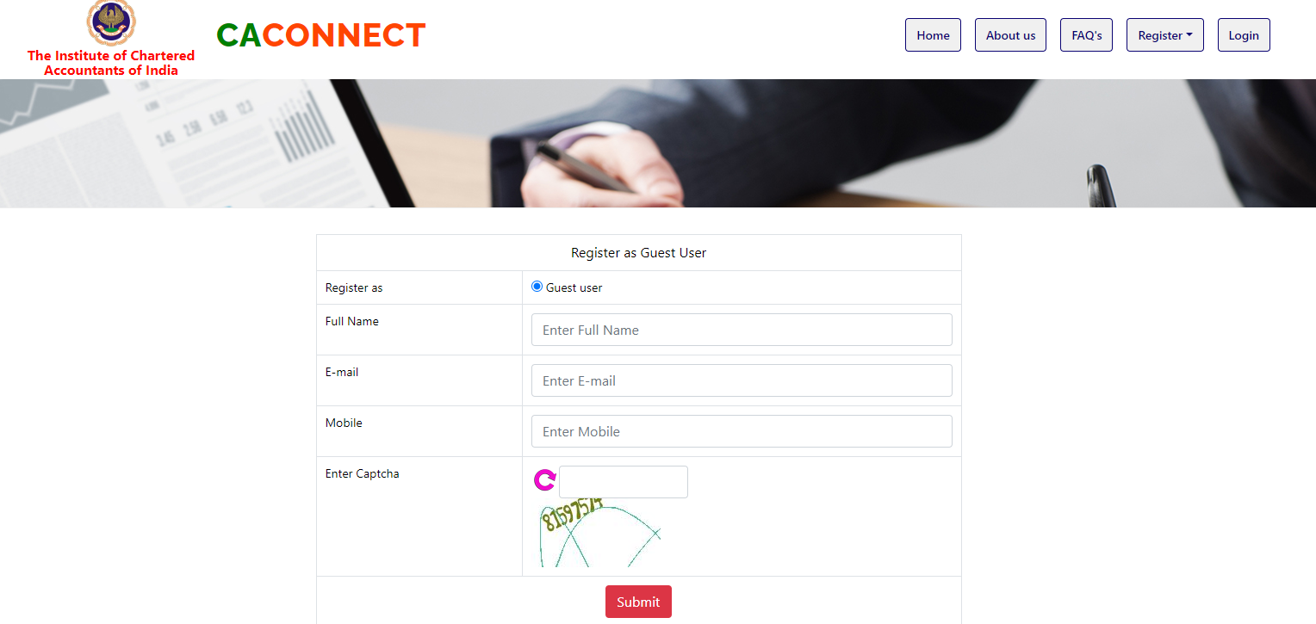

Slide 26
“CA Connect”
Portal : An addition permitted platform
Portal is in addition to, permitted platforms i.e :-
Firm’s Website
Listing on directory
Advertisement of Services
Online consultancy on third party Platforms
Own Website: Practicing CA Firms are Permitted to have it

Slide 27
“CA Connect” - Role of ICAI
Role of ICAI is of a Facilitator
ICAI enables search to Prospective Clients: City-wise and Subject-wise

Slide 28
“CA Connect” REIGISTER NOW
An innovative platform fostering Visibility & Growth
Showcasing Capabilities to Prospective Clients
Enhance Digital Presence

Slide 29
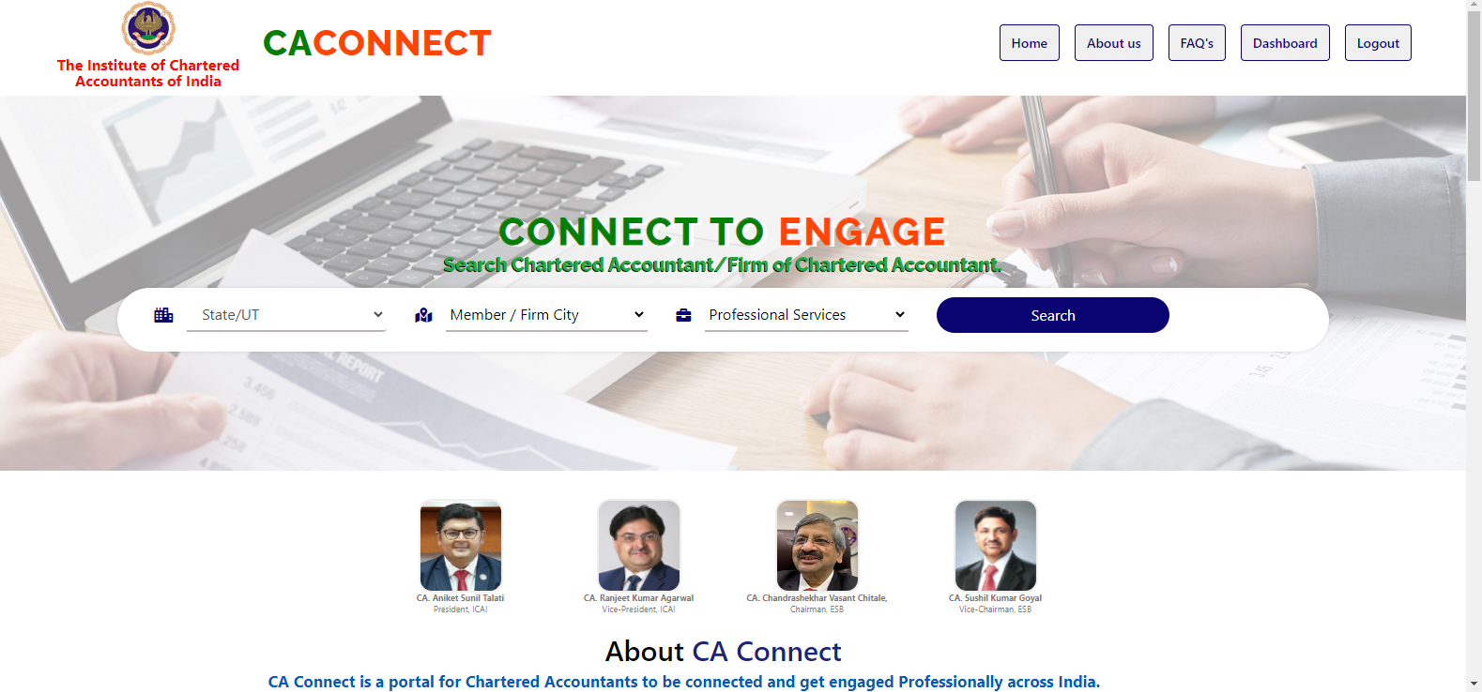

Slide 30
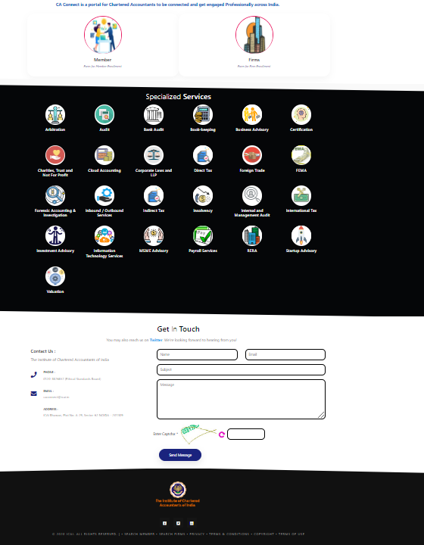

Slide 31
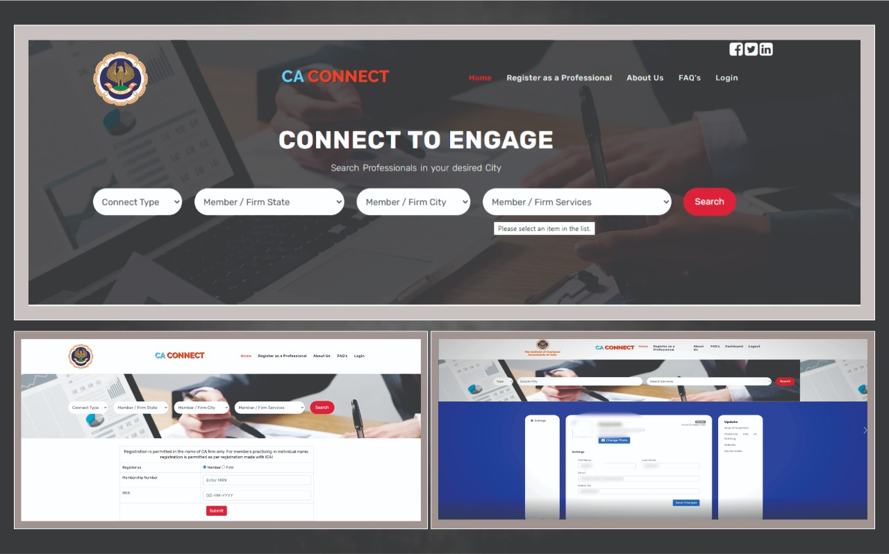
Slide title 29

Slide 32
ESB – Proposals for “CA Connect”
Increase Population of Proprietary, firms, LLP of Practicing Chartered Accountants on: ls for “CA Connect”
Widely advertise in India “CA Connect”
Go GLOBAL for “CA Connect”

Slide 33
ESB Well-comes U
“CA Connect”
Enroll Now
Open Vista of New Opportunities for
New Clients and Networking

Slide 34
Thank You
Ethical Standards Board

