Slide 1
VALUATION OF SHARE & SECURITIES
Institute of Chartered Accountants of India- EIRC
DATED 04-01-2024, THRUSDAY
CA MANISH GADIA
B.COM, FCA, DISA(ICAI), RV-SFA(IBBI)
REGISTERED VALUER (IBBI)
E: manish@jmpassociates.com
M- 98303 28772

Slide 2
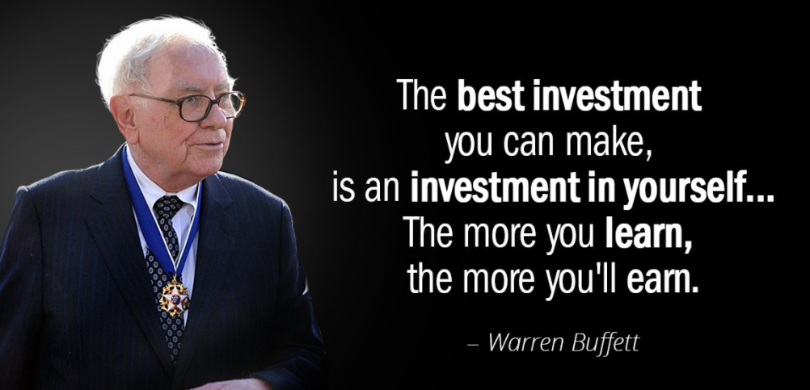
CA MANISH GADIA- REGD. VALUER (IBBI)

Slide 3
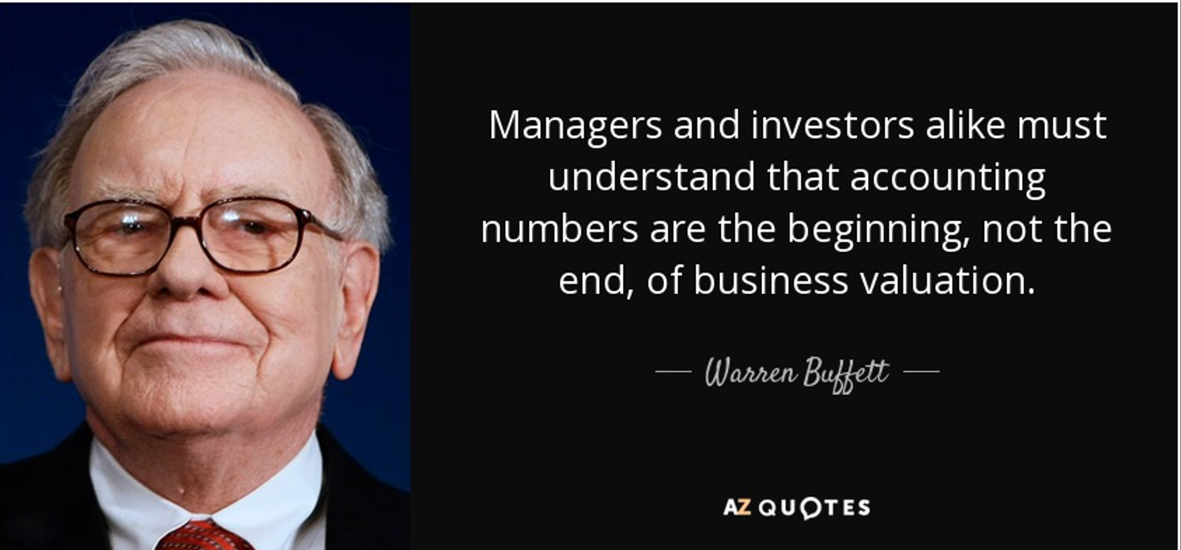

Slide 4
“The value of a business is a function of how well the financial capital and the intellectual capital are managed by the human capital. You'd better get the human capital part right.”
― Dave Bookbinder, The NEW ROI: Return on Individuals:
Dave

Slide 5
LEARNINGS (ROTI)
VALUATION – DIFFERENCE BETWEEN PRICE & VALUE,
VALUATION IS ART OR SCIENCE
REGISTERED VALUER
DIFFERENT PURPOSES OF VALUATION
KEY FACTORS THAT AFFECTS VALUATION
COMPLEXITIES IN VALUATION OF SHARE & SECURITIES
STEPS TO BE TAKEN CARE IN VALUE INVESTING
DIFFERENT VALUATION APPROACH
KEY FACTORS WHICH AFFECTS INCOME APPROACH VALUATION
VALUATION OF UNQUOTED EQUITY SHARES FOR FURTHER ISSUE OF SHARES
IMPORTANT Q & A
VALUATION FOR TRANSFER OF SHARE & SECURITIES
IMPORTANT Q & A

Slide 6
VALUATION – MOST COMPLICATED AND OFTEN MOST MISUNDERSTOOD PART OF THE ECONOMY
Valuation is an
analytical process of
estimating or determining the
market value or current worth of a
financial assets of a
business enterprise or individual.
CA MANISH GADIA, REGISTERED VALUER (IBBI) M 98303 28772 E: manish@jmpassociates.com

Slide 7
  It arises at the early stage of any transaction, strategy review, decision making or settlement of disputes.
The goal of valuation is to estimate what a reasonable person might pay or receive for a particular asset under specific circumstances.
CA MANISH GADIA, REGISTERED VALUER (IBBI) M 98303 28772 E: manish@jmpassociates.com

Slide 8
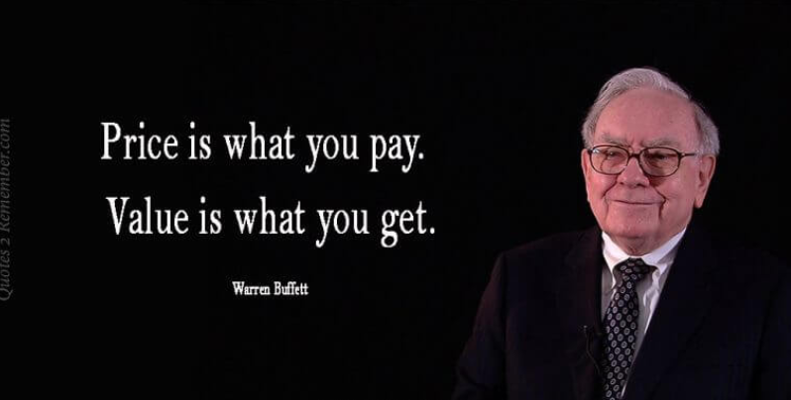

Slide 9
DIFFERENCE BETWEEN VALUE AND PRICE
PRICE IS WHAT YOU PAY AND VALUE IS WHAT YOU GET. - Warren Buffet
PRICE: Amount at which particular assets is bought or sold in an open market.
VALUE : Worth of an assets in normal circumstances or the amount at which it should be exchanged.
Example : water bottle, motorboat, neighbourhood office or home, painting by MF Hussain
CA MANISH GADIA, REGISTERED VALUER (IBBI) M 98303 28772 E: manish@jmpassociates.com

Slide 10
VALUATION – ART OR SCIENCE
Science is the effort to discover and increase human understanding of HOW the physical world works through controlled methods.
Art refers to a diverse range of human activities, creation and expression that are appealing to the human senses or emotions.
A craft is a skill that you learn by doing. The more you do it, the better you get at it. Valuation is a craft. - A. Damodaran
In the valuation process, valuer values the organisation by using the technology, applying different methods, approach of valuation ( part of science) and
Valuer uses his own experience, assumption and expectation in taking various decision (part of art).
CA MANISH GADIA, REGISTERED VALUER (IBBI) M 98303 28772 E: manish@jmpassociates.com

Slide 11
REGISTERED VALUER
Section 247(1) of the companies act, 2013 (Act) provides:
Valuation of property, stock, shares, debentures, securities, goodwill or other assets/
liabilities/ net worth of a company under the act
To be done by a registered valuer (RV) having such qualification and experience as may be
prescribed
Appointed by Audit Committee or in its absence the board of directors of that company
Section 247(2) – The valuer appointed under sub-section (1) shall
Make an impartial, true and fair valuation; (ITF)
Exercise due diligence while performing the function as valuer; (DD)
Make the valuation in accordance with such rules as may be prescribed (RULES)
CA MANISH GADIA, REGISTERED VALUER (IBBI) M 98303 28772 E: manish@jmpassociates.com

Slide 12
Not undertake valuation of any assets in which he has a direct or indirect interest. or
becomes so interested at any time during or after the valuation of assets. ("during a period
of three years prior to his appointment as valuer or three years after the valuation of assets
was conducted by him“)
Section 141(3)(d) deals with ineligibility of the auditor – A person who, or his relative or partner:
Is holding any security of or interest in the company or its subsidiary or of its holding or associate company..
The relative may hold security or interest in the company of face value not exceeding one lac Rupees
A person who directly or indirectly renders any services referred to in section 144
CA MANISH GADIA, REGISTERED VALUER (IBBI) M 98303 28772 E: manish@jmpassociates.com

Slide 13
DUTIES AND LIABILITY OF VALUER
(3) If a valuer contravenes the provisions of this section or the rules made thereunder, the valuer shall be punishable with fine which shall not be less than twenty-five thousand rupees but which may extend to one lakh rupees: (25k TO 100k)
Provided that if the valuer has contravened such provisions with the intention to defraud the company or its members, he shall be punishable with imprisonment for a term which may extend to one year (1YEAR) and with fine which shall not be less than one lakh rupees but which may extend to five lakh rupees. (1 LAC TO 5 LAC)
(4) Where a valuer has been convicted under sub-section (3), he shall be liable to—
(i) refund the remuneration received by him to the company; and
(ii) pay for damages to the company or to any other person for loss arising out of incorrect or misleading statements of particulars made in his report.
CA MANISH GADIA, REGISTERED VALUER (IBBI) M 98303 28772 E: manish@jmpassociates.com

Slide 14
PURPOSE OF VALUATION OF SHARE & SECURITIES-
SAME BUSINESS HAS DIFFERENT VALUE BASED ON DIFFERENT PURPOSES.
      A single valuation can not serve more then one purpose : -
Investment Decision Making:
Mergers and Acquisitions (M&A):
Financial Reporting and Accounting:
Risk Assessment:
Capital Budgeting:
Financial Planning and Strategy:
Shareholder Value Maximization:
Corporate Finance:
Legal and Regulatory Compliance:
Employee Stock Options & sweat share issue:
CA MANISH GADIA, REGISTERED VALUER (IBBI) M 98303 28772 E: manish@jmpassociates.com

Slide 15
PURPOSE OF VALUATION OF SHARE & SECURITIES
Business Valuation
Regulatory
Financial Reporting
Intangible Valuation
  Restructuring
  Purchase/Sale of Shares & Business
  Litigation & Family Settlement
  Fund Raising
  FEMA
  Income Tax Act
  SEBI Regulation
  Companies Act
  Purchase Price Allocation
  PE/Venture Capital Fund
  Financial Instruments
  Ind AS Reporting/Fair Value
  Purchase/Sale
  Hypothecation
  Accounting for Purchase
  Impairment
CA MANISH GADIA, REGISTERED VALUER (IBBI) M 98303 28772 E: manish@jmpassociates.com

Slide 16
KEY FACTORS WHICH AFFECTS THE VALUATION OF SHARE AND SECURITIES
Earnings and Profitability:
Market Conditions:
Industry and Sector Performance:
Future Growth Prospects:
Company Size and Scale:
Dividend Yield:
CA MANISH GADIA, REGISTERED VALUER (IBBI) M 98303 28772 E: manish@jmpassociates.com

Slide 17
Book Value:
Management Quality and Governance:
Market Sentiment:
Regulatory Environment:
Global and Geopolitical Factors:
CA MANISH GADIA, REGISTERED VALUER (IBBI) M 98303 28772 E: manish@jmpassociates.com

Slide 18
COMPLEXITIES IN VALUATION OF SHARE & SECURITIES
BIASNESS - information asymmetry, behaviour factors
UNCERTAINITIES- Future prospects, regulatory changes, Technological Changes, cyclical and seasonal effect, market dynamics
COMPLEXITIES- subjectivity and assumption and approaches, global factors
CA MANISH GADIA, REGISTERED VALUER (IBBI) M 98303 28772 E: manish@jmpassociates.com

Slide 19
STEPS TO BE TAKEN CARE IN VALUE INVESTING
VALUE INVESTING IS SIMPLE BUT NOT EASY - WARRANT BUFFET
1) KNOWLEDGE/HARD WORK
2) DISCIPLINE
3) COURAGE
4) PATIENCE
CA MANISH GADIA, REGISTERED VALUER (IBBI) M 98303 28772 E: manish@jmpassociates.com

Slide 20
VALUATION MYTHS
That business should be valued only when it is required to be sold
Valuation provides a precise value of share & securities
No need for outside valuer, the owner can value their business themselves.
Comparison with local competitor
No valuation in case of loss in business
Valuer uses specific formula for valuation
Valuation depends on good negotiation power
A single Valuation can serve purpose for long term.
Valuation is worthless as it involves lot of assumption
CA MANISH GADIA, REGISTERED VALUER (IBBI) M 98303 28772 E: manish@jmpassociates.com

Slide 21


Slide 22
DIFFERENT APPROACH AND METHODS FOR VALUATION
  Asset Approach
        Net Asset Value method (NAV)
        Sum of Part valuation (SPV)
        Liquidation Value (LV)
  Market Approach
        Market Price method (MPM)
        Comparable Companies Multiple Method (CCM)
        Comparable Transaction Multiple Method (CTM)
  Income Approach (Intrinsic Approach)
        DCF method
              Free cash flows to firm
              Free cash flow to Equity
Any other method accepted or notified by the RBI, SEBI or Income tax authorities
Any other method that Valuer may deem fit provided adequate justification for use of such method is prescribed
CA MANISH GADIA, REGISTERED VALUER (IBBI) M 98303 28772 E: manish@jmpassociates.com

Slide 23
Factors to be considered while doing DCF Method Valuation
Cash Flow Projections:
Discount Rate (Cost of Capital): Depends on company's risk profile, market conditions, and the specific project or investment. WACC
Terminal Value: Gordon’s Growth Model
Time Horizon:
Risk Factors:
Discount Period:
Working Capital and Capital Expenditures:
Tax Implications:
Consistency and Realism:
Sensitivity Analysis:

Slide 24
FCFF is the cash available to both equity and debt holders, while FCFE is the cash available only to equity holders after accounting for debt-related items and capital expenditures. Both metrics are crucial in financial analysis and valuation, providing insights into a company's ability to generate cash and its capacity to reward its investors.
FCFF
FCFE
DCF Method of Valuation
Discounting Rate
FCFF- WACC
FCFE - Ke

Slide 25
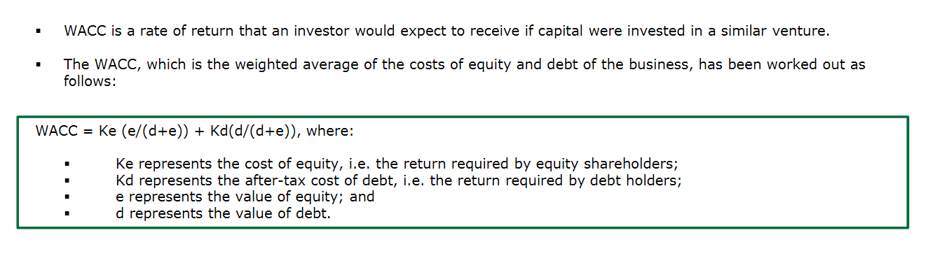
Discount Rate – WACC & Ke

Slide 26
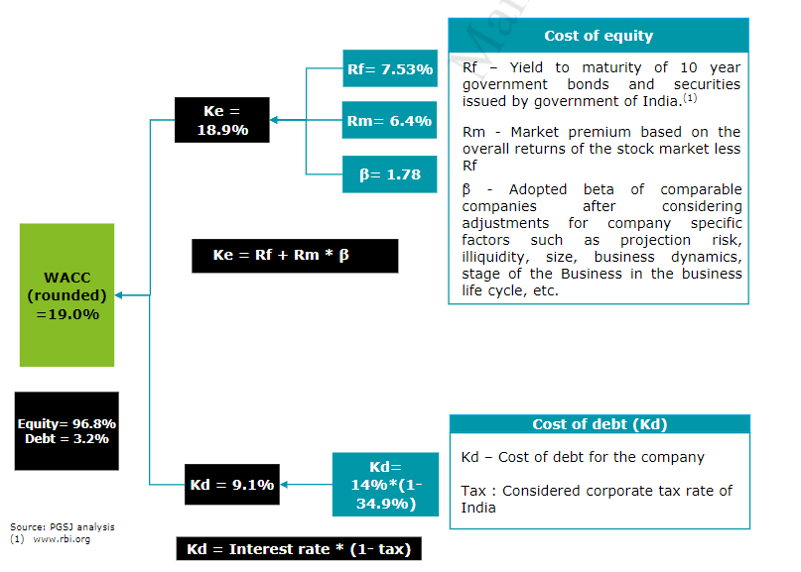

Slide 27
JUDICIAL PRONOUNCEMENTS
“It is not possible for a court to go into the exercise of carrying out a valuation itself. Courts do not have the expertise, the time or the means to do this. I do not believe that they are expected to do it. What the court’s approach must be to examine whether or not a valuation report is demonstrated to be so unjust, so unreasonable and so unfair that it could result and result only in a manifest and demonstrable, inequity or injustice. This injustice must be shown to apply to a class.”
“No valuation is to be disregarded merely because it has used one or the other of various methods. It must be shown that the chose method of valuation is such as has resulted in an artificially depressed or contrived valuation well below what a fair-minded person may consider reasonable.”
Cadbury India Limited Vs Mrs Malati Samant and
Mr. Alok C Churiwala (Samant Group and Churiwalal Group) (2014) (Bom HC)
CA MANISH GADIA, REGISTERED VALUER (IBBI) M 98303 28772 E: manish@jmpassociates.com

Slide 28
VALUATION OF UNQUOTED EQUITY SHARES FOR FURTHER ISSUE OF SHARES

Slide 29
Valuation of Unquoted Equity Share
Further issue of Share –
Sec 56(2)(viib)/ Rue 11UA(2)
Transfer of Share – Sec 50CA & 55(2)(x)/Rule 11UA(1)

Slide 30
VALUATION ON FURTHER ISSUE OF SHARE CAPITAL
Under Income tax Act as per Section 56 (2) (viib) – whichever is higher
Under Companies Act as per Section 62(1)(c)
As per rule 11UA(2)
Based on the Value of the Assets of the Company including intangible assets – Valuation by CA
Valuation by A Regd. Valuer (IBBI) as per Following Method
By NAV or Cost Method
NAV Method (A-L)/No. of Share– Valuation by a Chartered Accountant
By Market Approach Method
DCF Method- Valuation by A Merchant Banker Cat I
By DCF Method – FCFF/FCFE

Slide 31
VALUATION FOR FURTHER ISSUE OF SHARES & SECURITIES
Particulars | Section 56(2)(viib) | Section 62 (1)(c) of the Companies Act | FEMA
Applicable to | Closely held company | Closely held company | all companies
a) Right Issue | FMV Under rule 11UA(2) Book Value/NAV (CA/MB) B) DCF (only by MB) | Not required | valuation not required if price is same what is issued to resident SH. If relinquished by Existing SH, then valuation is required.
b) Private Placement of share | FMV Under rule 11UA(2) NAV or (i) Book Value (CA/MB) (ii) DCF (only by MB) Whichever is higher | Fair Value by Registered Valuer | valuation required. Internationally accepted pricing methodology (CA)
Valuation Applicable from | From 1st April, 2013 | 1st Feb, 2019
Tax | Income in the hand of the company if issued at more then its FMV | NA | NA

Slide 32
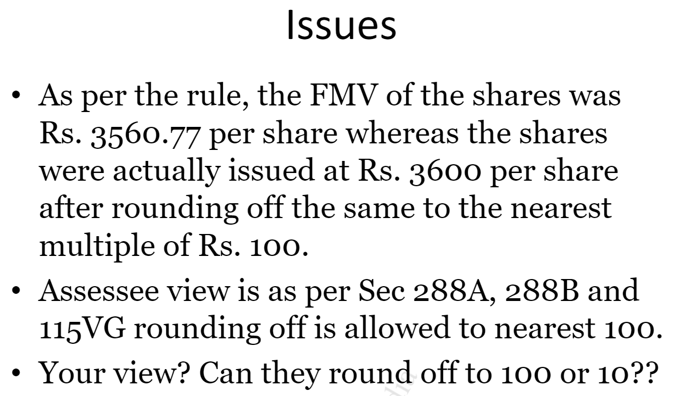

Slide 33
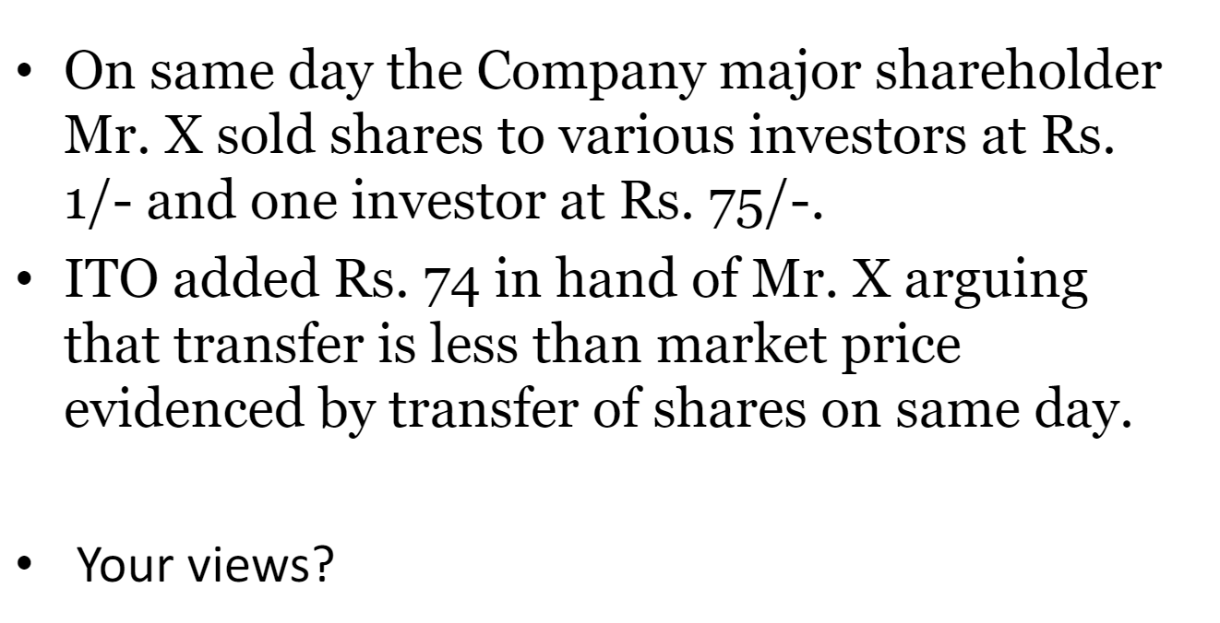

Slide 34
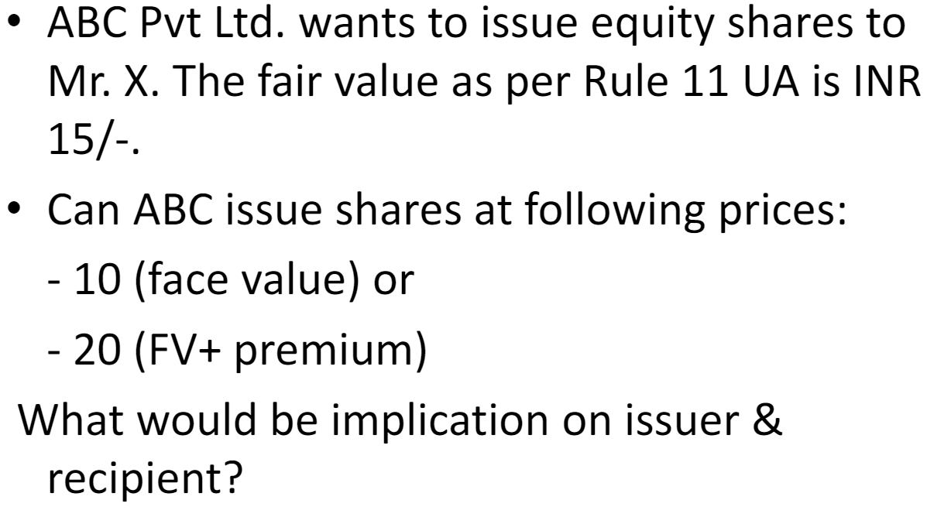

Slide 35
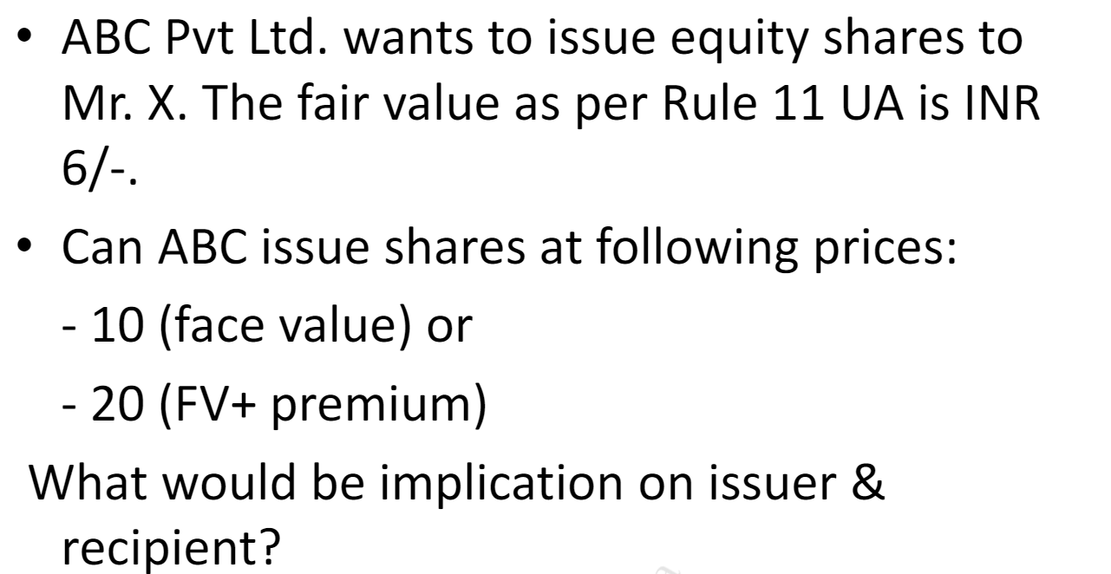

Slide 36
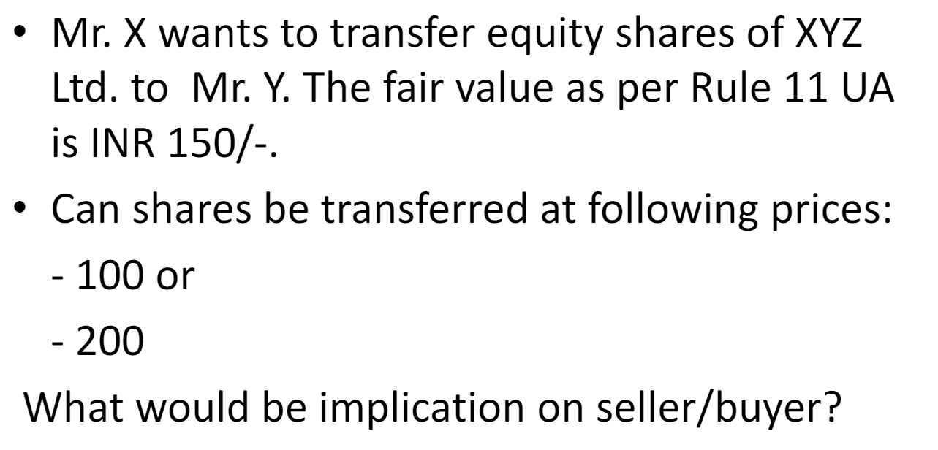

Slide 37
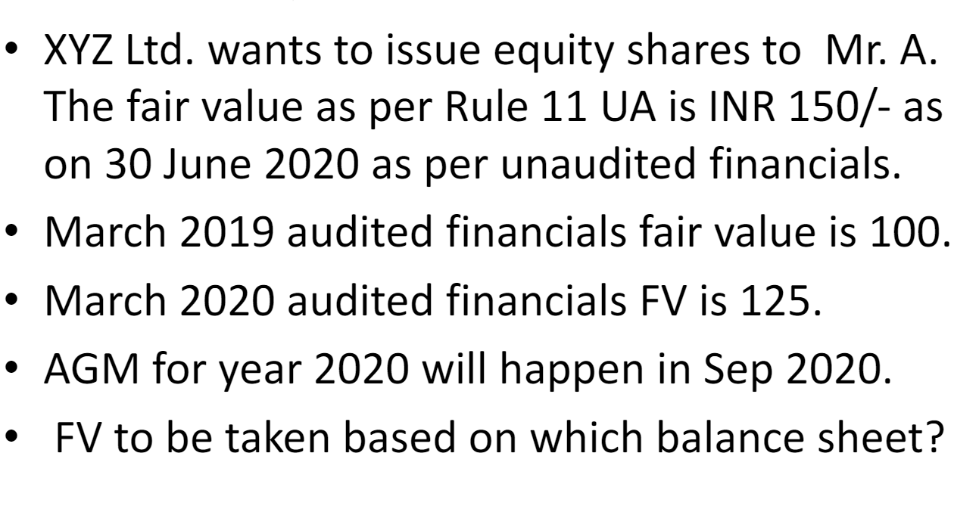

Slide 38
Valuation as per Rule 11UA(2) - Rs. 100 (Book Value )
Valuation under Co. Act 62(1)(c) - Rs. 500 (DCF Method)
Can Company issue share at Rs. 500
Whether Valuation report required under Income Tax Rule
Your View

Slide 39
Valuation as per Rule 11UA(2) - Rs. 500 (DCF Method )
Valuation under Co. Act 62(1)(c) - Rs. 600 (DCF Method)
Can Company issue share at Rs. 600
Your View

Slide 40
Q & A

Slide 41
COMMON QUESTIONS FACED DURING VALUATION AS PER RULE 11UA(2)
1. When valuation is not required for further issue of shares? Exemption
2. In case company issuing shares at book value, is valuation required?
3. Can a Chartered accountants issue DCF Method valuation?
4. Can shares be issued at more then DCF value?
5. Can share issued to existing share holder in disproportion to their existing
share in case of right issue
6. Can rounding off of share be done?
7. Which method to follow, DCF, NAV or Book Value method?

Slide 42
ABC PVT. LTD.
EXAMPLE
Liabilities | Amount | Assets | Amount
Share Capital |  | Assets
Ram (50000 SH @ Rs. 10 each) | 500000 | Land & Building | 10000000
Lakshman (50000 SH @ Rs. 10 each) | 500000
Reserve & Surplus | 9000000
Total | 10000000 | Total | 10000000
Transaction 1 (further issue of share)
ABC Pvt. Ltd. issued 10000 Share @ 200/- TO GOPAL OF Rs. 2000000/-
In this case, section 56(2)(viib) will apply in the hand of the company if the issue price is more then the fair market value.
CA MANISH GADIA, REGISTERED VALUER (IBBI) M 98303 28772 E: manish@jmpassociates.com

Slide 43
VALUATION ON FURTHER ISSUE OF SHARE CAPITAL : Section 56 (2) (viib)
If a closely held company raises funds through the issuance of its shares to an Indian resident AT A PRICE MORE than its fair market value (FMV), then the amount received in excess of fair market value of shares will be charged to tax as an income from other sources in the hands of the issuer.
Where a company, not being a company in which the public are substantially interested, receives, in any previous year, from any person being a resident, any consideration for issue of shares that exceeds the face value of such shares, the aggregate consideration received for such shares as exceeds the fair market value of the shares:
Explanation. – For the purposes of this clause,—
the fair market value of the shares shall be the value—
(i) as may be determined in accordance with such method as may be prescribed; rule 11UA(2) or
(ii) as may be substantiated by the company to the satisfaction of the Assessing Officer, based on the value, on the date of issue of shares, of its assets, including intangible assets being goodwill, know-how, patents, copyrights, trademarks, licences, franchises or any other business or commercial rights of similar nature,
Whichever is higher
CA MANISH GADIA, REGISTERED VALUER (IBBI) M 98303 28772 E: manish@jmpassociates.com

Slide 44
FURTHER ISSUE OF SHARE CAPITAL
This clause shall NOT apply where the consideration for issue of shares is received—
by a venture capital undertaking from a venture capital company or a venture capital fund; or
    Venture capital company, ―venture capital fund and ―venture capital undertaking shall have the meanings respectively assigned to them in clause (a), clause (b) and clause (c) of ¹[Explanation] to clause (23FB) of section 10;]
by a company from a class or classes of persons as may be notified by the Central Government in this behalf. *
*Notification 24/2018 dated 24 May 2018 read with notification GSR 364(E) subject to fulfilment of specified condition
(Eligible startup for the purpose of deduction under section 80-IAC)
CA MANISH GADIA, REGISTERED VALUER (IBBI) M 98303 28772 E: manish@jmpassociates.com

Slide 45
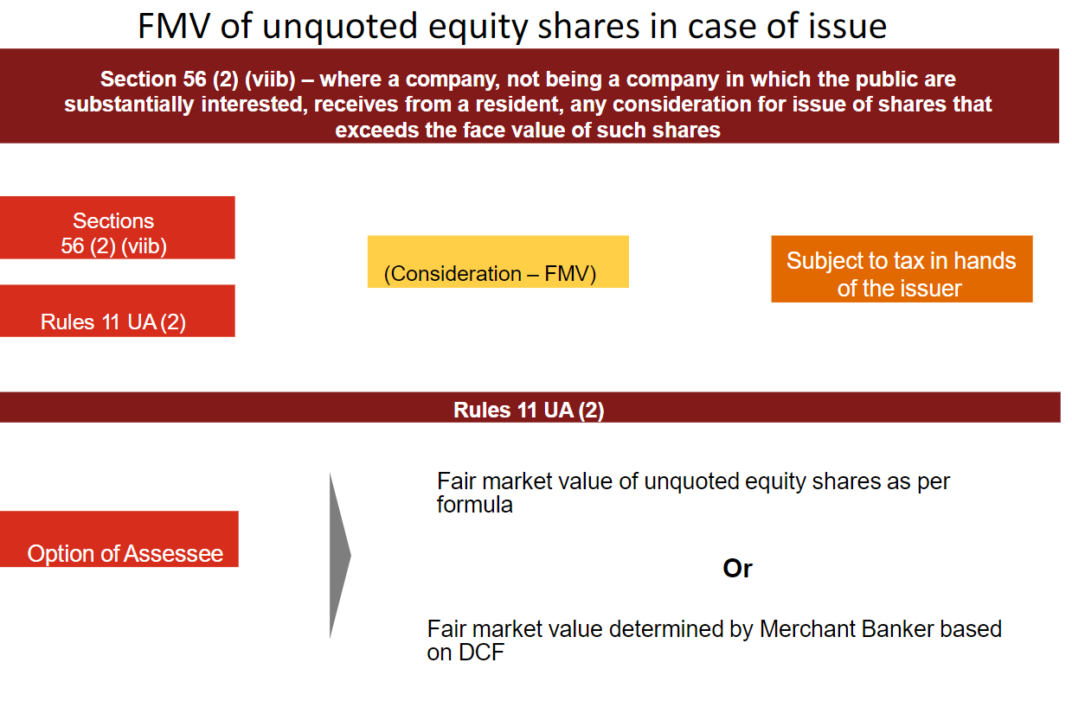

Slide 46
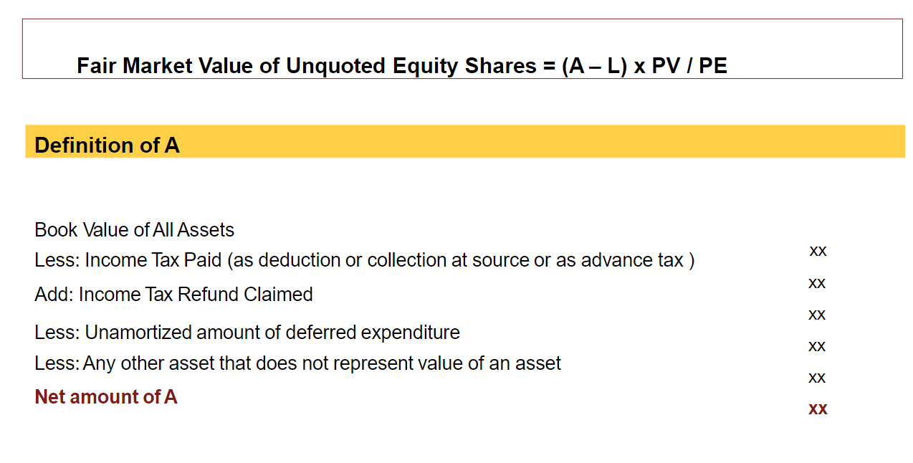

Slide 47
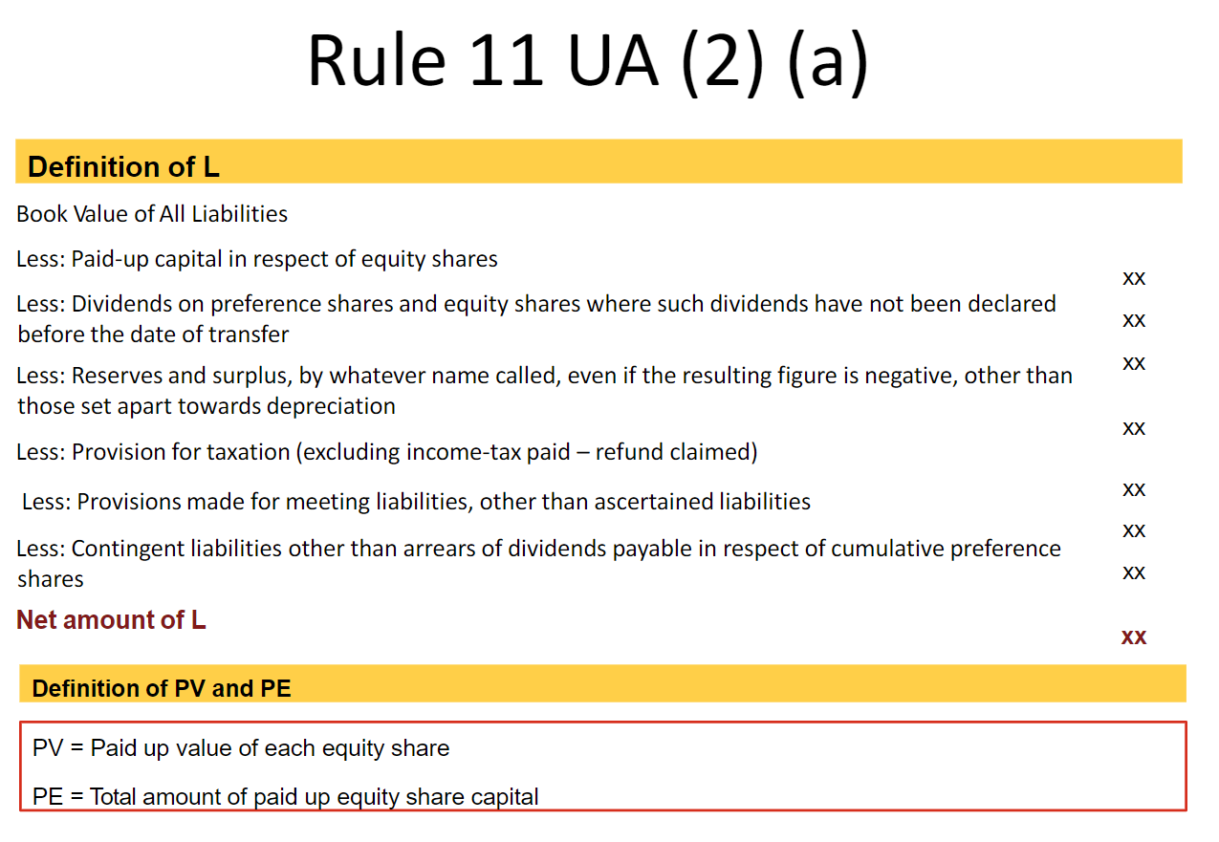

Slide 48
PRESCRIBED METHODS FOR VALUATION OF UNQUOTED SHARES ON ISSUE OF SHARE AS PER RULE 11UA(2)
The fair market value of unquoted equity shares for the purposes of clause (viib) of sub-section (2) of section 56 shall be the value, on the valuation date, of such unquoted EQUITY SHARES as determined in the following manner under clause (a) or clause (b), at the option of the assessee, namely
(a) the fair market value of unquoted equity shares = (A-L)/PE*PV
Where
A= book value of the assets in the balance-sheet as REDUCED by any amount of tax paid as deduction or collection at source or as advance tax payment as REDUCED BY THE AMOUNT OF TAX CLAIMED AS REFUND under the Income-tax Act and any amount shown in the balance-sheet as asset including the unamortised amount of deferred expenditure which does not represent the value of any assets
L= book value of liabilities shown in the balance-sheet, but not including the following amounts,

Slide 49
the paid-up capital in respect of equity shares;
the amount set apart for payment of dividends on preference shares and equity shares where such dividends have not been declared before the date of transfer at a general body meeting of the company;
reserves and surplus, by whatever name called, even if the resulting figure is negative, other than those set apart towards depreciation;
any amount representing PROVISION FOR TAXATION, other than amount of tax paid as deduction or collection at source or as advance tax payment as reduced by the amount of tax claimed as refund under the Income-tax Act, TO THE EXTENT OF THE EXCESS OVER THE TAX PAYABLE with reference to the book profits in accordance with the law applicable thereto;
any amount representing provisions made for meeting liabilities, other than ascertained liabilities;
any amount representing contingent liabilities other than arrears of dividends payable in respect of cumulative preference shares;
PE = total amount of paid up equity share capital as shown in the balance-sheet
PV = the paid up value of such equity shares;
    OR
(b) the fair market value of the unquoted equity shares determined by a merchant banker ²[***] as per the Discounted Free Cash Flow method.
Earlier, a Chartered Accountant was also permitted to determine the FMV of such equity shares as per DCF method. However, with effect from 24th May 2018, this right of Chartered Accountant is taken away and therefore only Merchant Banker is authorised to determine the FMV of such equity shares under DCF method.

Slide 50
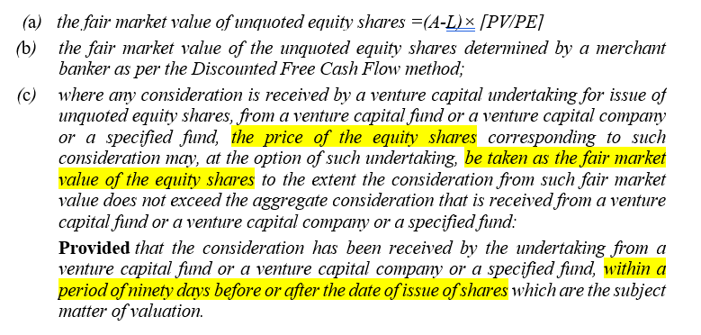
²[(2) Notwithstanding anything contained in sub-clause (b) or sub-clause (c), as the case may be, of clause (c) of sub-rule (1):—

Slide 51
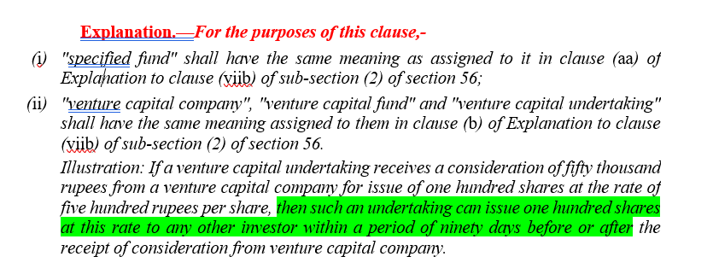

Slide 52
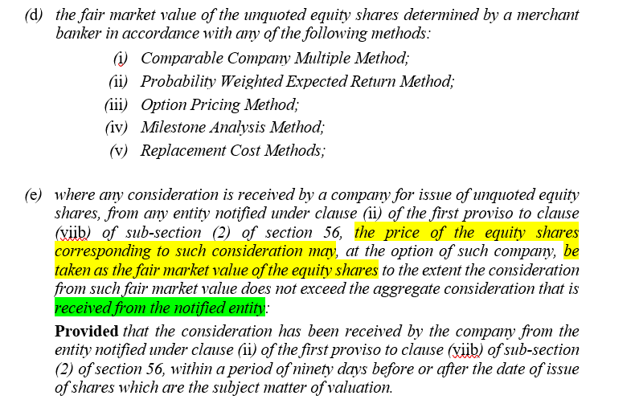

Slide 53
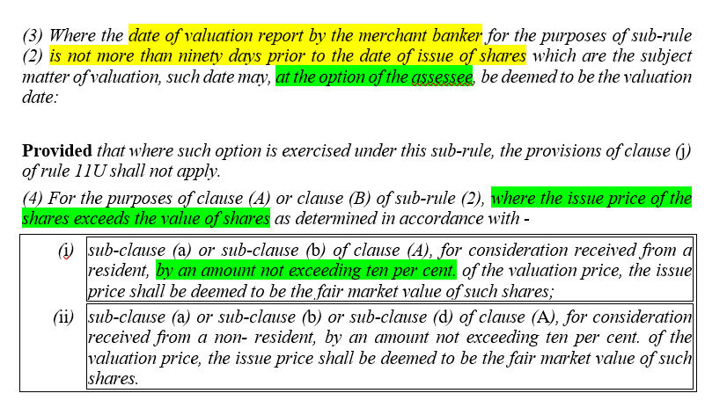

Slide 54
RULE FOR VALUATION OF PREFERENCE SHARES
Rule 11UA(2) which is specifically applicable for the valuation of shares for the purpose of section 56(2)(viib) covers only unquoted equity shares within its ambit and there is no reference to the preference shares. Thus, the only method for determining the FMV of the preference share is Rule 11UA(1)(C)(C) which is reproduced below:
“the fair market value of unquoted shares and securities other than equity shares in a company which are not listed in any recognized stock exchange shall be estimated to be price it would fetch if sold in the open market on the valuation date and the assessee may obtain a report from a merchant banker or an accountant in respect of such valuation.”
CA MANISH GADIA, REGISTERED VALUER (IBBI) M 98303 28772 E: manish@jmpassociates.com

Slide 55
VALUATION OF QUOTED SHARES AS PER RULE 11UA(1)(C)(A)
QUOTED SHARES & SECURITIES UNDER RULE 11UA(1)(c)(a)
Received through SE
Other Mode
Transaction value on SE
Quoted on SE on transaction date
Not quoted on SE on transaction date
Lowest price on that date
Lowest price of last trade

Slide 56
RULES FOR UNQUOTED EQUITY SHARES
Issue u/s 56(2)(viib)
Transfer
Issuer
Receiver
Seller
Buyer
Sec 9(1)(i)
Sec 56(2)(viib) – whichever is higher
No specific Sec
50CA
56(2)(x)
Rule 11UB(2)
Asset based
Rule 11UA(2)
Rule 11UAA
Rule 11UA(1)
By CA or MB
RV/CA /MB
MB if DCF
Specified
Specified
IVSC
BV
No Valuer required
No Valuer required

Slide 57
VALUATION FOR TRANSFER OF SHARE & SECURITIES

Slide 58
Background
Finance Act, 2017 inserted two new provisions under the Income Tax Act - clause (x) under section 56(2) and section 50CA.
The said sections were inserted to deal with a situation where the property, including unquoted equity shares, are being transacted for inadequate consideration below the FMV of such property.
Section 56(2)(x) provided for taxability in the hands of the purchaser of property, including shares, the differential amount of consideration and FMV of such property.
Section 50CA of the Act, on the other hand, provide for the purpose of computing capital gains in the hands of the seller of the property being the unquoted equity shares, the FMV of the such property shall be considered the sales consideration in case it is less then the FMV.
Thus, in case of transaction involving transfer of unquoted equity shares, the aforesaid computational mechanism seeks to tax the same differential amount of consideration received and FMV of the unquoted equity shares in hands of Both Tax Payers i.e., the transferor and transferee.
It is further important to note that section 56(2)(x) has widened the scope of the provisions as the same becomes applicable for all taxpayers unlike provisions of clauses section (vii) and (viia) of section 56(2) of the Act which were applicable to selected taxpayers.
CA MANISH GADIA, REGISTERED VALUER (IBBI) M 98303 28772 E: manish@jmpassociates.com

Slide 59
Transfer or Sale of Unquoted Shares – Sec 50CA
When an owner of Unquoted share ("Shares") in a Company transfers the shares to any person, he is required to pay Capital Gain tax on the difference between the sale consideration received by him and the cost of acquisition of such shares (or the inflation indexed cost, wherever applicable).
It is important to check if the "Sale consideration" that he receives from the buyer is at least equal to or more than the "Fair Market Value" ("FMV") as defined under Rule 11UAA of The Income Tax Rules, of the shares sought to be transferred.
As defined under Rule 11UAA, the fair market value of unquoted equity shares shall be the value, on the valuation date, of such unquoted equity shares as determined in the manner provided in sub-clause (b) or sub-clause (c) of clause (c) of rule 11UA(1)
CA MANISH GADIA, REGISTERED VALUER (IBBI) M 98303 28772 E: manish@jmpassociates.com

Slide 60
SECTION 50CA
Where the consideration received or accruing
to an assessee
as a result of the transfer
of a capital asset,
being share of a company other than a quoted share,
is less than the fair market value of such share determined in such manner as may be prescribed, the value so determined shall be deemed to be the full value of consideration received or accruing as a result of such transfer.
CA MANISH GADIA, REGISTERED VALUER (IBBI) M 98303 28772 E: manish@jmpassociates.com

Slide 61
BACKGROUND OF SECTION 50CA
Prior to introduction of section 50CA, there was no mechanism to substitute the full value of consideration with the FMV of the unquoted shares of a company. Section 50C dealt with transfer of capital assets being land or buildings or both. To plug this loophole, section 50CA was introduced wef 1-4-2017.
There are lots of court decision also which might have triggered introduction of section 50CA.
Bhoruka Engineering Ind. Ltd. Vs DCIT (2013) 36 Taxmann.com 82 (Karnataka High Court) &
DCIT Vs Maya Appliances Pvt. Ltd. (2017) 82 taxmann.com 447 (Chennai Trib)

Slide 62
BHORUKA ENGINEERING IND. LTD. VS DCIT
The assessee held 98.73% shares in Bhoruka Financial Services Limited (BFSL). In AY 2005-06 BFSL purchased a plot of land from a group sick company called Bhoruka Steels Ltd for Rs.3.75 crores which was accepted to be the prevailing market price u/s 50C. BFSL was a shell company with no assets other than the said land. In AY 2006-07 the assessee sold its shareholding in BFSL to DLF Commercial Developers Ltd for a net consideration of Rs. 20 crore.
Though BFSL was a shell company with no asset other than the land and by buying the shares of BFSL, DLF in effect purchased the land, the transaction cannot be said to a sham or an unreal one. In coming to the conclusion that the transaction is a colourable devise, the authorities have been carried away by the fact that the assessee was able to avoid payment of income tax. The assessee did resort to tax planning and took advantage of the law/ loopholes in the law. After seeing how the loophole was exploited within the four corners of the law, it is open to Parliament to amend the law plugging the loophole. However it cannot be done by judicial interpretation. S. 10(38) of the Act is unambiguous. If the share holder chooses to transfer the lands through a transfer of the shares of the company owning the land, it would be a valid legal transaction in law and cannot be said to be a colourable devise or a sham merely because tax is avoided thereby (McDowell 154 ITR 148 (SC), Azadi Bachao Andolan 263 ITR 706 (SC) & Vodafone International 341 ITR 1 (SC) referred)

Slide 63
DCIT VS MAYA APPLIANCES PVT. LTD
In this case, the main contention of the ld.A.R is that the provisions of the section 50C does not attract to the transactions, which are not registered with the Stamp Duty Valuation Authority and there was no direct transfer of land and building or both.
In the present case, the assessee company, sold the shares of M/s.General Wood Industries (P) Ltd., at its prevailing book value to the following persons:- Mr.T.T.Varadarajan 50% -12,000 shares at `100 - `12 lakhs Mrs.Maya Varadarajan 50% -12,000 shares at `100 - `12 lakhs
Thus, the ownership of the company viz. M/s.General Wood Industries (P) Ltd., now owned by the above two persons jointly.
According to ld. Assessing Officer, the assessee sold the actual land and building in the guise of sale of shares to the above persons and the provisions of the section 50C of the Act is applicable, though the properties are not registered with the Stamp Valuation Authority.
In the instant case, what was transferred by the assessee, even the shares in M/s.General Wood Industries (P) Ltd., and not the land and building or both.
The assets transferred being the shares, which was never part of ITA No.2677/14 :- 14 -: assessment of Stamp Duty Authority of the State Government. In such circumstances that cannot be any question of invoking the provisions of the section 50C of the Act as there is no direct transfer as enumerated in Sec.50C of the Act r.w.s 2(47) of the Act. Being so, Ld.CIT(A) had taken a correct view of the facts of the case by placing reliance on the judgement of Karnataka High Court in the case of Bhoruka Engineering Inds. Ltd. vs. DCIT 356 ITR 25 (Kar) and also the judgement of Tribunal in the case of Asif Abdul Kader Faziani vs. ACIT 36 CCH 234.
Accordingly, we are inclined to uphold the order of Ld.CIT(A). Hence, the ground raised by the Revenue stands dismissed.

Slide 64
Important Points related to section 50CA
Applicable to all assessee (resident, non resident)
Applies to all shares whether equity or preference
Not applicable on quoted shares, applicable on Unquoted shares only
Company means shares of Indian company section 2(17)
Unquoted shares should be capital assets, stock in trade not covered section 2(14)
Not applicable with respect to gains from transfer of an interest in partnership, trust where the property of such entities consists directly or indirectly of immovable property.
May cover even some quoted shares based on the definition of “quoted shares”
Explanation.—For the purposes of this section, ―quoted share‖ means the share quoted on any recognised stock exchange with regularity from time to time, where the quotation of such share is based on current transaction made in the ordinary course of business
No tolerance band provided. Thus, FMV as per new formula method will be taken as full value of consideration, even if difference in FMV and the sale consideration is marginal.
Double taxation. Tax in the hand of seller under section 50CA and tax in the hand of buyer under section 56(2)(x) if the sale consideration is less then the FMV.
CA MANISH GADIA, REGISTERED VALUER (IBBI) M 98303 28772 E: manish@jmpassociates.com

Slide 65
WHERE UNQUOTED EQUITY SHARES ARE CONTRIBUTED BY A PARTNER TO A FIRM, THE QUESTION WILL ARISE WHETHER THE PROVISIONS OF SECTION 50CA WOULD OVERRIDE THE PROVISION OF SECTION 45(3) OR VICE VERSA.
45(3) The profits or gains arising from the TRANSFER OF A CAPITAL ASSET by a person to a firm or other association of persons or body of individuals (not being a company or a co-operative society) in which he is or becomes a partner or member, by way of capital contribution or otherwise, shall be chargeable to tax as his income of the previous year in which such transfer takes place and, for the purposes of section 48, THE AMOUNT RECORDED IN THE BOOKS OF ACCOUNT OF THE FIRM, association or body as the value of the capital asset shall be deemed to be the full value of the consideration received or accruing as a result of the transfer of the capital asset.

Slide 66
EXAMPLES
ABC INDIA PVT. LTD.
BALANCE SHEET AS ON 31ST MARCH 2010
Liabilities | Amount | Assets | Amount
Share Capital |  | Assets
Ram | 5000000 | Land & Building | 10000000
Sita | 5000000
Total | 10000000 | Total | 10000000
ABC INDIA PVT. LTD.
Balance sheet as on 31st march 2016
Liabilities | Amount | Assets | Amount
Share Capital |  | Assets
Krishna | 5000000 | Land & Building | 10000000
Radha | 5000000
Total | 10000000 | Total | 10000000

Slide 67
Section 56(2)(x):
Section 56(2)(x):
If the buyer acquires/receives unquoted equity shares from a seller which is less than the FMV of such shares,
the difference between the FMV of the shares and actual price paid by the buyer (in so much as it exceeds Rs. 50,000/-) will be taxable in the hands of the buyer under the head "Income from Other Sources.“
It is important to note here that both these sections are applicable ONLY
when the seller or the buyer holds the shares as Capital Asset ie. As Investment.
This is not applicable when the shares are held as Stock in Trade.
CA MANISH GADIA, REGISTERED VALUER (IBBI) M 98303 28772 E: manish@jmpassociates.com

Slide 68
56(2)(x) where any person RECEIVES, in any previous year, from any person or persons on or after the 1st day of April, 2017,—
(c) any property, other than immovable property,—
(A) without consideration, the aggregate FAIR MARKET VALUE of which exceeds fifty thousand rupees, the whole of the aggregate fair market value of such property;
(B) for a consideration which is less than the aggregate FAIR MARKET VALUE of the property by an amount exceeding fifty thousand rupees, the aggregate fair market value of such property as exceeds such consideration :
CA MANISH GADIA, REGISTERED VALUER (IBBI) M 98303 28772 E: manish@jmpassociates.com

Slide 69
Any such shares received by the buyer Under the following circumstances would be outside the ambit of section 56(2)(x) –
from any relative; or
on the occasion of the marriage of the individual; or
under a will or by way of inheritance; or
in contemplation of death of the payer or donor; or
from any local authority; or
from any trust or institution referred to in section 10(23C); or
from any trust or institution registered under section 12AA; or
by way of transaction not regarded as transfer under specific circumstances as stated under Section 47; or
from an individual by a trust created solely for the benefit of relative of the individual.
CA MANISH GADIA, REGISTERED VALUER (IBBI) M 98303 28772 E: manish@jmpassociates.com

Slide 70
Diluting impact on buyer: Section 49(4) –
In the event when under section 56(2)(x), the buyer is charged to tax on the difference between the FMP of the shares and the actual price paid by the buyer,
Section 49(4) comes to the rescue of such buyers.
According to this section, whenever this buyer sells these shares, the cost of acquisition will be taken to be value which has been considered for the purpose of Section 56(2)(x).
Thus, the buyer will be saved from double taxation on the differential amount.
CA MANISH GADIA, REGISTERED VALUER (IBBI) M 98303 28772 E: manish@jmpassociates.com

Slide 71
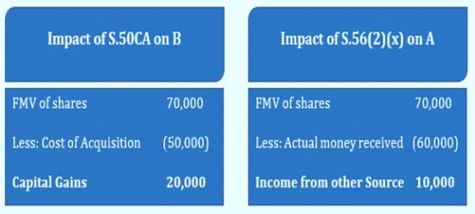
Example : section 50CA & section 56(2)(x)
Buyer: - A Seller: - B
A purchased 100 equity shares of unquoted company from B @ Rs.600/- per share. Thus, total consideration is Rs. 60,000/-.
B had acquired these shares @ Rs. 500/- per share i.e. Total cost for B is Rs. 50,000/-.
Current FMV is say Rs. 700/ Share.
CA MANISH GADIA, REGISTERED VALUER (IBBI) M 98303 28772 E: manish@jmpassociates.com

Slide 72
Impact u/s 49(4): -
When A subsequently sell shares at (say) Rs.800/- (which is also the FMV):
Thus, although the actual purchase price for A was only Rs. 60,000/- (but he had paid tax on FMV of Rs. 70,000/-), he will be able to claim Rs. 70,000/- as cost of shares whenever he sells these shares.
FMV of shares (when sold) | 80,000
Less: - FMV of shares (when purchased) | (70,000)
Capital Gains | 10,000
CA MANISH GADIA, REGISTERED VALUER (IBBI) M 98303 28772 E: manish@jmpassociates.com

Slide 73
VALUATION OF QUOTED SHARES AS PER RULE 11UA(1)(C)(A)
QUOTED SHARES & SECURITIES UNDER RULE 11UA(1)(c)(a)
Received through SE
Other Mode
Transaction value on SE
Quoted on SE on transaction date
Not quoted on SE on transaction date
Lowest price on that date
Lowest price of last trade

Slide 74
VALUATION OF UNQUOTED EQUITY SHARES AS PER RULE 11UA(1)(c)(b) wef AY 2018-19
FMV of unquoted equity shares as per provision of rule 11UA = (A+B+C+D-L) x PV/PE, where
A – book value of the assets in the balance-sheet (except those mentioned at B, C and D below) as REDUCED by any amount of tax paid as deduction or collection at source or as advance tax payment as REDUCED BY THE AMOUNT OF TAX CLAIMED AS REFUND under the Income-tax Act and any amount shown in the balance-sheet as asset including the unamortised amount of deferred expenditure which does not represent the value of any assets
B - Fair market value of jewellery and artistic work based on the valuation report of a registered valuer
C - Fair market value of shares or securities as determined according to this rule
D - Stamp duty valuation in respect of any immovable property
L - Book value of liabilities, excluding **
PV - Paid up value of equity shares
PE - Total amount of paid up equity share capital as shown in the balance sheet.
CA MANISH GADIA, REGISTERED VALUER (IBBI) M 98303 28772 E: manish@jmpassociates.com

Slide 75
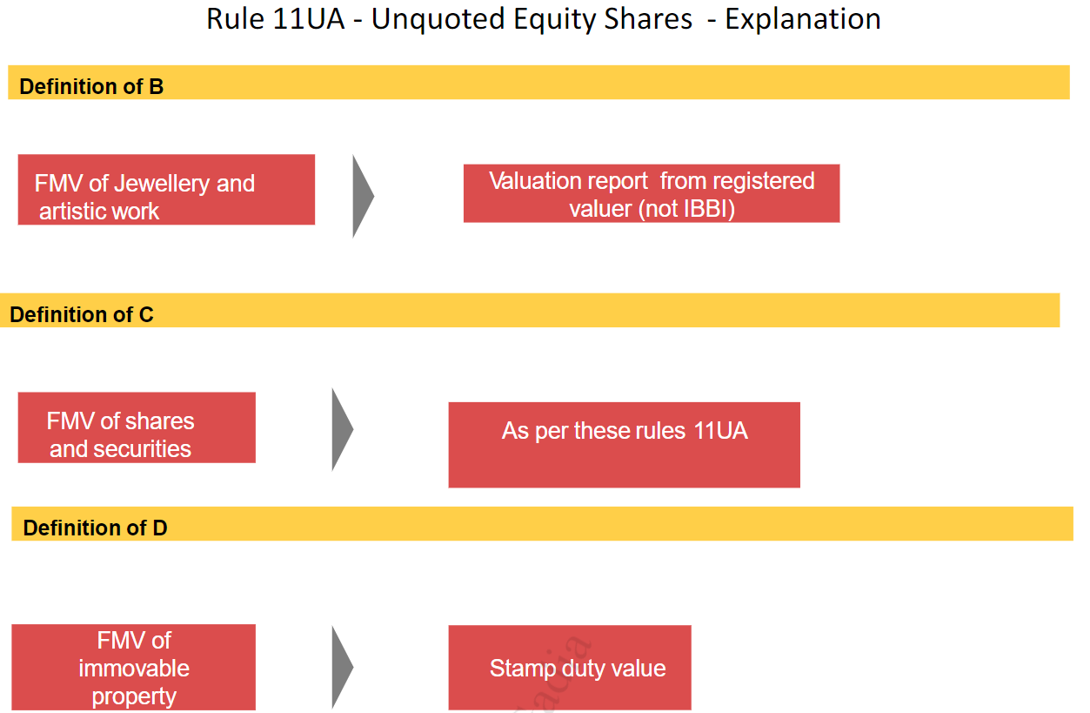

Slide 76
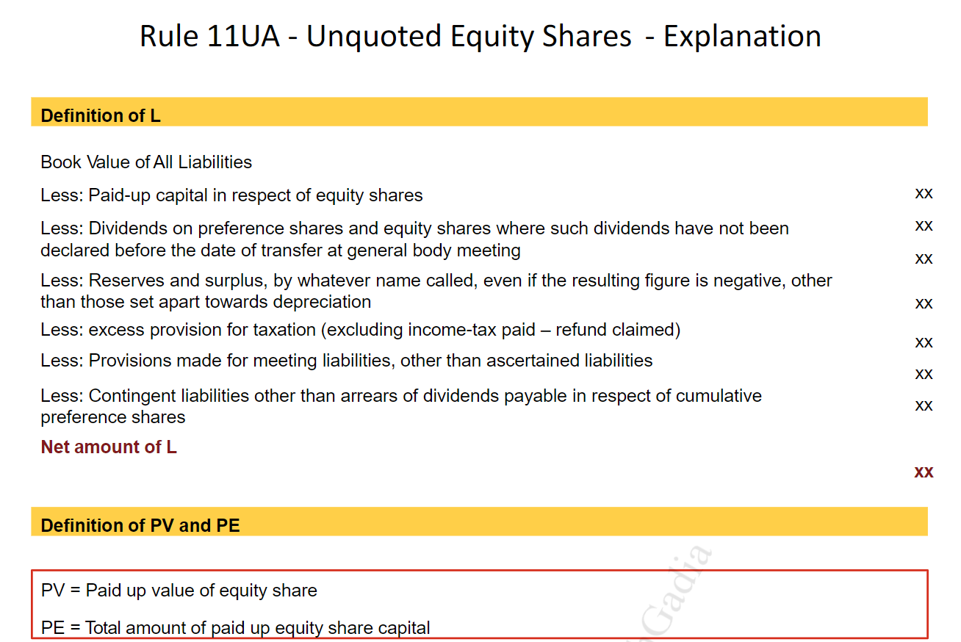

Slide 77
the paid-up capital in respect of equity shares;
the amount set apart for payment of dividends on preference shares and equity shares where such dividends have not been declared before the date of transfer at a general body meeting of the company;
reserves and surplus, by whatever name called, even if the resulting figure is negative, other than those set apart towards depreciation;
any amount representing PROVISION FOR TAXATION, other than amount of tax paid as deduction or collection at source or as advance tax payment as reduced by the amount of tax claimed as refund under the Income-tax Act, TO THE EXTENT OF THE EXCESS OVER THE TAX PAYABLE with reference to the book profits in accordance with the law applicable thereto;
any amount representing PROVISIONS MADE FOR MEETING LIABILITIES, other than ascertained liabilities;
any amount representing CONTINGENT LIABILITIES other than arrears of dividends payable in respect of cumulative preference shares;
CA MANISH GADIA, REGISTERED VALUER (IBBI) M 98303 28772 E: manish@jmpassociates.com

Slide 78
VALUATION OF PREFERENCE SHARES AS PER RULE 11UA(1)(C)(C)
Rule 11UA(2) which is specifically applicable for the valuation of shares for the purpose of section 56(2)(viib) covers only unquoted equity shares within its ambit and there is no reference to the preference shares. Thus, the only method for determining the FMV of the preference share is Rule 11UA(1)(C)(C) which is reproduced below:
“The fair market value of unquoted shares and securities OTHER THAN EQUITY SHARES in a company which are not listed in any recognized stock exchange shall be estimated to be price it would fetch if sold in the open market on the valuation date and the assessee may obtain a report from a merchant banker or an accountant in respect of such valuation.”
CA MANISH GADIA, REGISTERED VALUER (IBBI) M 98303 28772 E: manish@jmpassociates.com

Slide 79
RULES FOR UNQUOTED EQUITY SHARES
Issue u/s 56(2)(viib)
Transfer
Issuer
Receiver
Seller
Buyer
Sec 9(1)(i)
Sec 56(2)(viib) – whichever is higher
No specific Sec
50CA
56(2)(x)
Rule 11UB(2)
Asset based
Rule 11UA(2)
Rule 11UAA
Rule 11UA(1)
By CA or MB
RV/CA /MB
MB if DCF
Specified
Specified
IVSC
BV
No Valuer required
No Valuer required

Slide 80
SOME IMPORTANT POINTS
DATE OF BALANCE SHEET TO BE CONSIDERED FOR THE PURPOSE OF VALUATION
For the purposes of rule 11UA(2) :
the balance-sheet of such company (including the notes annexed thereto and forming part of the accounts) as drawn up on the valuation date WHICH HAS BEEN AUDITED BY THE AUDITOR OF THE COMPANY and
where the balance-sheet on the valuation date is not drawn up, the balance-sheet (including the notes annexed thereto and forming part of the accounts) drawn up as on a date immediately preceding the valuation date which has been approved and adopted in the annual general meeting of the shareholders of the company
CA MANISH GADIA, REGISTERED VALUER (IBBI) M 98303 28772 E: manish@jmpassociates.com

Slide 81
IN ANY OTHER CASE i.e. Rule 11UA(1)
  in relation to an INDIAN COMPANY, the balance-sheet of such company (including the notes annexed thereto and forming part of the accounts) as drawn up on the valuation date which has been AUDITED BY THE AUDITOR OF THE COMPANY appointed under the laws relating to companies in force; and
  in relation to a company, NOT BEING AN INDIAN COMPANY, the balance-sheet of the company (including the notes annexed thereto and forming part of the accounts) as drawn up on the valuation date which has been AUDITED BY THE AUDITOR OF THE COMPANY, if any, appointed under the laws in force of the country in which the company is registered or incorporated
CA MANISH GADIA, REGISTERED VALUER (IBBI) M 98303 28772 E: manish@jmpassociates.com

Slide 82
CHALLENGES IN VALUATION
Valuing investments held by the entity – investment in other company or Immovable property
Cross holding
Investment in foreign subsidiaries
CA MANISH GADIA, REGISTERED VALUER (IBBI) M 98303 28772 E: manish@jmpassociates.com

Slide 83
EXAMPLES
ABC INDIA PVT. LTD.
BALANCE SHEET AS ON 31ST MARCH 2010
Liabilities | Amount | Assets | Amount
Share Capital |  | Assets
Mr. Sharma | 5000000 | Investment in PQR partnership firm | 10000000
Mrs. Sharma | 5000000
Total | 10000000 | Total | 10000000
ABC INDIA PVT. LTD.
Balance sheet as on 31st march 2016
Liabilities | Amount | Assets | Amount
Share Capital |  | Assets
Mr. Gupta | 5000000 | Investment in PQR partnership firm | 10000000
Mrs. Gupta | 5000000
Total | 10000000 | Total | 10000000

Slide 84
PQR PARTNERSHIP FIRM
BALANCE SHEET AS ON 31ST MARCH 2010
Liabilities | Amount | Assets | Amount
Share Capital |  | Assets
ABC Pvt. Ltd. | 10000000 | Land & Building | 10000000
Mr. Sharma | 500000 | Cash & Bank Balance | 500000
Total | 10500000 | Total | 10500000
PQR PARTNERSHIP FIRM
BALANCE SHEET AS ON 31ST MARCH 2019
Liabilities | Amount | Assets | Amount
Share Capital |  | Assets
ABC Pvt. Ltd. | 10000000 | Land & Building | 10000000
Mr. Gupta | 500000 | Cash & Bank Balance | 500000
Total | 10500000 | Total | 10500000

Slide 85
INTEREST IN PARTNERSHIP FIRM TO BE TAKEN AT BOOK VALUE
The term “Shares” is not defined in Income tax act hence will be taken from Companies act where the share is defined as share in a share capital of the company.
Hence fair market valuation is not applicable with respect to gains from transfer of an interest in partnership firm where the property of such entities consists, directly or indirectly of immovable property.
CA MANISH GADIA, REGISTERED VALUER (IBBI) M 98303 28772 E: manish@jmpassociates.com

Slide 86
COMMON QUESTIONS FACED DURING VALUATION AS PER RULE 11UA(1)
1. Valuation method in case of shares held in Calcutta listed companies?
2. Whether valuation is required in case shares held as stock in trade?
3. Whether valuation is required in case of transfer of preference shares (OCRPS, CCPS) ?
4. Valuation in case of land & building of Tea Gardens?
5. Valuation of shares in case shares held before 1st April 2001?
6. Whether valuation is required in case of shares transferred by a Trust, PF?
7. can Fair market value be taken for valuation of Land and building?
8. What will be value of Advance tax paid and Provision for Tax?
9. What happens in case a company is in loss?
10. What happens in case a company has negative networth or the FMV is negative ?
11. What should be date of balance sheet in case of valuation as per rule 11UA(1)
12. Contingent liability not shown in the balance sheet, whether it should be taken as liability?
13. whether Undeclared dividend to be taken as liability?

Slide 87
SOME IMPORTANT POINTS
DATE OF BALANCE SHEET TO BE CONSIDERED FOR THE PURPOSE OF VALUATION
For the purposes of rule 11UA(2) :
the balance-sheet of such company (including the notes annexed thereto and forming part of the accounts) as drawn up on the valuation date WHICH HAS BEEN AUDITED BY THE AUDITOR OF THE COMPANY and
where the balance-sheet on the valuation date is not drawn up, the balance-sheet (including the notes annexed thereto and forming part of the accounts) drawn up as on a date immediately preceding the valuation date which has been approved and adopted in the annual general meeting of the shareholders of the company
CA MANISH GADIA, REGISTERED VALUER (IBBI) M 98303 28772 E: manish@jmpassociates.com

Slide 88
WHETHER THE AO CAN DISREGARD THE METHOD ADOPTED BY THE ASSESSEE AND CARRY OUT THE VALUATION OF SHARES USING A DIFFERENT METHOD
In the case of INNOVITI PAYMENT SOLUTIONS PVT. LTD., the banglore tribunal addressed the issue on the application of DCF methodology and the powers of the AO to inquire into it. In the said case, the ASSESSEE COULD NOT CONCLUSIVELY ESTABLISH that the projections used for DCF valuation were prepared scientifically.
The tribunal referred to the Technical Guide on share valuation by a research committee of the ICAI, where it was stated that the DCF value is good as the assumptions used in developing the projections, and these projections should consider various factors affecting the business.
The Tribunal held that if the assessee has opted for the DCF method, the AO cannot discard it and adopt another method; however, the AO is well within his rights to examine the methodology adopted by the assessee and the underlying assumption made. IF HE IS NOT SATISFIED, HE CAN CHALLENGE THE SAME AND SUGGEST NECESSARY MODIFICATIONS.
CA MANISH GADIA, REGISTERED VALUER (IBBI) M 98303 28772 E: manish@jmpassociates.com

Slide 89
Decision of the Delhi Tribunal in the case of AGRO PORTFOLIO PVT. LTD.
It was held that since there was no possibility of verifying the correctness of the data supplied by the assessee to the merchant banker, the correctness of the result of DCF method could not be verified. Hence, the AO had no option but to reject the DCF method and to go by the NAV method to determine the FMV of the shares.
ALLOTMENT OF SHARES TO EXISTING SHAREHOLDER AT LESS THAN MARKET VALUE not taxable under section 56(2)(vii)
SUDHIR MENON HUF VS ASSISTANT COMMISSSIONER of Income tax held that additional allotment of shares to an existing shareholder of a company at less than fair market value (“FMV”) as part of a genuine business transaction should not be subject to section 56(2)(vii)(c) of the Income tax act, 1961, where the allotment is not higher than the proportion of existing shareholding.
CA MANISH GADIA, REGISTERED VALUER (IBBI) M 98303 28772 E: manish@jmpassociates.com

Slide 90


