Slide 1
RECENT DEVELOPMENTS IN THE VALUATION FIELD
Anurag Singal
9088026252

Slide 2
INTRODUCTION
Income-tax is a tax on income (and nothing else). However, in a few instances capital transactions (like issuance of share, transfer of shares, etc.) can be deemed as notional income and subjected to tax. As such a levy is a deviation from the normal scheme of taxation, elaborate and clear Legislation is of essence.
Section 56(2)(viib) and Section 56(2)(x) of the Income Tax Act are a few instances where notional sums (arising on capital transactions) are deemed as income. These sections treat specified transactions entered into at a price in variance to the Fair Market Value (FMV) as being notional income of the parties entering into the transactions.
Determination of FMV for the purpose of these sections are governed by Rules framed by the subordinate authorities. While determination of FMV for assets, more particularly value of a business in today’s scenario, is clearly an art, the artificial Rules framed for valuation, till recently were more theoretical and in large deviation from practice.
The Central Board of Direct Taxes has, vide Notification No. 81/2023, dated 25 September 2023, substantially modified the valuation rules. The amended rules, to a large extent tend to give extra elbow room to taxpayers and provide a safe harbor to a few classes of transactions. They also expand the ambit of valuation to expressly include Compulsorily Convertible Preference Shares (CCPS) as well.

Slide 3
Section 56(2)(viib) of the Income tax Act 1961, & Rule 11UA

Slide 4
BACKGROUND
Section 56(2)(viib)
Section 56(2)(viib) of the ITL (popularly known as the “angel tax” provision) is an anti-abuse provision which applies when a CHC issues shares (including preference shares) at a premium and receives consideration which is in excess of the FMV of the shares. The excess amount so received is deemed as income from other sources in the hands of the CHC in the year of issue of the shares.
Rule 11UA of the Income Tax Rules
Rule 11UA of the Income Tax Rules5 prescribes the valuation methodology for determining the FMV of various types of assets (including unquoted equity shares), not only for the purposes of the angel tax provision, but also for other anti-abuse provisions involving transfer of assets without consideration or at a value less than the FMV.

Slide 5
OLD VALUATION RULES (BEFORE AMENDMENT OF RULE 11UA)
Prior to Notification, the FMV of unquoted equity shares for the purpose of the angel tax provision read with earlier Rule 11UA was the higher of the following:
    Net asset value as reflected in the audited balance sheet of the CHC (NAV method); or
    The Discounted Cash Flow (DCF) value as determined by a Category-I Merchant banker (DCF method); or
    The value that the company is able to substantiate to the satisfaction of the tax authority, basis the holding of various intellectual property rights (IPRs) like goodwill, know-how, patents, copyrights etc.
Prior to the Notification, Rule 11UA prescribed valuation of preference share at a price it would fetch if sold in the open market on the valuation date (Open market value) and the CHC may obtain a report from a merchant banker or an accountant in respect of such valuation.
Prior to the amendment by the Finance Act 2023 (FA 2023), the angel tax applied only to shares issued to a resident. FA 2023 amended the angel tax provisions, with effect from tax year 2023-24, to extend it to issue of shares by a CHC to NR investor. FA 2023 also extended the exemption from angel tax to investments in CHC by VCFs set up in IFSC (specified funds).

Slide 6
CONCERNS
The expansion of angel tax provisions gave rise to concerns regarding trigger of angel tax and valuation disputes on investments made by genuine and regulated NR investors in Indian companies (including start-ups registered with Department for Promotion of Industry and Internal Trade -DPIIT).

Slide 7
RESPONSE
In response to such concerns, the CBDT issued a Press Release on 19 May 2023 announcing a slew of reliefs from “angel tax” viz, amendment to valuation rules, excluding certain entities from the scope of angel tax provision and non-applicability of the provision to start-ups. Accordingly, the CBDT prescribed as under:
    Notification No. 29/2023 (effective from 24 May 2023) enlists categories of persons whose investments in CHC shall not be subject to trigger of angel tax provisions like (i) Government and Government related investors, (ii) banks or regulated entities involved in insurance business and (iii) investors resident in any of the 21 jurisdictions and regulated in the country where it is established, incorporated or resident like category-I foreign portfolio investors, endowment funds, pension funds and broad-based pooled investment vehicles or funds.
    Notification No. 30/2023 (effective retrospectively from 1 April 2023) exempts start-up companies from the angel tax provision if the start-up company fulfils the conditions specified by DPIIT in para 4 of its Notification No. G.S.R 127(E) dated 19 February 2019 and files a self-declaration to that effect. The exemption is applicable where a start-up company issue shares for a consideration at a premium to any person (whether resident or NR).
    On 26 May 2023, the CBDT issued a public consultation document providing a draft of amended Rule 11UA. The proposed amended Rule 11UA was aimed to prevent valuation disputes on investment by resident and NR investors in CHC.
    On 25 September 2023, post public consultation, the CBDT notified final valuation rules amending Rule 11UA for computing FMV of unquoted equity shares and CCPS.

Slide 8
NEW VALUATION RULES (AMENDED RULE 11UA)
Effective date: The amended Rule 11UA shall be effective from the date of publication in Official Gazette i.e., 25 September 2023.
Types of shares covered:
  The amended Rule 11UA prescribes valuation methods for unquoted equity shares and CCPS issued to resident and NR investors.
  The change in valuation methods for CCPS is a variation as compared to the draft valuation rule issued earlier. The amended Rule 11UA also provides an option that FMV of CCPS can also be based on FMV of unquoted equity shares which is determined as per prescribed valuation methods

Slide 9
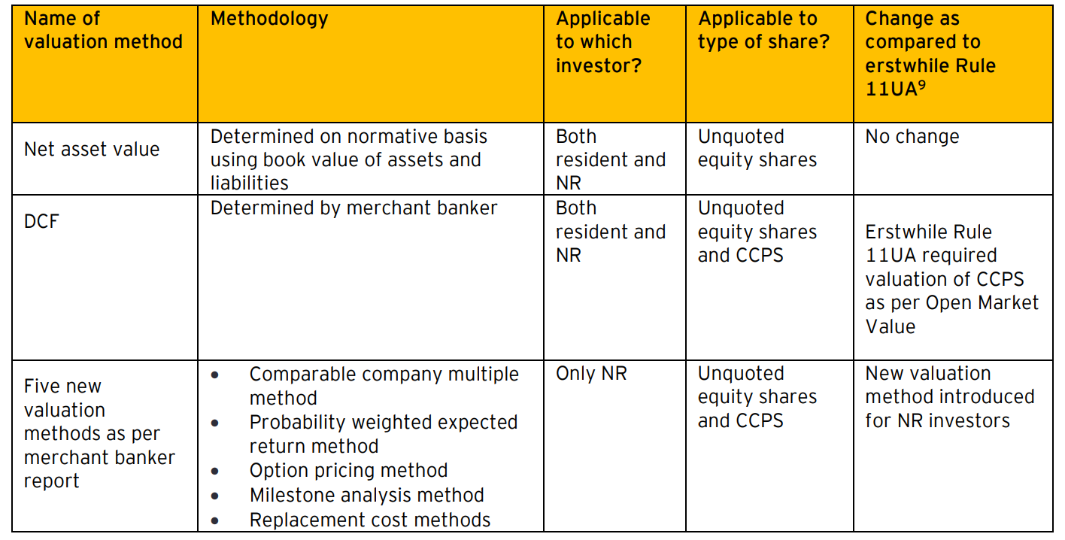
Valuation method for unquoted equity shares and CCPS: The CHC has an option to select from any of the following valuation methods in relation to unquoted equity share or CCPS investment by residents and NRs:
    The valuation of preference shares other than CCPS continues to be based on Open Market Value based on report from a merchant banker or an accountant.

Slide 10
Price matching facility for both resident and NR investment:
  • The price at which unquoted equity shares and CCPS are issued by CHC to NR entities notified in Notification No. 29/2023 shall be adopted as the FMV for the purposes of benchmarking investments by both resident and NR investors, subject to compliance of following conditions:
    The consideration received from other investors at such FMV does not exceed aggregate consideration received from notified NR entity; and
    Consideration is received by CHC from notified NR entity within a period of 90 days before or after10 the date of issue of shares which are the subject matter of valuation.
  • Similar price matching facility shall also be available with respect to investment made by VCF/venture capital company and specified funds in venture capital undertakings. This is explained with the help of illustration in the amended Rule 11UA.
90 days window period for merchant banker valuation :
  • Erstwhile Rule 11UA required merchant banker valuation report as on the date of issue of shares.
  • The amended Rule 11UA provides flexibility by making the valuation report issued up to 90 days prior to the date of issue of equity shares and CCPS acceptable for computing FMV for investments by both resident and NR investors.
  • Consequently, the reference to date of valuation stands modified from date of receipt of consideration to date of merchant banker valuation report.

Slide 11
Safe harbor valuation tolerance limit of 10%
  • Erstwhile angel tax provision and Rule 11UA did not provide for any safe harbor valuation tolerance limit.
  • The amended Rule 11UA provides a tolerance limit of 10% for both resident and NR investors as follows:
    In case of resident investor, if the issue price for unquoted equity shares is within 10% of price determined as per NAV or DCF method or if the issue price for CCPS is within 10% of price determined as per DCF method, then such issue price shall be deemed to be FMV of such shares.
    In case of NR investor, if the issue price for equity shares is within 10% of price determined as per NAV or DCF or any of the five new methods or if the issue price for CCPS is within 10% of price determined as per DCF or any of the five new methods, then such issue price shall be deemed to be FMV of such shares.
    For this purpose, “issue price” is defined to mean the consideration received by the CHC for one share.

Slide 12
CASE STUDY
    Case Study of RBSA Valuation Advisors LLP
    Alleged contraventions and submissions of the IP
    Contraventions alleged in the SCN and RBSA’s written and oral submissions are summarized as follows:
    Contravention-I
    The scope, assumptions and limiting conditions for the valuation report provided as
    follows:
    “Considering that the consolidated financial statements of the Companies were not available as of the ICD, based on the discussions with the RP, we have summed up items of fixed assets and other financial assets (excluding cash and bank balances, debtors and inventories) as at the erstwhile ICD, which has been considered as representative balance as on the ICD (after inter-company adjustments). We are unable to comment where the same is reflective of the financial position as of the ICD.”
    It has been observed that in the valuation report, the summation of valuation of individual companies, which was undertaken at an earlier date, has been done. The element of synergy among the different units of the CD and the value derived from such synergy has not been considered. The synergy valuation is not provided for the CD while submitting the Fair Value(FV) and Liquidation Value(LV). Hence, it was observed that RBSA is in violation of rule 7(g) read with clause 6 of the Model Code of conduct for Registered Valuers under the Valuation Rules.

Slide 13
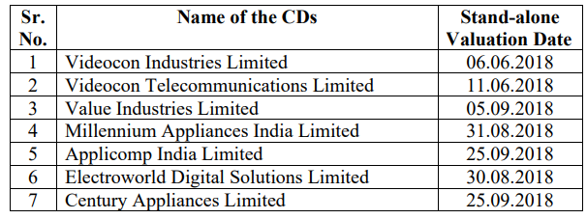
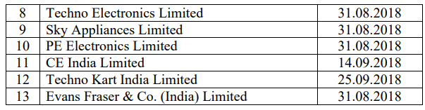
Submissions made by RBSA
RBSA submitted that it was appointed vide engagement letter dated 20.01.2020, to carry out FV and LV of assets of the Videocon Group entities on a consolidated basis, under the CIRP, as per the order Adjudicating Authority (AA) dated 08.08.2019 (Consolidated Insolvency Commencement Date (ICD)/Consolidated Valuation Date) read with AA Order dated 25.09.2019. Apart from working out the FV and LV of assets on a consolidated basis, RBSA was also requested to provide the FV and LV of assets segregated into following business segments
Consumer Electronics and Home Appliances
Oil and Gas
Telecommunication
Real Estate
RBSA submitted that they were previously appointed by the RPs/ IRPs of the respective Videocon entities to carry out valuation of all 13 entities of the Videocon Group, on a standalone basis, with following valuation dates,

Slide 14
RBSA submitted that while the stand-alone valuation of the Videocon group entities were carried out between June– September, 2018, the actual site visits were carried out during the months of September, 2018 to February, 2019. During site visits, they carried out necessary inspections, verification, conducted interviews, market inquiries etc. to work out the FV and LV of assets.
It further submitted that they had requested the new Resolution Professional (RP) to provide the details/ information in respect of certain assets which were not received from the earlier RPs, to enable them to determine their values and incorporate the same in the consolidated valuation. Towards this, we had carried out the following additional site visits (during November 2019 and August 2020) and had updated our consolidated valuation working for the same.
RBSA submitted that synergies are primarily realized in three areas: revenue, cost, and financial. Revenue synergies result in higher revenues on consolidation, cost synergies result in lower costs, and financial synergies result in overall improved finances, such as lower interest rates on debt, lower cost of production etc. Synergies can often be easy to identify but hard to realize; it requires a good amount of work to be done to yield the identified benefits.

Slide 15
RBSA submitted that the operations of consumer electronics and home appliances business were majorly suspended and the plants were not in active use and had incurred operating losses in the recent past. The Videocon brand had taken a beating and there were quality issues with its products, resulting in inventory pile up. In the Ravva oilfield, the stake was valued considering estimates of reserves and cash flows, which was operator driven. For telecommunication business, the CD had shut down its operation in all circles, due to intense competition and the spectrum for 6 circles were sold to Bharti Airtel. During site visit, it was observed by RBSA that majority of the components pertaining to business were in dismantled condition and lying at warehouses. Considering the same, the valuation was carried out on ex-situ scenario, resulting in substantial haircut in value of its assets. With regards to Real Estate business, it included Real estate assets of the Videocon Group
RBSA submitted that for consolidated valuation of the Videocon Group:
Adjustments, as appropriate, for inter-company receivables and payables, loans and advances, etc., were considered
Cash and bank balance, receivables, and the inventories of the respective entities as at the Consolidated Valuation Date as provided by RP, were considered.

Slide 16
RBSA submitted that due to submissions made above and following factors, in their professional opinion, no material value could have been attributed to the Market participant synergy.
• the diverse nature of businesses of various Videocon group companies,
• their operational status as at the Valuation Date,
• technology of the plant(s),
• historical performance of the companies/ operational losses,
• competitive scenario, etc., we respectfully submit that
RBSA further submitted during the personal hearing that no reference has been made regarding synergy valuation in the valuation report as in their professional opinion there was no business synergy could be found in the Videocon group during valuation. It further submitted that every working paper or note cannot be made part of the valuation report.

Slide 17
Findings
The Authority notes the admission by RBSA that synergy valuation was not made part of the valuation report because not synergy was found by RBSA in the Videocon group. It noted that only accounting adjustments were made while submitting consolidated valuation report.
Clause 6 of the Model Code of Conduct for Registered Valuers under Valuation Rules provides that a valuer shall render at all times high standards of service, exercise due diligence, ensure proper care and exercise independent professional judgment.
Considering the fact that it was case of its kind and RVE got the opportunity to set standards for dealing with group insolvency case, following aggregation approach and simply summing up results of individual assets without discounting the possibility of synergy in treating assets of the CDs as a group is an error on part of his professional judgement.

Slide 18
    Contravention-II
It has been observed that the following assumptions/limitations/disclaimers elucidated by the RVE in its valuation report is in violation of rule 8(3)(l) of the Valuation Rules as it limits the responsibility of RV for his valuation report. “The RV has not conducted any site visit for this exercise. The report is based on the information/data collected during the site visit carried out during the year 2017-18 (previous engagement)” “The RV has relied on information provided by the RP / management of the companies considering that the same is materially accurate and complete, fair in its manner of portrayal and forms a reliable basis for the valuation.”
The valuation reports on standalone basis were prepared in February 2019. The report for consolidated basis was submitted in September, 2020. There is significant passage of time. 5 The actual availability of plant and machinery on the site and their condition cannot be ascertained without a physical site visit. The depreciation value then used becomes entirely assumptive. Assumption that there is no change in fixed assets is unreasonable. The physical visit was a part of required due diligence for valuation to be conducted by the valuers themselves and not decided on the basis of understanding. Hence, it was observed that RBSA has violated of rule 8(3)(l) of the Valuation Rules

Slide 19
    Submissions made by RBSA
RBSA submitted that it was appointed to carry out valuation of all 13 entities on a standalone basis by erstwhile RPs / IRPs. While the stand-alone valuation was carried out between August – September 2018, the actual site visits were carried out during the months of September 2018 to February 2019. Most of the entities were non-operational at the time of site visit. It submitted that during our site visits, they have carried out necessary inspections, verification, conducted interviews, carried out market inquiries etc. to work out the FV and LV of the assets.
RBSA submitted that on 16.09.2019, the CoC appointed Mr. Abhijit Guhathakurta as the RP for the 13 Videocon group entities on consolidated basis. After taking over the office, the RP sought the draft reports on standalone basis of the 13 Videocon Group entities on 22.10.2019 from RBSA. The RP on 23.10.2019, requested to provide timeline and most incremental fee quote for carrying out the aggregation of FV and LV of the CDs considering the valuation reports submitted by it to individual RP’s as required under relevant provisions of the Code read with its Rules and Regulations, with a valuation date of 08.08.2019. It submitted that their appointment letter, though signed on 20.01.2020, was effective from 01.11.2019. It further mentioned that the signed report (for standalone Videocon Group entities) was between 13.11.2019, and 29.11.2019 i.e. post the new RP’s appointment to value group on a consolidated basis. It submitted that their appointment was deemed extension of the earlier exercise and considering that they had not issued our signed report till 01.11.2019, the RP had sought from them new timeline and most incremental fee quote for carrying out Fair Valuation and Liquidation Valuation of CD on a consolidated basis.

Slide 20
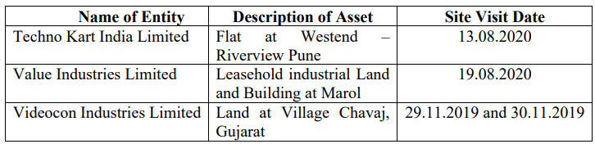
RBSA further submitted that they had requested the new RP to provide the details/ information in respect of certain assets which were not received from the earlier RPs, to enable them to determine their values and incorporate the same in the consolidated valuation. Towards this, they had carried out the following additional site visits (during November 2019 and August 2020) and had updated our consolidated valuation working for the same
RBSA submitted that for the purposes of the consolidated valuation, they had carried out further due diligence including market survey to arrive and conclude at the consolidated valuation of the fixed assets. Adjustments, as appropriate, were made to the Gross Current Replacement Cost/ Market Value on the basis of the aforementioned procedures.

Slide 21
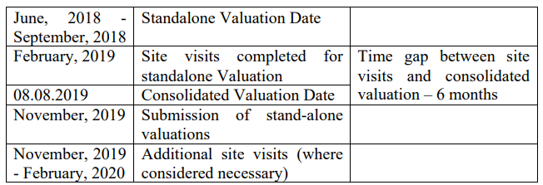
RBSA submitted that considering the consolidated financials of the CDs were not available as of the Consolidated ICD, based on the discussions with the RP and that most of the units were non-operational, the aggregate amount of the stand-alone fixed assets and other financial assets (except, cash and bank balances, debtors and inventories) of the respective CDs as at the stand-alone ICD, were considered as representative of their book balances as on the Consolidated ICD. For consolidated valuation of the Videocon Group:
  • Adjustments, as appropriate, for inter-company receivables and payables, loans and advances, etc., were considered
  • Cash and bank balance, receivables, and the inventories of the respective entities as at the Consolidated Valuation Date as provided by RP, were considered.
RBSA presented the chronology of the stand-alone valuation dates, site-visits date, consolidated valuation date and additional site visits (where considered necessary) as below to facilitate reference:

Slide 22
RBSA submitted that they were given to understand by the RP that there was no change in the fixed assets in any of the CDs. All assets were under the control and custody of RP. Further since no manufacturing operations were being carried out, there could not be much change in the status of fixed assets.
RBSA finally submitted to consider as follows:
    Consolidated valuation of the Videocon Group being extension/ interconnected with the stand-alone valuation of the Videocon group entities carried out by the same team;
    Physical verification of the assets carried out by the same team in relatively recent past for stand-alone valuation of the relevant Videocon group companies;
    Assets in the physical custody of the RP during the CIRP period;
    Non-operational status of most of the units during the interim period;
    No change in the position of the fixed assets; 7
    Additional site visits carried out for the consolidated valuation (where considered necessary)
    Adjustments, as appropriate, made to the Gross Current Replacement Cost/ Market Value of the fixed assets on the basis of the additional due diligence including market survey [and maintenance status of the fixed assets] carried out for the consolidated valuation
    Adjustments, as appropriate, made for inter-company receivables and payables, loans and advances, etc., cash and bank balance and inventories as at the Consolidated ICD;
    RBSA finally submitted that the procedures carried out by us were adequate and reasonable for determination of the FV and LV of the assets of the Videocon Group on a consolidated basis

Slide 23
Findings
The Authority notes the submission of RBSA that it was appointed for stand-alone valuation between June-September, 2018. RBSA further submitted that site visit were completed for stand-alone valuation by February, 2019. Hence the site visits may be said to be conducted in year 2018-19.
The Authority now notes the statement made under head of Scope, Assumption and Limiting Conditions of the Valuation Report that “The RV has not conducted any site visit for this exercise. The report is based on the information/data collected during the site visit carried out during the year 2017-18 (previous engagement)”
A conjoint analysis of above facts highlights that RBSA has made wrong statement in the valuation report as year 2017-18 even predates its appointment for stand-alone valuation.
Annexure-1 of the Engagement Letter dated 20.01.2020 contains the scope of work/services and para 2 of the same read as under:
  ‘The Valuation Report should be a detailed report including but not limited to the asset verification, equipment list etc. to gain a comprehensive view of the assets of the Corporate Debtors along with the photographs or documents, if any.’
Further indicated scope of work, the fee for the service exclusive of out of pocket expenses as agreed between the CDs represented through RP and the vendor which is RBSA has been fixed as Rs. 16.20 lakhs. Given the fee structure assigned and the scope of work as reproduced above, not updating the records and visiting a few sites on selective basis is bereft of any professional justification. If the task assigned was only for consolidating the earlier reports of respective valuers then such a huge fees is not justified in any way.

Slide 24
The term of engagement does mention that RBSA as registered valuer shall determine FV and LV of the CD on a consolidated basis, however it cannot be presumed that consolidated report on the CDs means aggregation of available reports and not de novo exercise for a meaningful consolidation of information in respect of group CDs afresh. More so purpose 8 of this exercise has been enunciated as gaining a comprehensive view of the assets of the CDs and therefore detailed report was sought after the asset verification.
Para 3 of the op cited annexure also gives liberty to RBSA to adopt methodologies and give its rational. Therefore, not trying innovations in the methodology which may be relevant to the valuation of group CDs again demonstrates lack of due diligence.
Rule 8(l) of the Valuation Report provides as follows: 8. The valuer shall, in his report, state the following: (l) caveats, limitations and disclaimers to the extent they explain or elucidate the limitations faced by valuer, which shall not be for the purpose of limiting his responsibility for the valuation report. The bare reading of above rule specifically states that caveat, limitations and disclaimers shall not be for purpose of limiting responsibility for the valuation report but to explain and elucidate. Hence, the Authority finds that RBSA has violated rule 8(l) of the Valuation Rule as it has limiting its responsibility by stating that the report is based on the information/data collected during the site visit carried out during the year 2017-18 and not carrying out independent inspection considering change in value of assets with time

Slide 25
    Contravention-III
It has been observed that the valuation report does not provide for contribution of partners of RVE who have signed the valuation report. It is observed that no submission of specific explicit disclosure of information pursuant to Rule 7(i) has been submitted by RVE. Hence, it was observed that RBSA has violated rule 7(i) of the Valuation Rules
    Submissions made by RBSA
RBSA submitted that Rule 7(i) does not specify that the capital employed / contributed should be disclosed in the Valuation Report. It accepted that the disclosure should be made to the CD.
RBSA submitted that following clauses/ disclosures in the engagement letter signed between RP inter alia the CD and RBSA
  10.4 The Vendor represents and warrants that, prior to entering into this Agreement, the Vendor undertakes to ensure that none of their shareholders, Personnel/ Deputies are Related Party to the Corporate Debtors, as defined under the Code and undertakes to fully and accurately disclose within 24 hours to RP information regarding the shareholders/ Personnel/ Deputies of Vendor and their relevant interests as and when called for by RP or his Authorized Representatives.

Slide 26
10.6 The Vendor represents and warrants that, prior to entering into this Agreement, the Vendor has fully and accurately disclosed to RP or his Authorized Representatives all relevant corporate information regarding the shareholder structure and relevant interests including controlling entities, upstream associate entities, global ultimate parent of each upstream associate entities, individual having control over such global ultimate parent(s), controlled entities, downstream associate entities and sister entities, as applicable
RBSA further submitted that being a registered valuer entity, it needs to file/ submit copy of the partnership deed, to Registered Valuer Organisation (RVO), IBBI, and Registrar of Companies (ROC) whenever there is a change in the partnership deed and the same is a publicly available document. It submitted that on the basis of foregoing they believed that we have complied with the disclosure requirements on execution of the engagement letter with the CD

Slide 27
Findings
The Authority observes that RBSA relies on clause 10.6 of the engagement letter which states that the vendor, ie, RBSA, represents and warrants that, prior to entering into this Agreement, the Vendor has fully and accurately disclosed to RP or his Authorized Representatives all relevant corporate information regarding the shareholder structure and relevant interests.
Rule 7(i) specifically provides that in case a partnership entity or company is the registered valuer, it shall disclose to the company concerned, the extent of capital employed or contributed in the partnership entity or the company by the partner or director, as the case may be, who would sign and act in respect of relevant valuation assignment for the company. The report has been signed by Mr. Rajeev R Shah, Manish D Kaneria, Ravishu Shah, Jignesh Shah, Sandesh Trivedi and Tejas Shah. There is no clarity from the report and the engagement letter about the capital employed or contributed by the abovesaid persons.
The Authority observes that clause 10.6 above reflects a general presumption and implies shifting of responsibility by RBSA to RP. Hence, the Authority finds that RBSA has violated rule 7(i) of the Valuation Rules.

Slide 28
Order
In view of the above, the Authority, in exercise of powers conferred vide notification of Central Government no. GSR 1316(E) dated 18.10.2017 under Section 458 of the Companies Act, 2013 and in pursuance of rule 15 and rule 17 of the Valuation Rules directed that RBSA Valuation Advisors LLP shall not seek or accept any assignment or render any services under the Code and its underlying Regulations for a period of 6 months from the date of coming into force of this Order for violating rules rule 7(g) read with clause 6 of the Model Code of conduct for Registered Valuers, 8(3)(l) and 7(i) of the Valuation Rules. While RBSA will not be able to seek fresh assignments for the indicated period, however, it will have no impact on ongoing assignments and it shall continue to handle the assignments in hand unimpacted as on date of this order.

